Slide 1
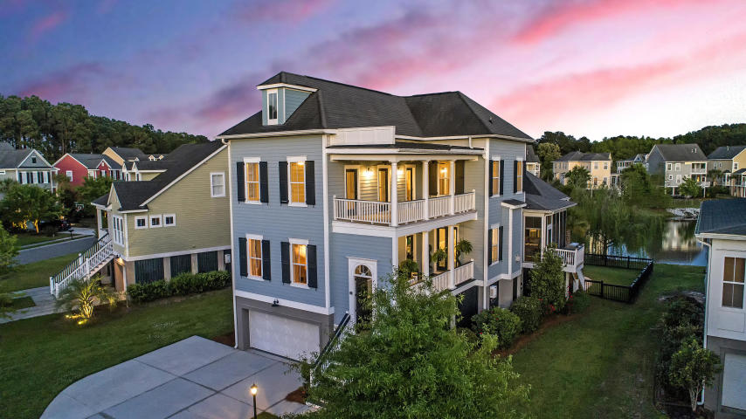



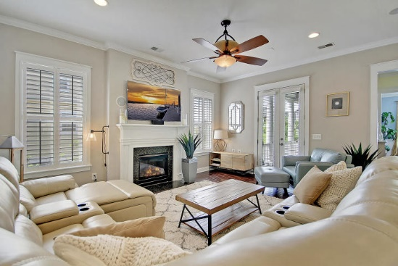
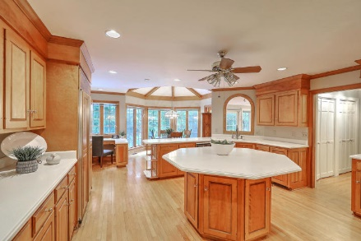
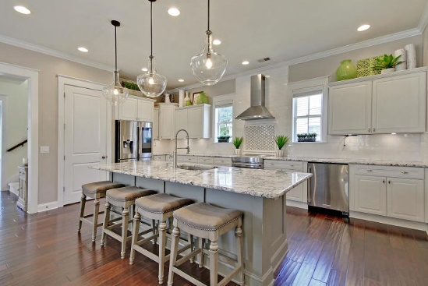



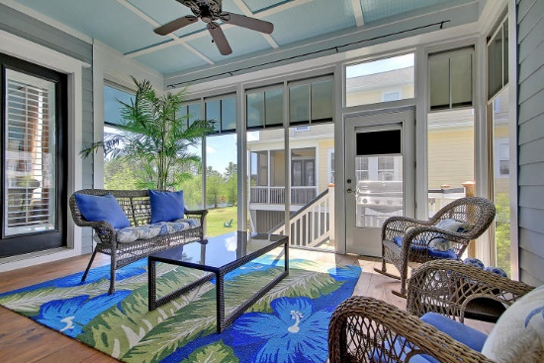

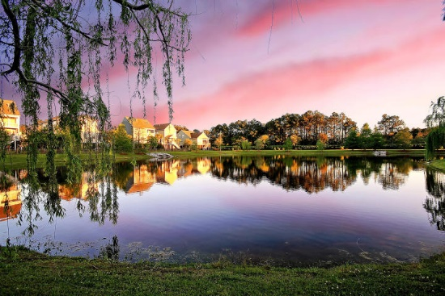
Parkshore Marshfront
Back On The Market
118 Sandshell Drive
Shellring at St Thomas Island ~ Charleston ~ MLS# 19011240 ~ $589,500
Peacefully backing to a pond at Shellring on St Thomas Island, this three level home of luxurious living awaits you! This home is light, bright, open & very spacious! The granite kitchen boasts a center island with breakfast bar seating, upgraded lighting fixtures, marble backsplash, SS appliances & it flows into the living room with its cozy fireplace. The formal dining room has gorgeous lighting fixtures, wainscoting & plenty of room for guests and entertaining. The master suite features a relaxing master bath with dual vanities, a garden tub, walk-in shower & walk-in closet. The ground level is a massive, additional 817 sq ft bonus room that can accommodate any need you may have! There is a patio in the fenced-in backyard that looks out to the weeping willows on the edge of the pond.
Additional features include:
There is a front porch, screened-in porch and upper balcony
The garage has an epoxy finish
Community pool
Just around the corner from shopping, dining, fishing, and schools on Daniel Island...hop on your golf cart and head on over!
Book your showing today!
Christopher Smith christopher@mattoneillteam.com 843-267-0735

