Slide 1


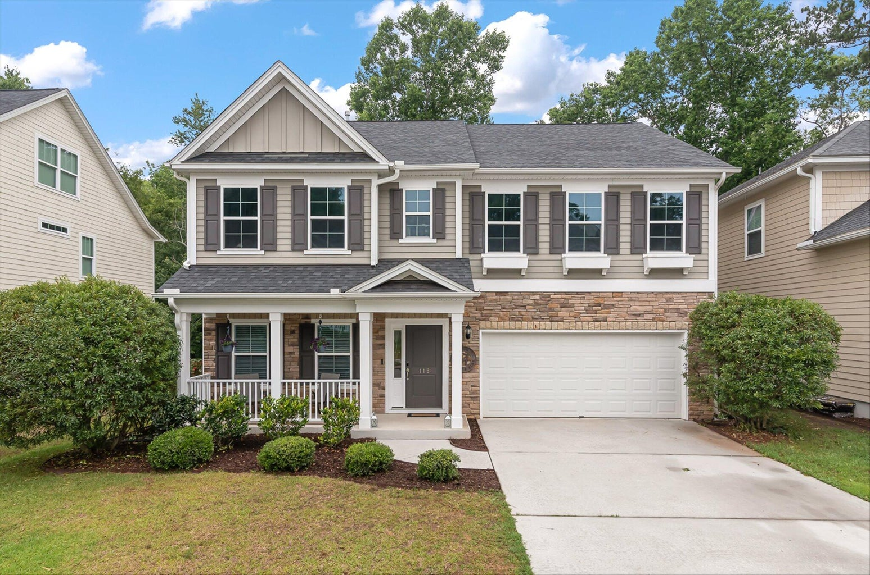
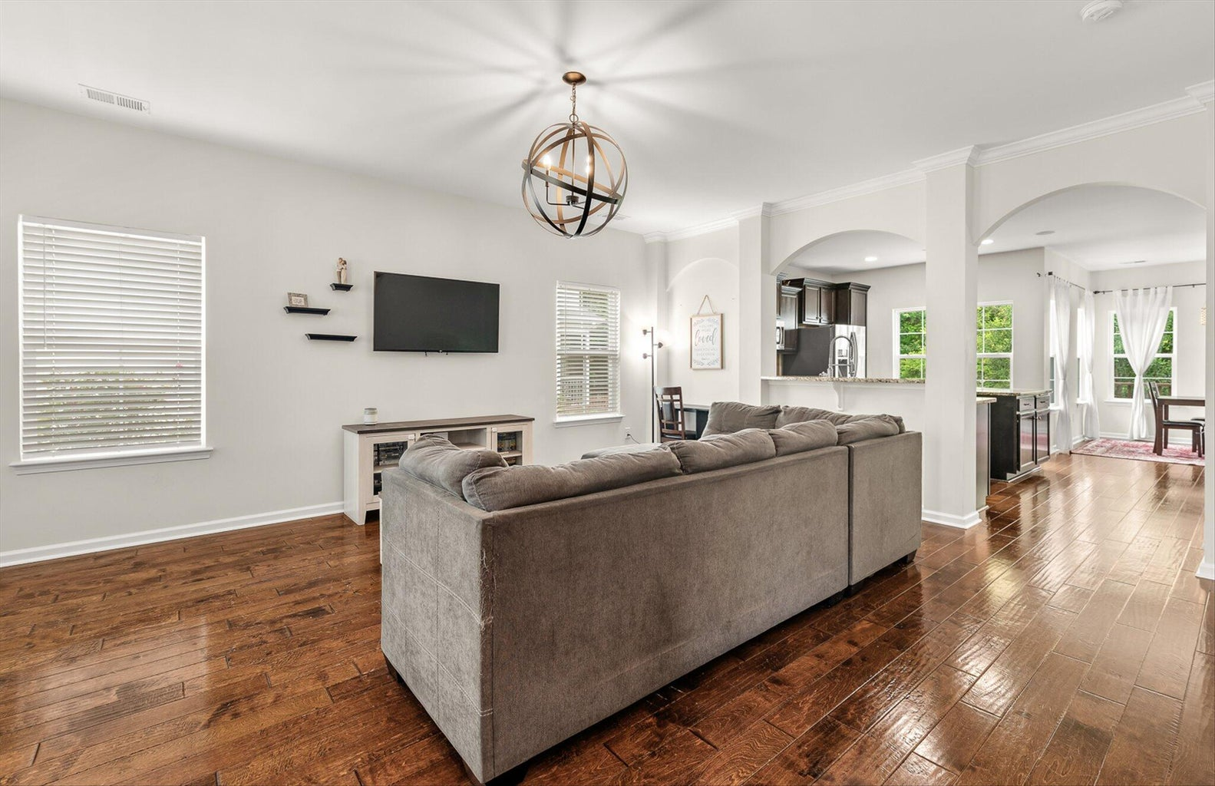
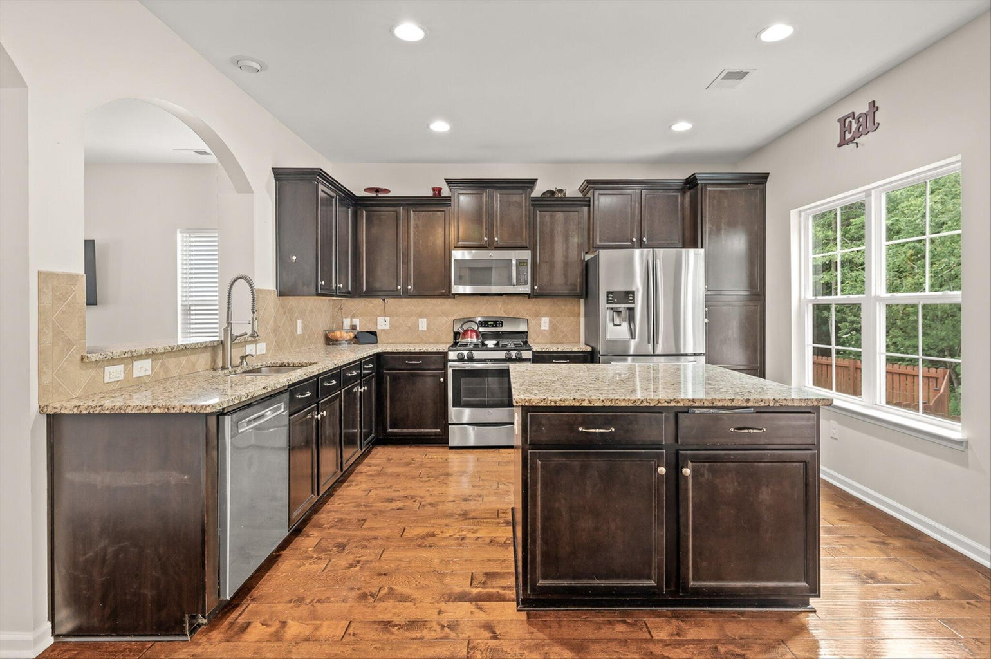
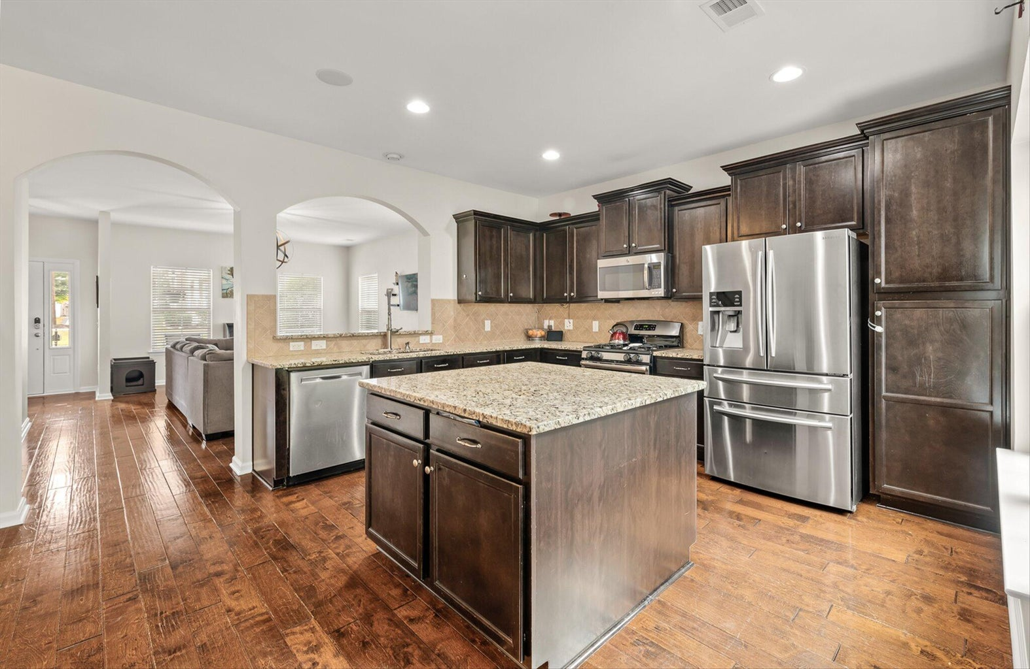
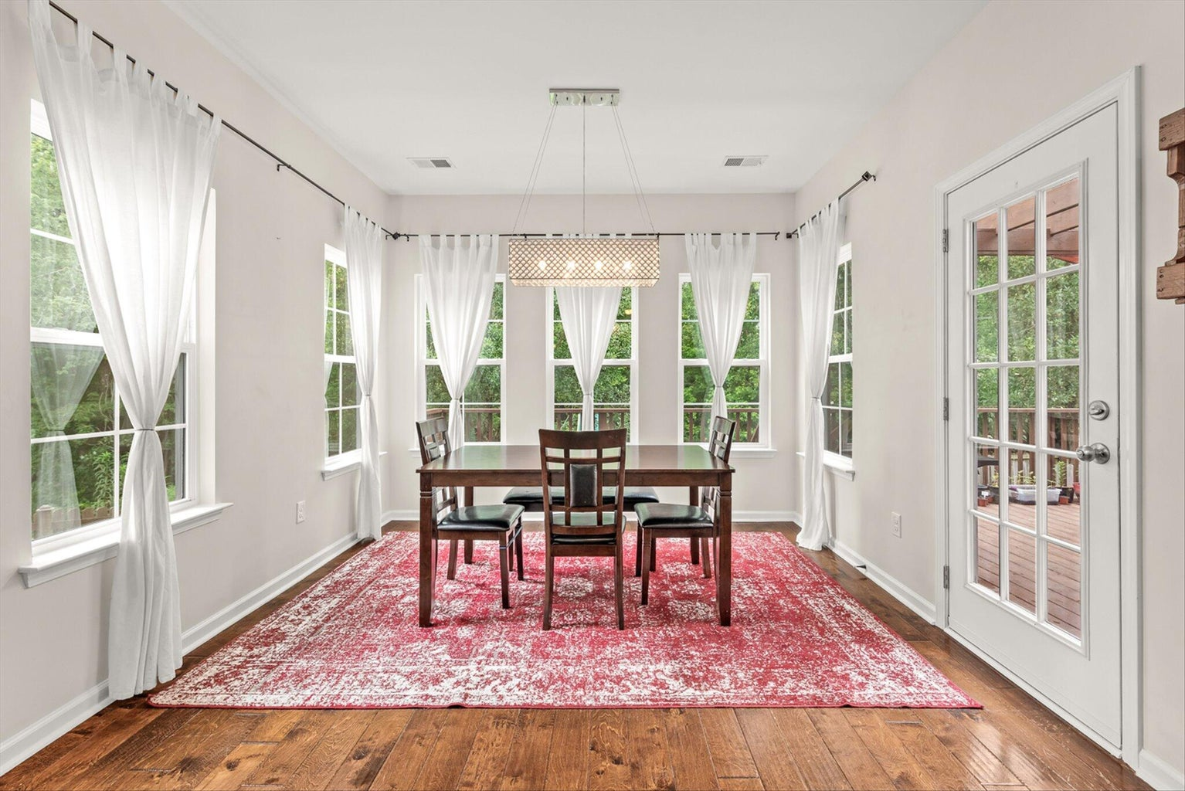
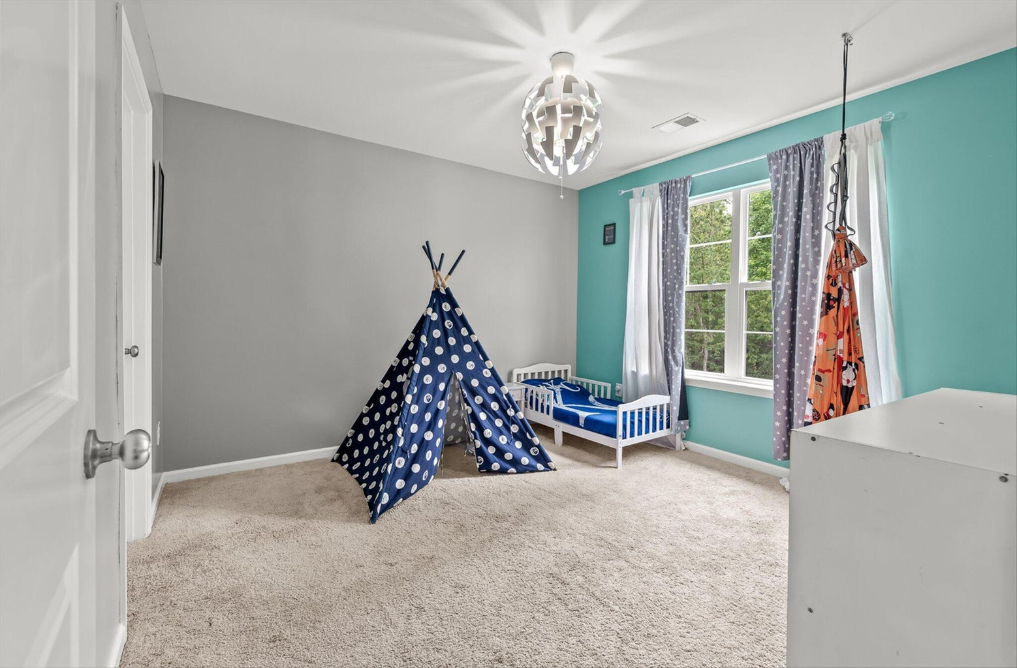
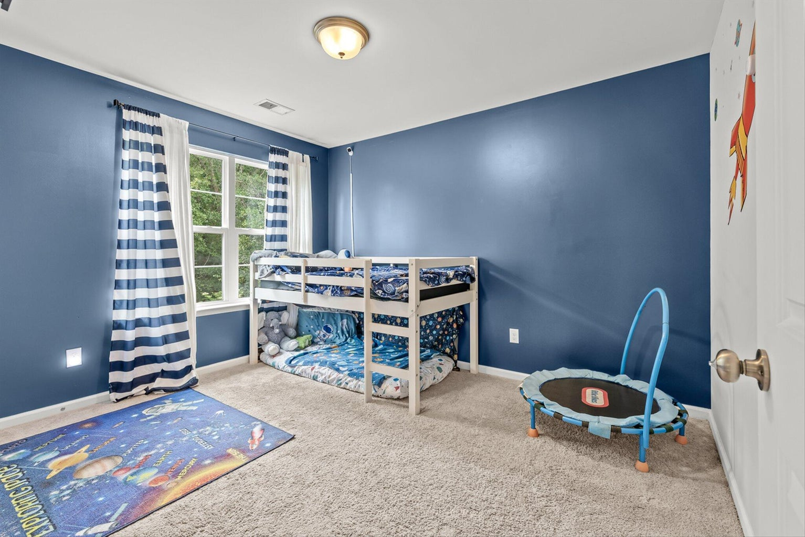
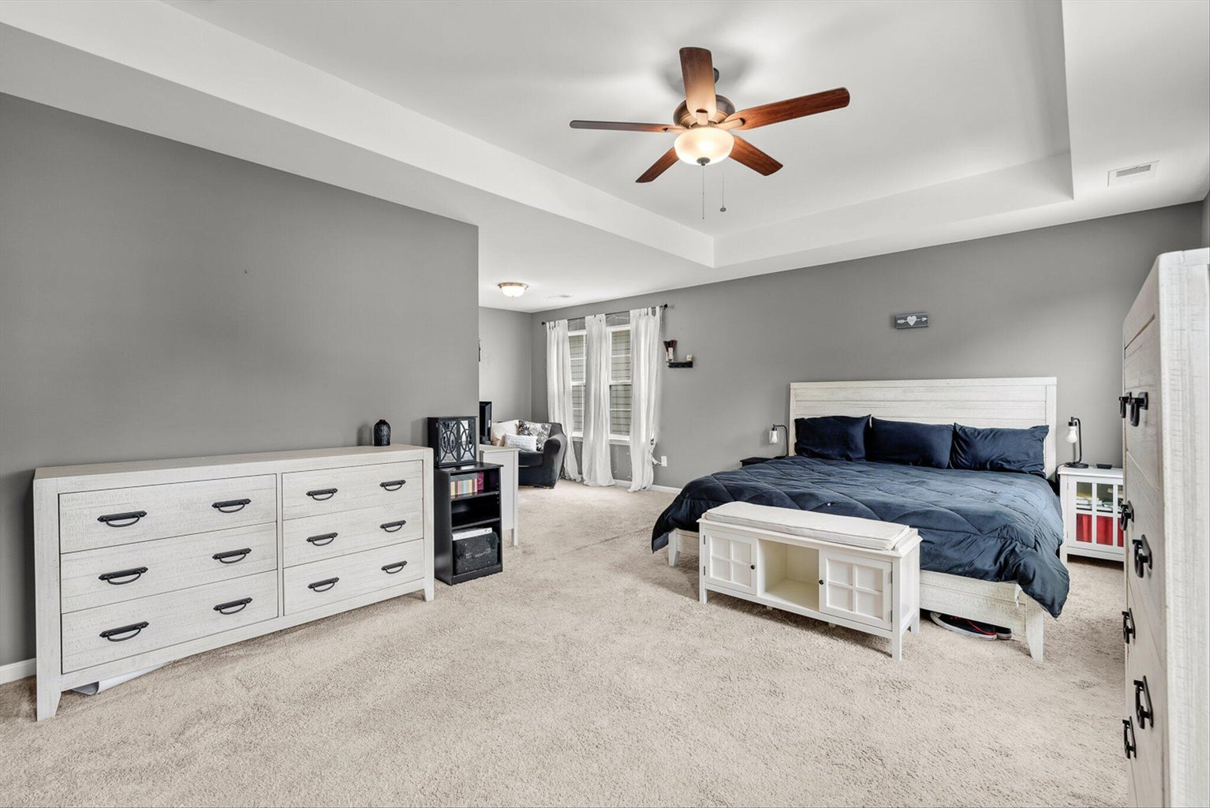
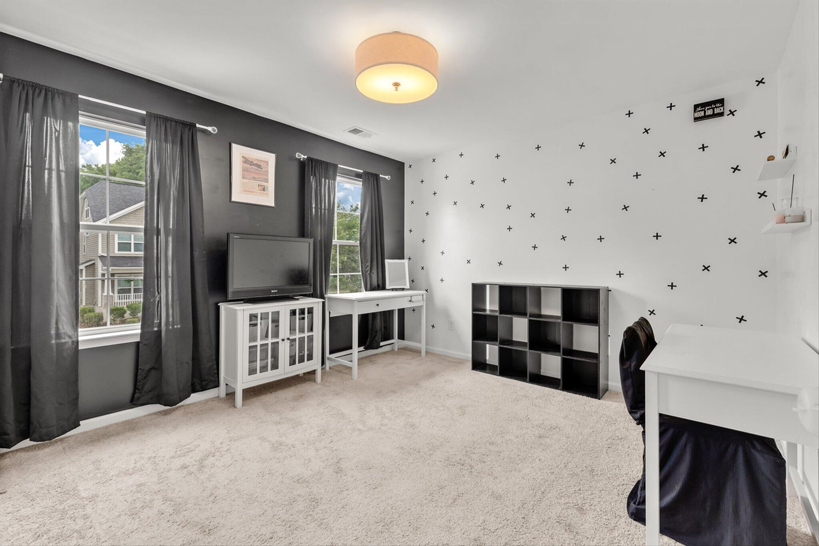
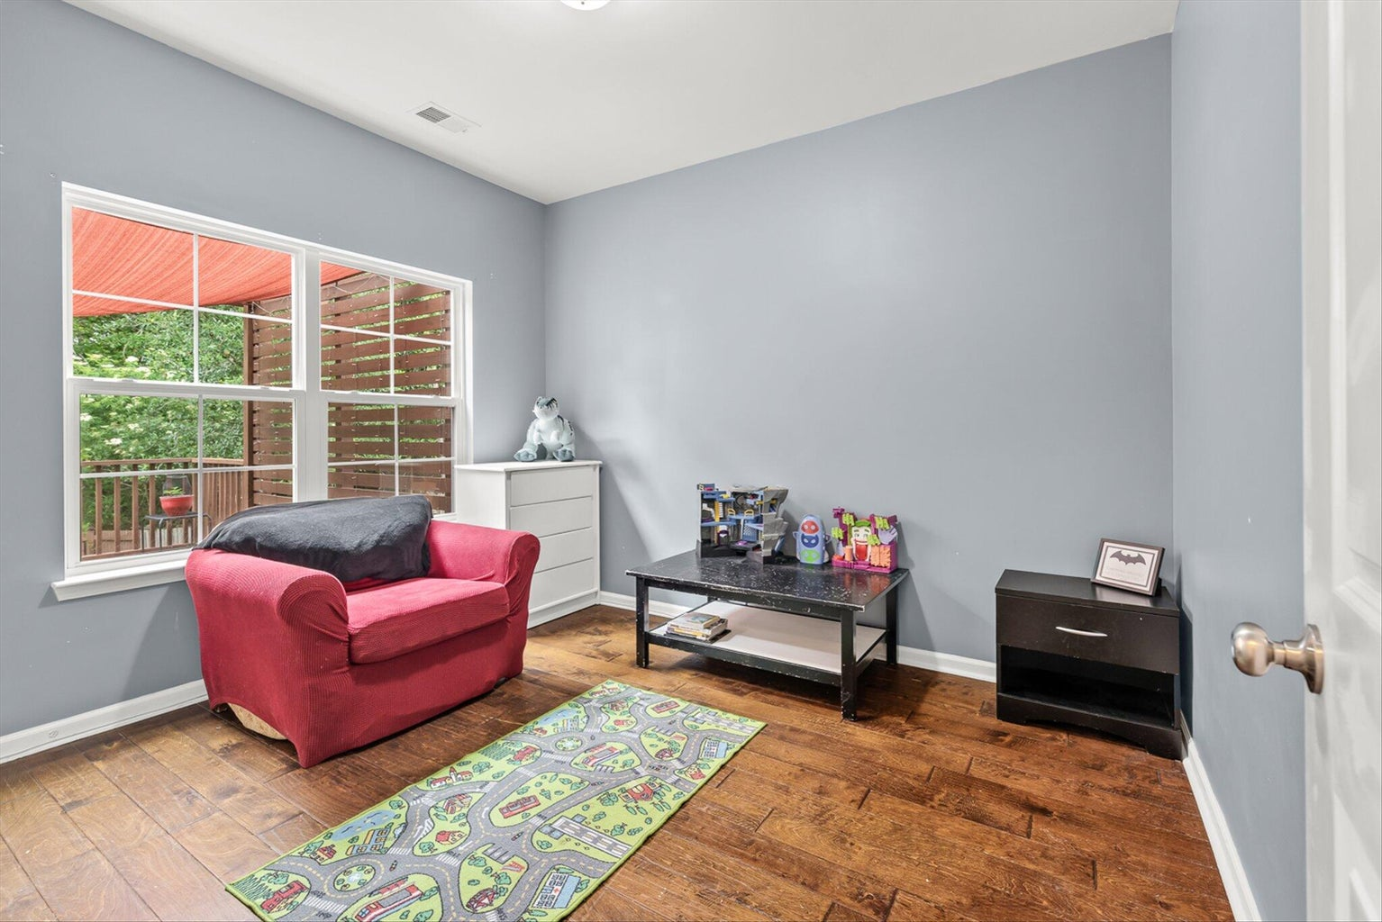
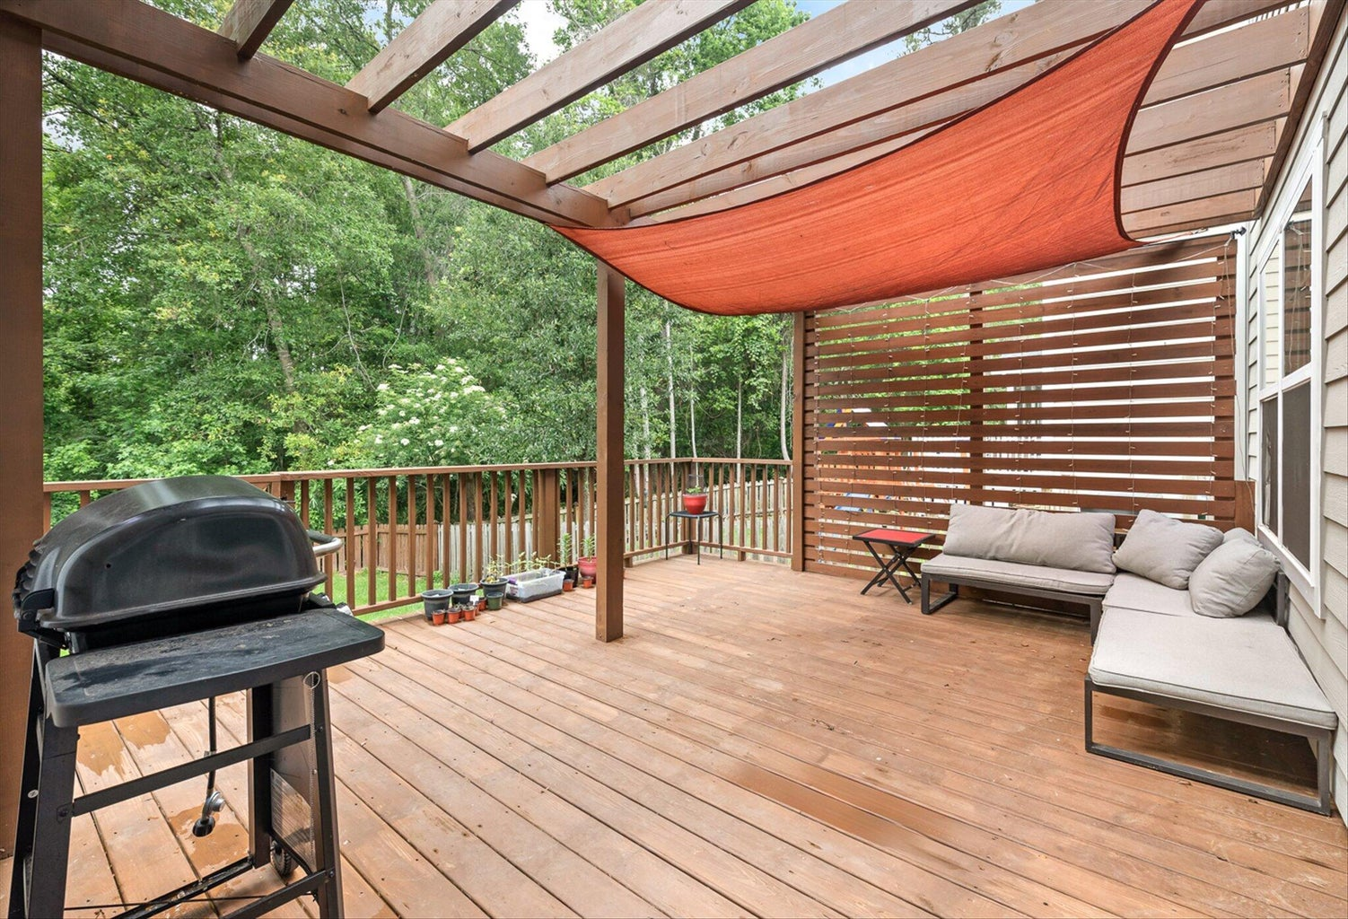
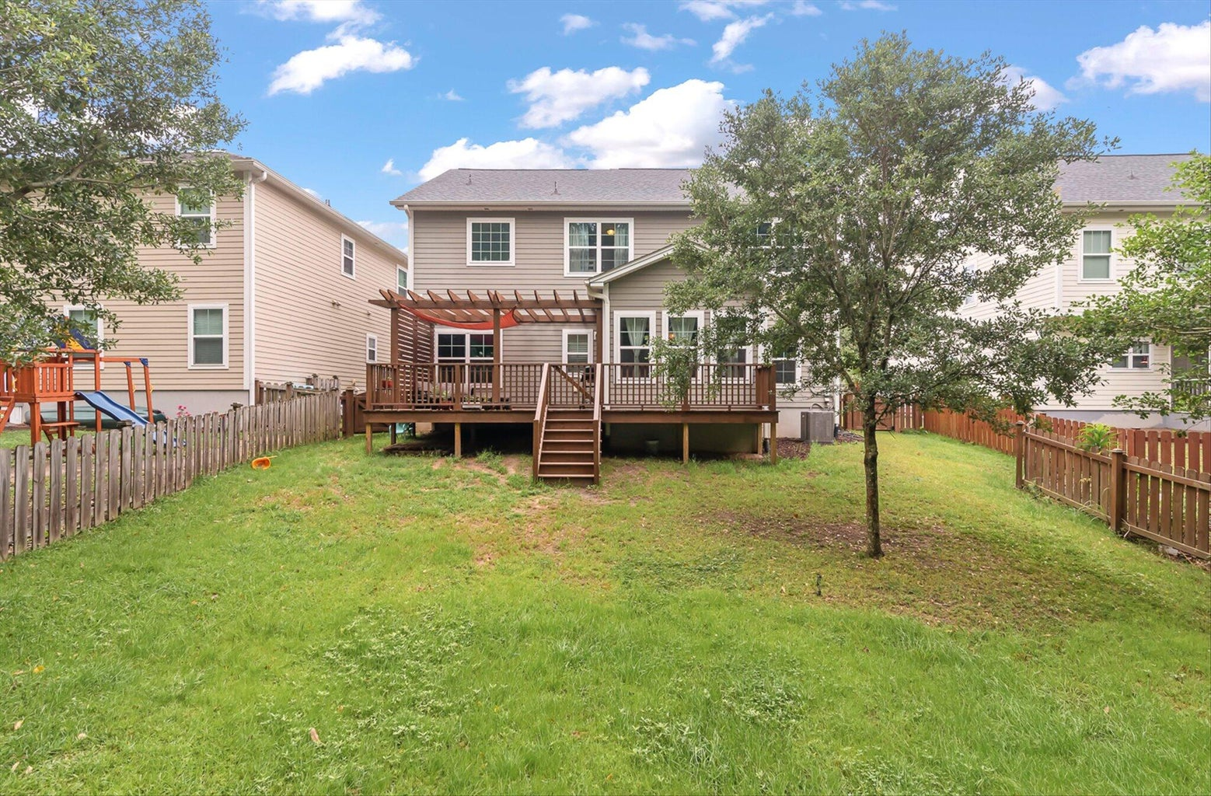
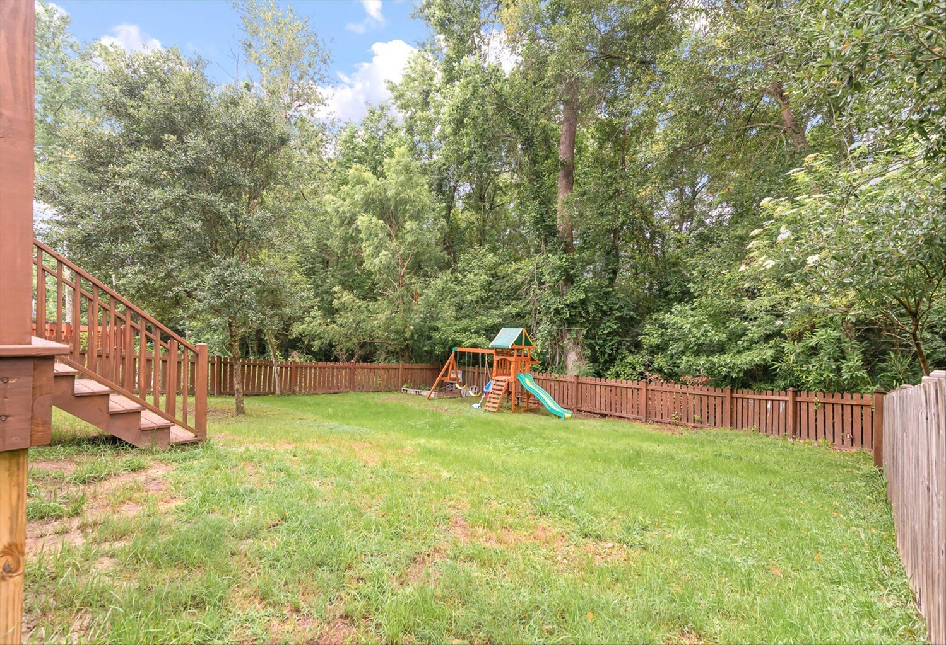
Price Reduction
118 Elliott Creek Lane
The Bluffs at Ashley River | Summerville, SC 29485
MLS# 23011708 | $433,000
Walk inside this beautiful home to see hearty wood floors and a beautiful arched entrance way that really highlights the space. This open floor plan feels so spacious and inviting. Take a peek at the kitchen with granite countertops, stainless steel appliances, and a large kitchen island perfect for prepping food! Next to your kitchen space, is the dining room, illuminated by tons of natural light and centered with a modern light fixture. Down the hall, a bonus room, that's perfect as an office, playroom, or 5th bedroom! In the backyard, take advantage of ample fenced-in space overlooking woods and a huge back deck for lounging and get togethers. Brand new french drains in the back yard were installed in 2021. This is one of the largest backyards in the neighborhood. The second story of the home boasts four bedrooms, one being a spacious owners suite with a sitting area, spacious closet, and a separate shower and tub. Freshly painted bedrooms, bathrooms and downstairs hallway. New LVP in the upstairs hallway in 2021. Located in the Dorchester District 2 schools, and with plenty of neighborhood amenities to include a pool and playground, ponds to fish, and an active HOA with food trucks once a month.
Take a virtual tour: https://app.cloudpano.com/tours/J6gestg3v
Tina Hartford
EXP Realty LLC
843-779-8646
tinahartford@lowcoasthomes.com

