Slide 1
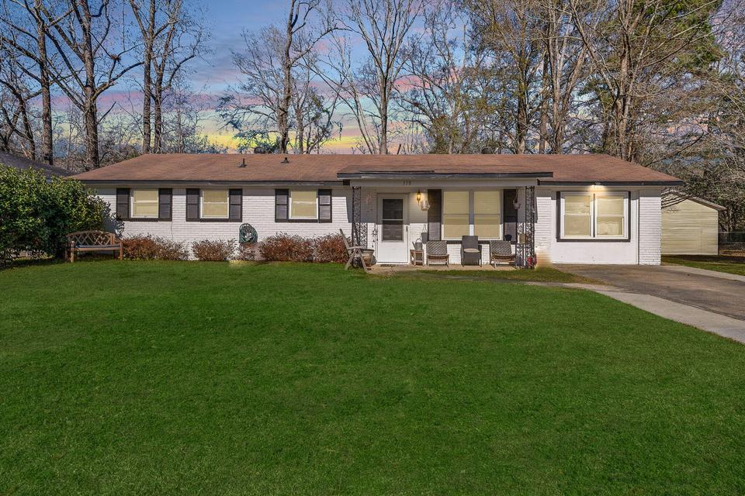
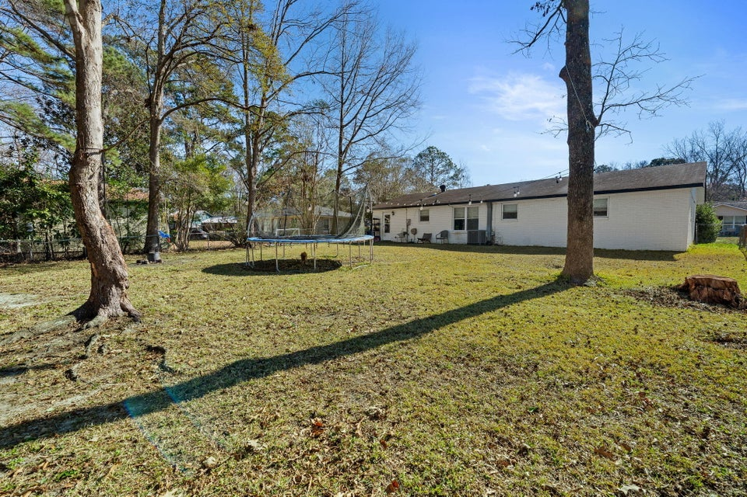
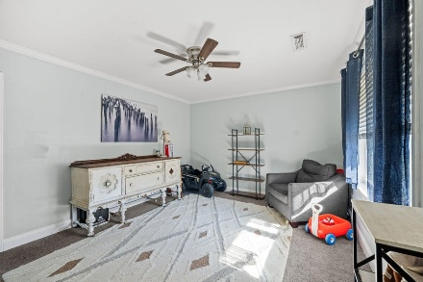
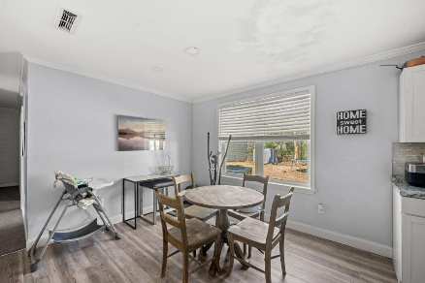
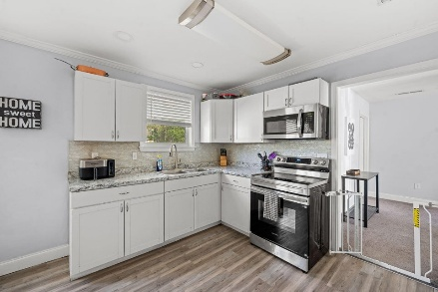
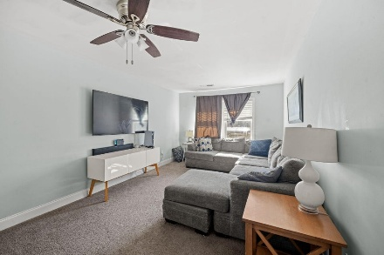
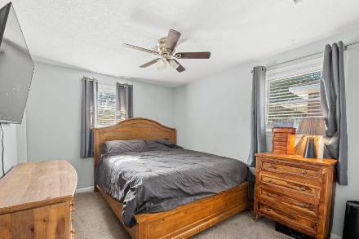
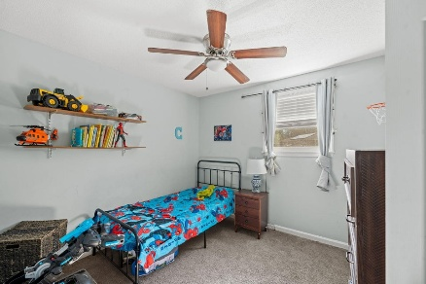
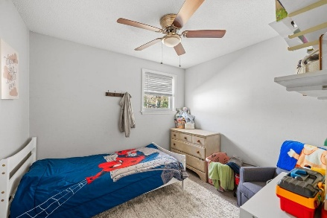
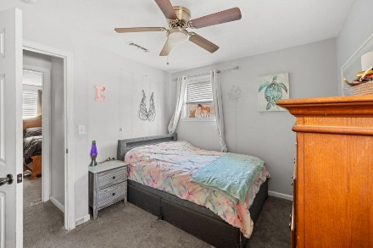


118 Froman Drive
True 4 Bedroom Home In Dorchester District II Under $300k!
Flowertown | Summerville, SC 29483
MLS# 26001722 | $295,000
A wonderful opportunity for first time home buyers or anyone seeking a home with space to enjoy. Located in the desired Dorchester II school district. This adorable clean and well maintained home is ready for you to make it your own.
Offering over 1400sqft which includes 4 bedrooms and 1.5 baths. The eat-in kitchen and additional living area create a comfortable layout for everyday living, flexibility and entertaining. Step outside to a spacious, fully fenced backyard-ideal for pets, play, or weekend gatherings. Floor plan and backyard allow for additions if so desired. The shed does convey.
Kelly Rozier
(843) 209-3129
kellywrozier@gmail.com
Brand Name Real Estate
4 Carriage Lane Suite 106
Charleston, SC 29407

