Slide 1
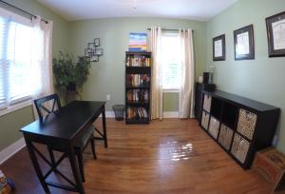
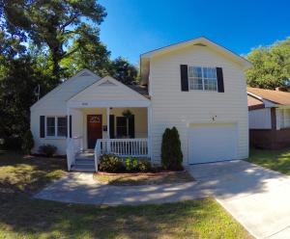
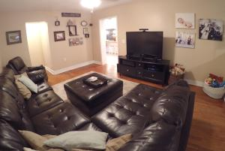
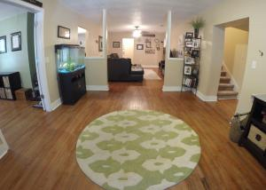
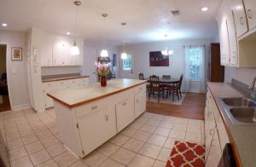
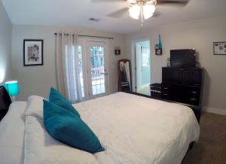
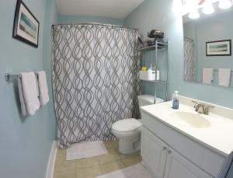
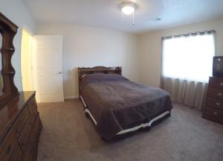
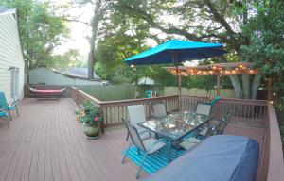
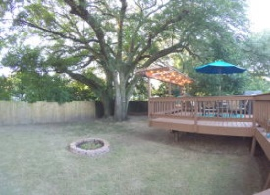


There is nothing else like this in Park Circle.
1190 Braddock Avenue
Park Circle ~ North Charleston ~ MLS# 15020238 ~ $299,900
There’s nothing else like this home in Park Circle! Check out the full walk-through video tour and photos. The first thing you will notice about this 4 bedroom, 3 full bath home, is the convenient location. It is right down the street from 526 interchanges, and a quick bike ride to the timeless Park Circle downtown area, which boasts some of the best restaurants that North Charleston has to offer. This area is also home to many events, parades, and festivals throughout the year. The home is perfect for the growing family or anyone that loves to entertain. You will take note of the front porch with ample space for seating. Upon entering the home you will love the open floor plan. Among the gems that make this home so great for entertaining are the grand island in the kitchen, complete with bar seating, which leads onto the spacious deck where you can grill and sip your favorite beverage and look out onto the newly landscaped back yard. Your new backyard will also boast a beautiful live oak, fruit trees, fire pit, and pergola. Prefer to stay indoors? Then enjoy the separate kitchen space ideal for formal dining. Downstairs are two bedrooms, to include the spacious master with walk-in closet, and attached bathroom. The master bedroom even has its own entry onto the scenic deck space. The other two bedrooms are located upstairs, connected by Jack and Jill bathroom. The location of these bedrooms provides ideal tranquility in those spaces, and privacy for your family or guests. Just some of the updates worth noting are the brand new roof, paint, appliances, carpeting, and the recently restored deck. Come check out this move-in ready, one of a kind home-it won't last long!
Eric Bickel
Office - (843) 284-3959
Mobile - (843) 633-1744
eric@bigrealtyllc.com
B.I.G. Realty, LLC
1540 Patterson Ave
Charleston, SC 29412
www.bigrealtyllc.com

