Slide 1
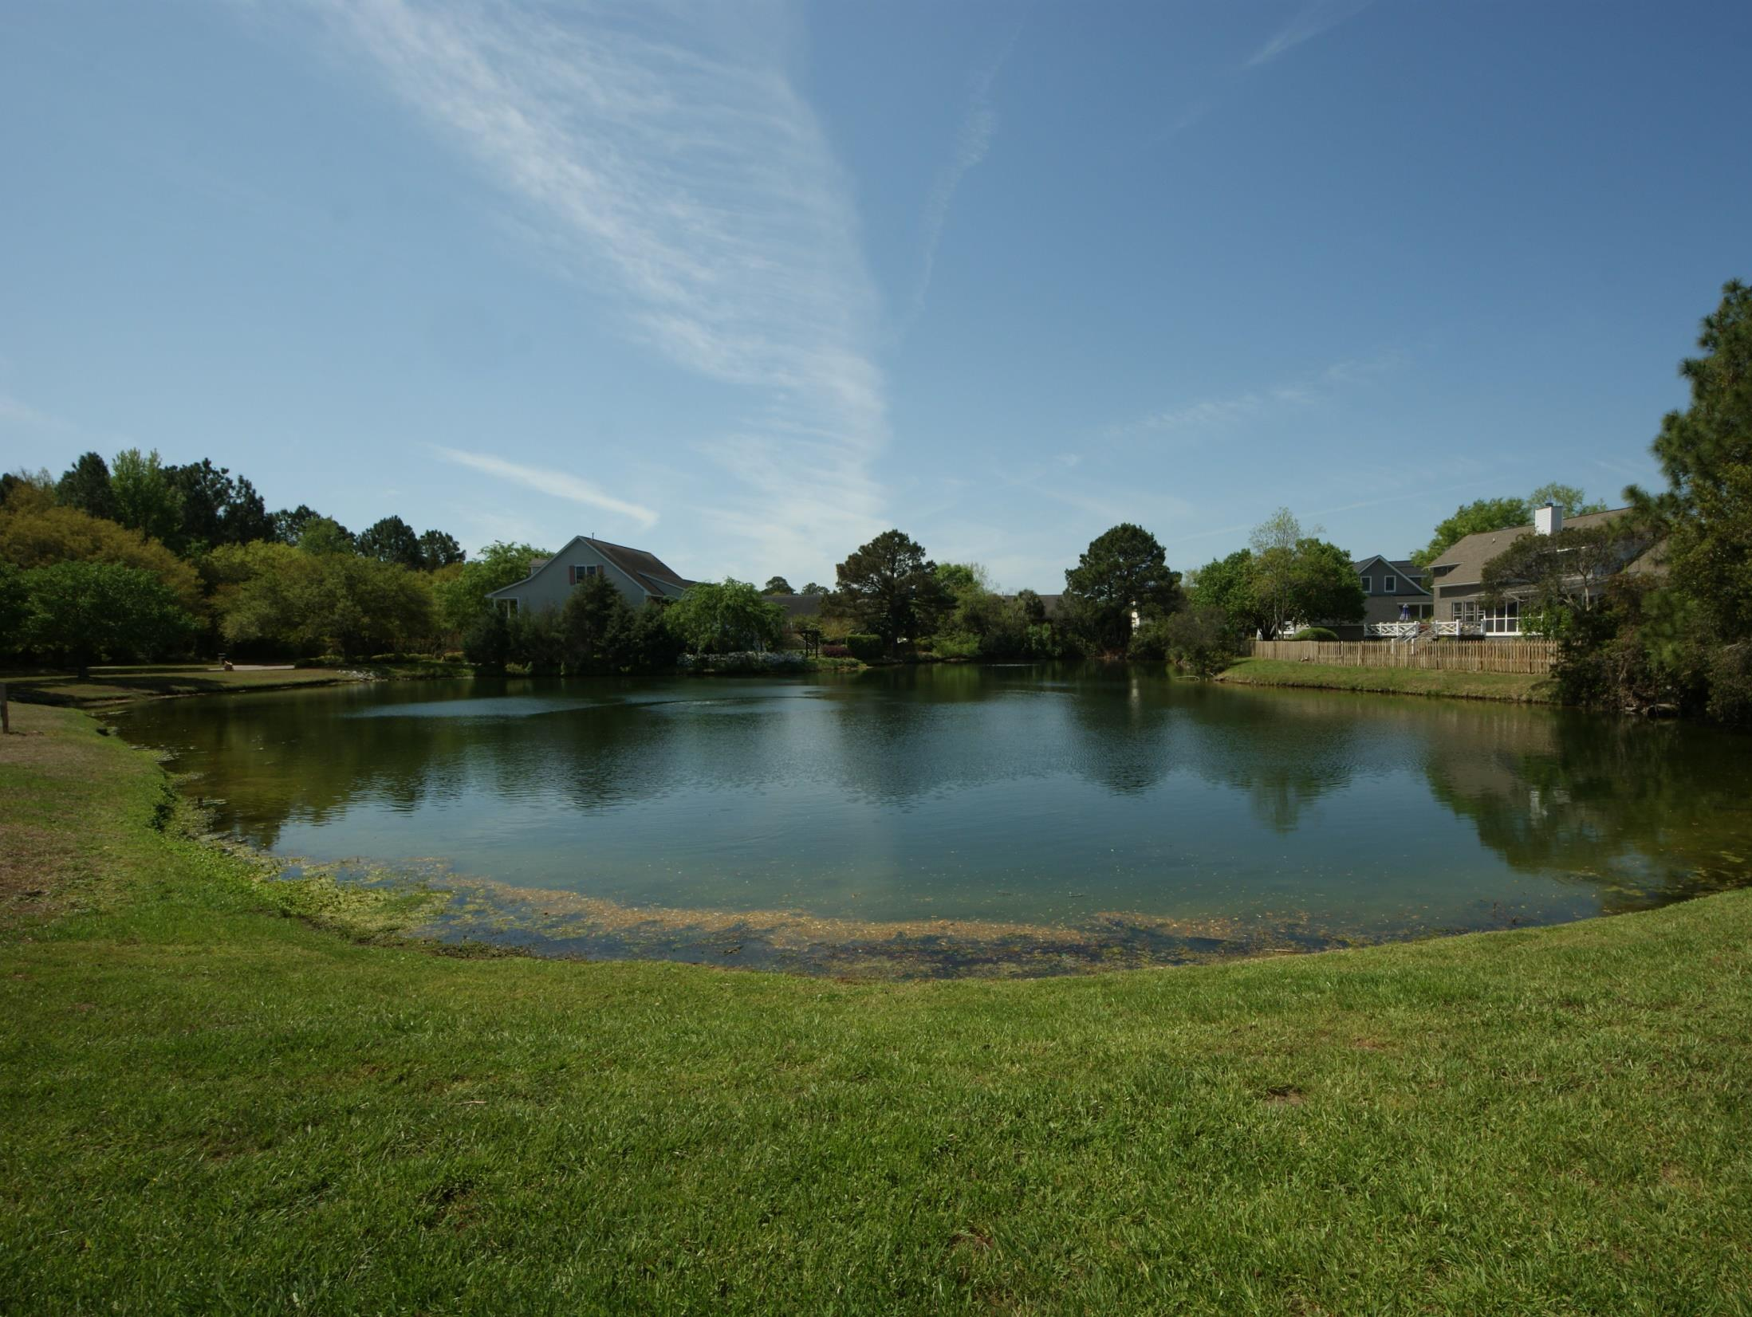
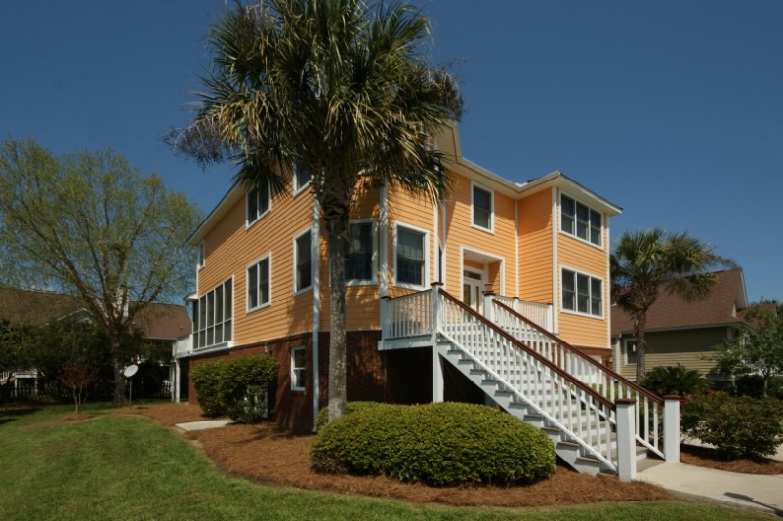
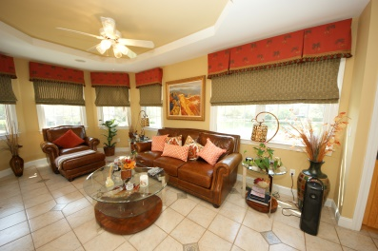
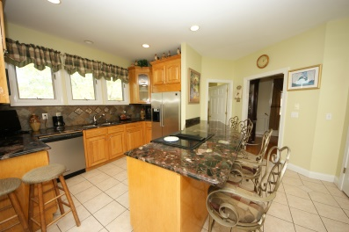
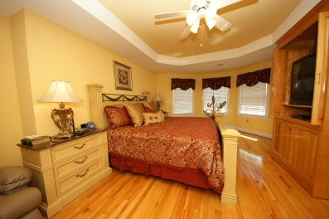
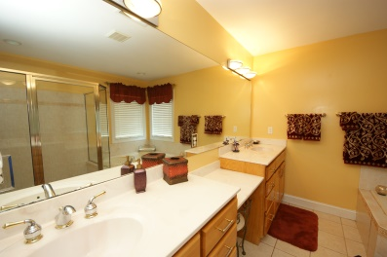
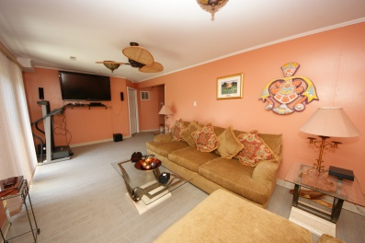
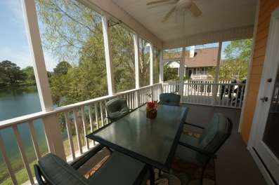

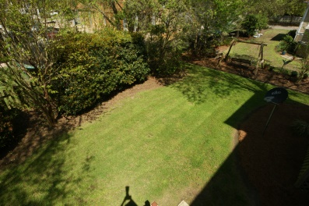
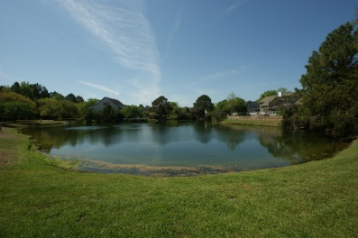
Just Reduced!
1190 Sea Eagle Watch
Seaside Plantation
James Island, SC 29412
MLS# 15008858
$615,000
Beautiful pond lot home that has been well maintained and freshly painted inside and out. This 4BR, 2Full Bath, 2Half Bath home is a must see. It has beautiful hardwood and tile floors, a formal living room, formal dining room, family room, with wet bar and entertainment ctr and kitchen, with granite and stainless steel appliances, laundry room and half bath on the main level. There is a screened porch and deck also on this level. The second floor has 4BR and 2 Full Baths. The master bedroom has hardwood floors and large en suite bathroom with a water closet, double vanities, jetted tub and oversized shower. The ground level has a den, with french doors and a beautiful pond view, office and half bath that are not included in the square footage. There is a three car garage with storage.
Terry Seabrook
Mobile 843 607-2490
Office 843 577-2676
seabrookspace@aol.com

