Slide 1
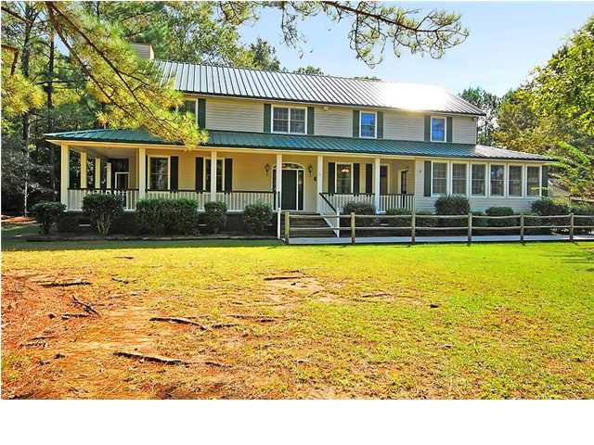
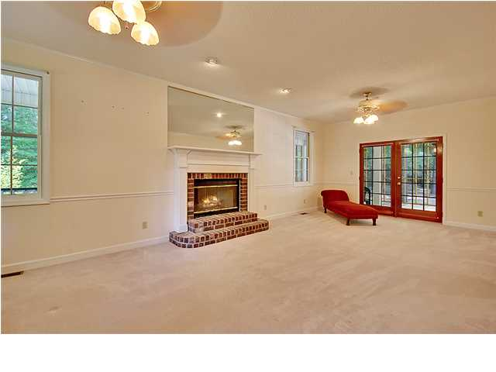
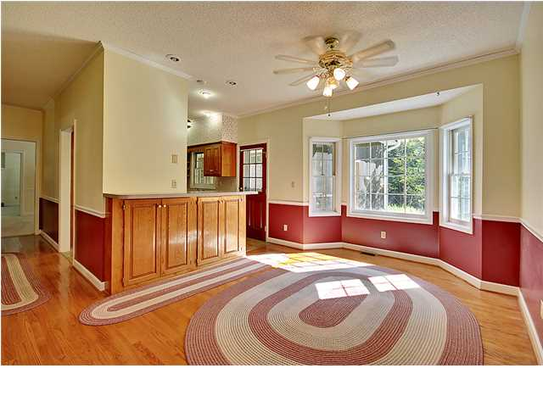
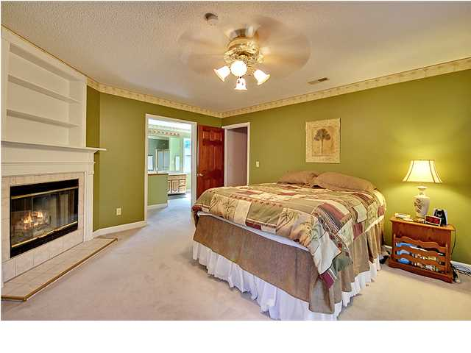
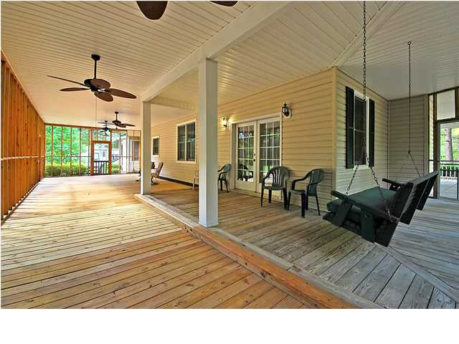


CLASSIC 5 ACRE COUNTRY ESTATE
1191 Witherbee Rd
Moncks Corner
MLS# 1325507
$339,900
*** BACK ON THE MARKET-PRICE REDUCED ***
This Distinctive Country Style 2 Story home is situated on a quiet country road and is surrounded by 5 beautifully landscaped acres of land and offer an Exclusive and Impressive front driveway with beautiful positioned crepe myrtle.
This Magnificent home with a authentic wrap-around front porch has four spacious bedrooms upstairs including the remarkable master bedroom suite with a cozy fireplace and a large private bathroom with double vanities, jetted tub and separate shower. There are several large rooms with 9 ft ceilings on the main floor including a classic formal living room with a genuine fireplace, a banquet size formal dining room, a valuable & bright family room, a priceless sunroom, a surprising laundry room appointed with beautiful wood cabinets (large enough for ironing, hanging clothes and more).
In addition, there is a family-size country kitchen with upgraded built-in appliances, beautifully crafted wood oak cabinets, an awesome over-sized breakfast area, a private office with built in's and a spacious game room. There is a French door to the surprisingly large screened-in porch perfect for relaxing in a swing or a rocking chair.
There are several out buildings including a an accredited workshop for the handyman. This Unique home and property is priced for a quick sale.
It won't last long!
Bill Everett, Jr
Broker
Office 843-767-7777
Direct 843-693-8539
Fax 843-576-5352
RE/MAX Pro Realty, 9209 University Blvd, Charleston, SC 29406

