Slide 1
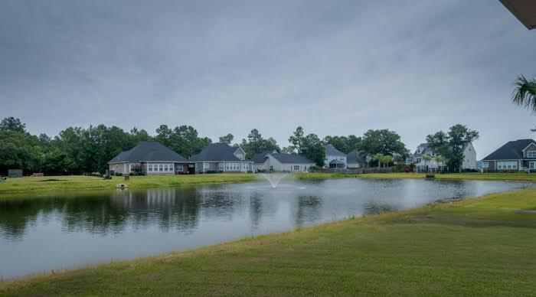
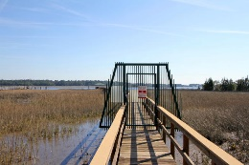
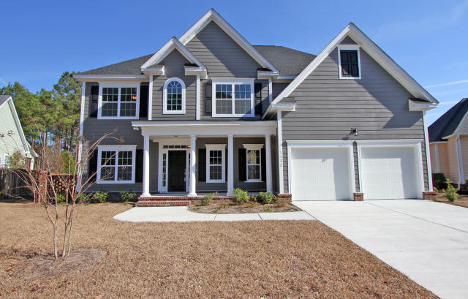
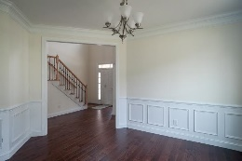
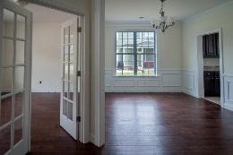
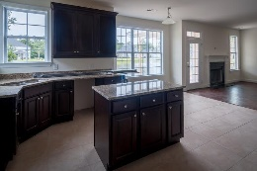
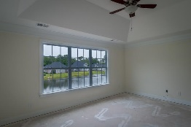
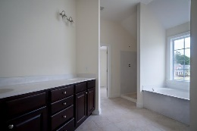
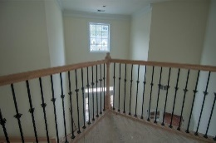


Waterfront Community with Dock on the Wando 2 Other Homes Nearing Completion…3 Other Homes About to Begin
1192 Rivers Reach Dr
Wando, SC 29492 River Reach Pointe
MLS# 15019197
Just Reduced to $449,900
SEMI CUSTOM - NEW CONSTRUCTION COZY WATERFRONT community with private neighborhood dock & gazebo ON THE WANDO!
Great VALUE among other existing homes from the $400s to close to $1M! Handsome & stately exterior*Beautiful interior architectural elements like 2 story foyer, dramatic stairway & attractive entrances to formal Dining Room & Media/Office
Standard upgraded features include wood floors, stainless, granite, tile & screened porch overlooking large lake*Private Guest room on main level*
On the Second level you'll find a wonderful large Master Suite with lake views & lots of light along with 3 additional good sized bedrooms-all with lots of natural light! BRAND NEW-state of the art- elem., middle & high schools nearby scheduled to open in 2016! GREAT LIFESTYLE!
Stroll, bike or take a golf cart ride to the neighborhood dock to fish, crab or just relax under the gazebo. It's all about the lifestyle-
Come see for yourself TODAY...
Sheila Romanosky
(843) 224-0242
sromanosky@carolinaone.com

