Slide 1
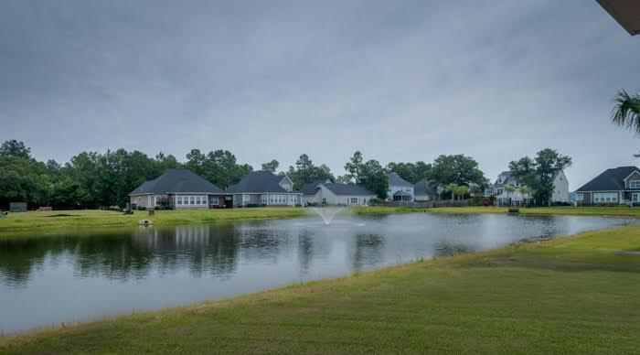
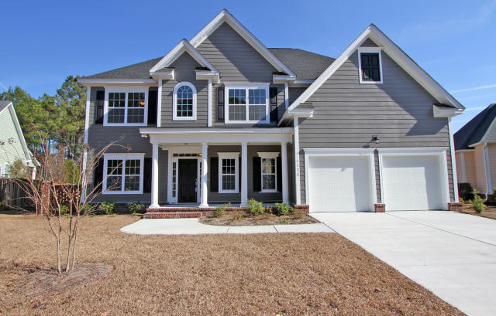
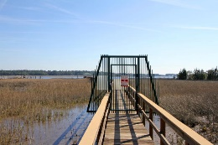
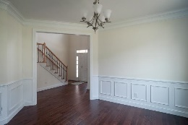
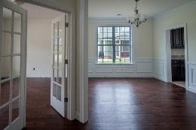
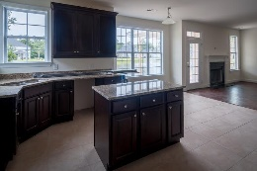
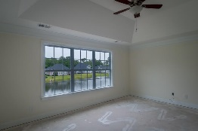
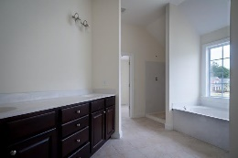
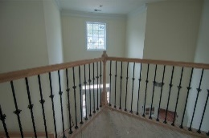


Waterfront Community with Dock on the Wando
1192 Rivers Reach Dr
Wando, SC 29492 River Reach Pointe
MLS# 15019197
Just Reduced to $449,900
NEW SEMI CUSTOM CONSTRUCTION-in waterfront community on the Wando with neighborhood dock! Handsome & stately exterior architectural curb appeal.
Beautiful interior architectural elements like 2 story foyer, dramatic stairway & attractive entrances to formal Dining Room & Media/Office area welcome your guests.
Standard upgraded features include wood floors, stainless, granite, tile & screened porch overlooking large lake.
Private Guest room on main level. On the Second level you'll find a wonderful large Master Suite with lake views & lots of light along with 3 additional good sized bedrooms-all with lots of natural light!
Stroll, bike or take a golf cart ride to the neighborhood dock to fish, crab or just relax under the gazebo. It's all about the lifestyle.
Come see for yourself TODAY...
Sheila Romanosky
(843) 224-0242
sromanosky@carolinaone.com

