Slide 1
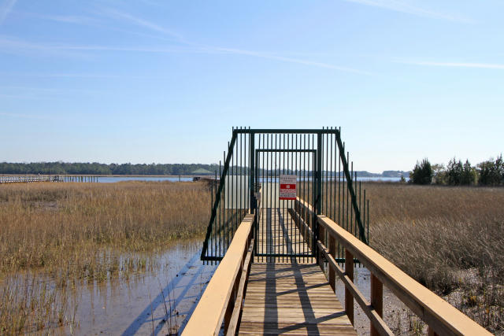
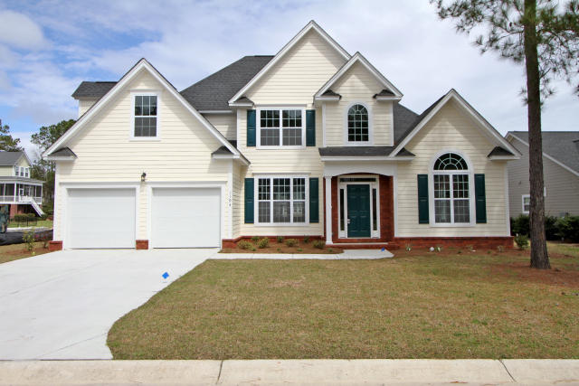
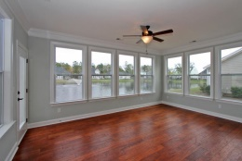
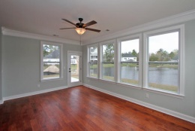
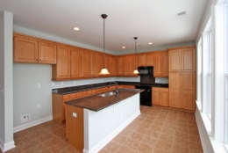
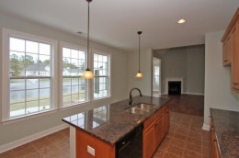
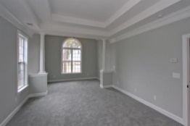
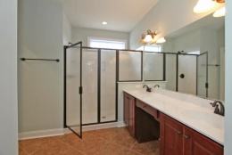
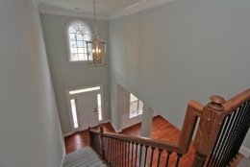
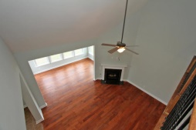
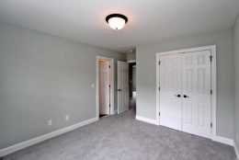
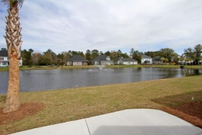
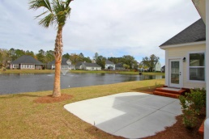
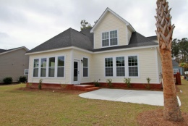


Waterfront Community with
Dock on the Wando
1194 Rivers Reach Dr
Wando, SC 29492
River Reach Pointe
MLS# 15008576
Reduced to $449,000
** NEW Construction ** Semi-Custom home**
Beautiful home! Main level features Maser Suite with sitting area, gorgeous separate dining area, open family room w/vaulted ceiling, kitchen & sunroom overlooking tranquil lake
Upstairs you'll find secondary BRs PLUS a large BONUS room to serve as 4th BR/media room AND LOTS of storage
Stroll or golf cart ride to private neighborhood dock for fishing, crabbing or simply relaxing under the covered gazebo.
Yes, it's the lifestyle! Take a look today!
Sheila Romanosky
(843) 224-0242
sromanosky@carolinaone.com

