Slide 1
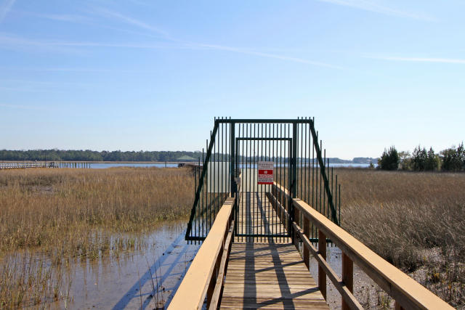
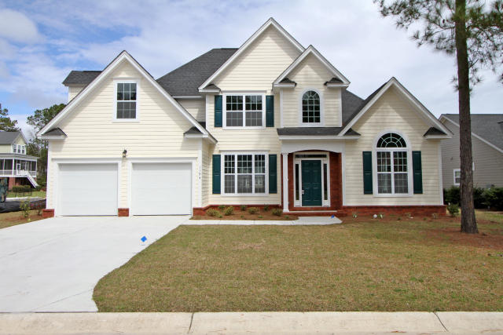
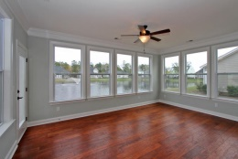
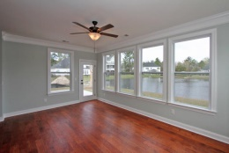
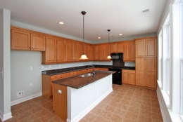
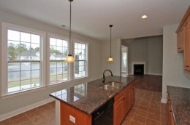
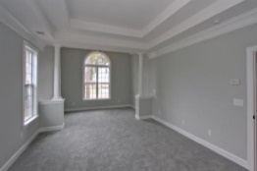
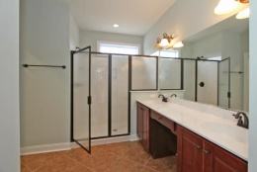
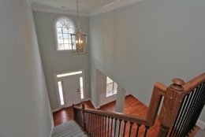
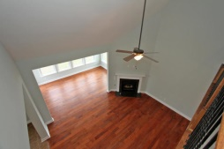
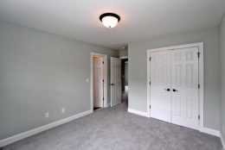
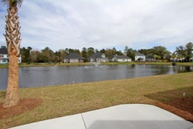
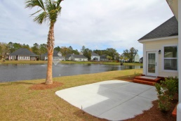
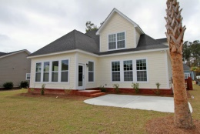


Includes Deeded Deep Water Boat Slip On The Wando! (Can Also Be Purchased Without Boat Slip)
1194 Rivers Reach Dr
Wando, SC 29492 River Reach Pointe
MLS# 15008576
New Price $499,000
* NEW Construction * Semi-Custom home in waterfront community *
Great value- homes nearby selling in the $600s & $700s! Beautiful home! Main level features master Suite with sitting area, gorgeous separate dining area, open family room w/vaulted ceiling, kitchen & sunroom overlooking tranquil lake
Upstairs you'll find secondary BRs PLUS a large BONUS room to serve as 4th BR/media room AND LOTS of storage
Stroll or golf cart ride to private neighborhood dock for fishing, crabbing or simply relaxing under the covered gazebo. Yes, it's the lifestyle! Brand NEW schools very close by and ready in 2016 per Berkeley Co!
Take a look today!
Sheila Romanosky
(843) 224-0242
sromanosky@carolinaone.com

