Slide 1
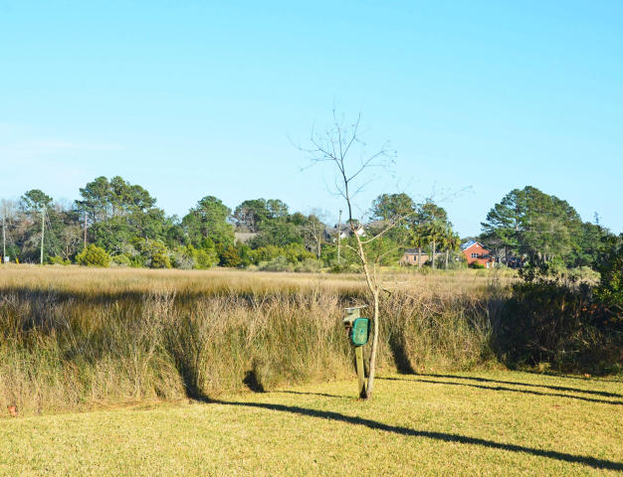
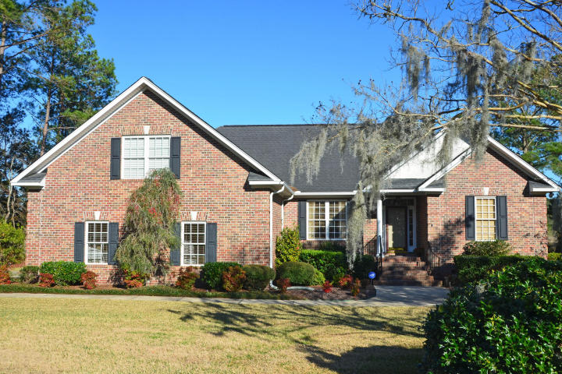
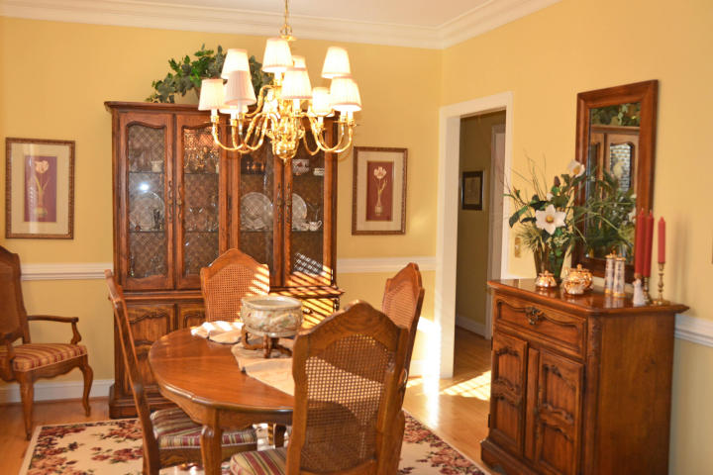
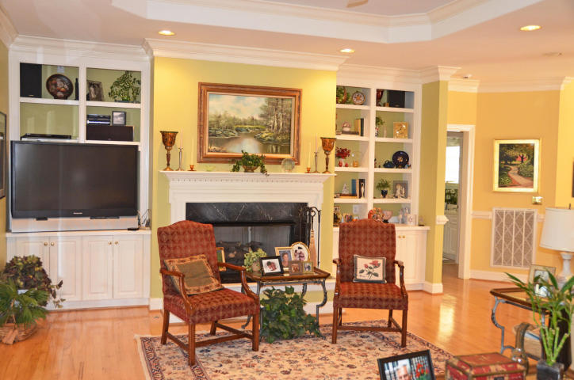
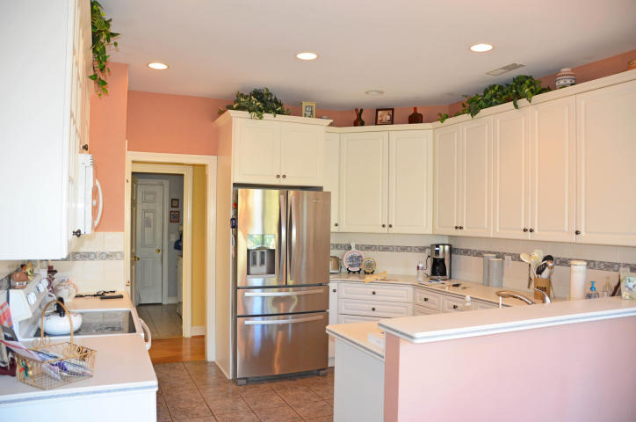
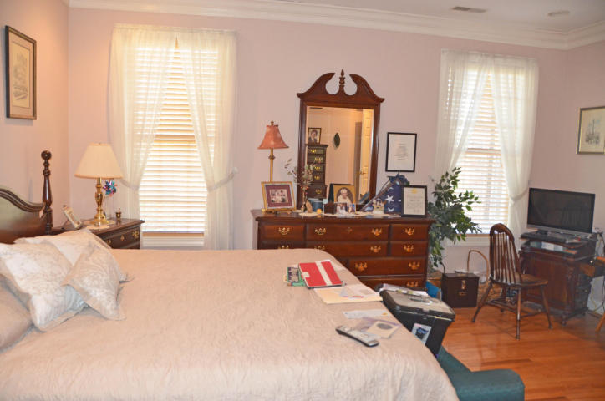
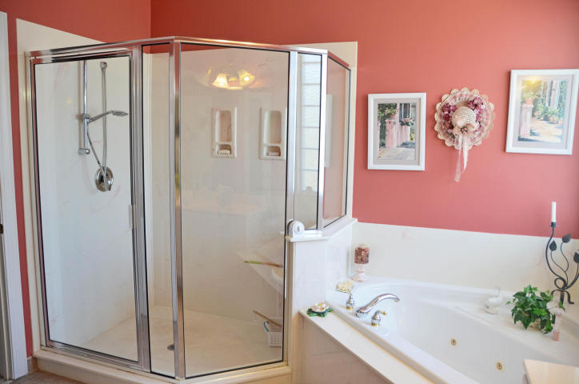
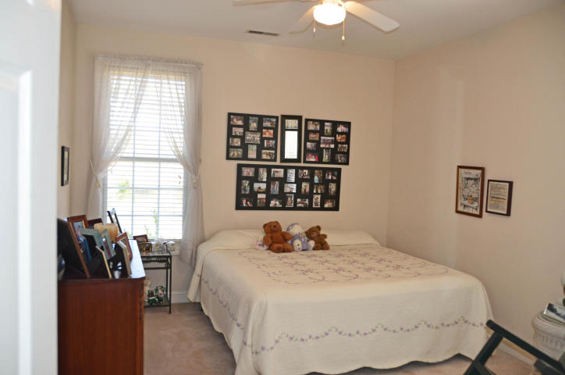
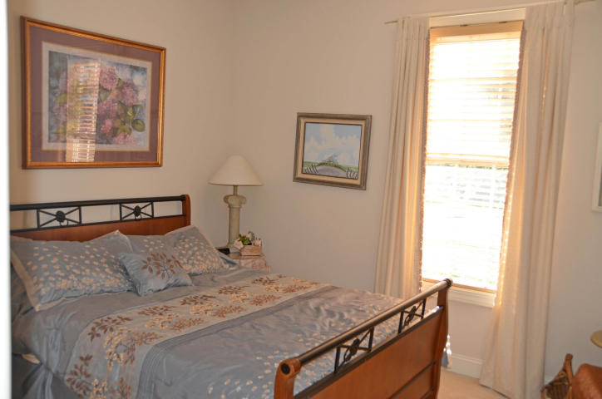
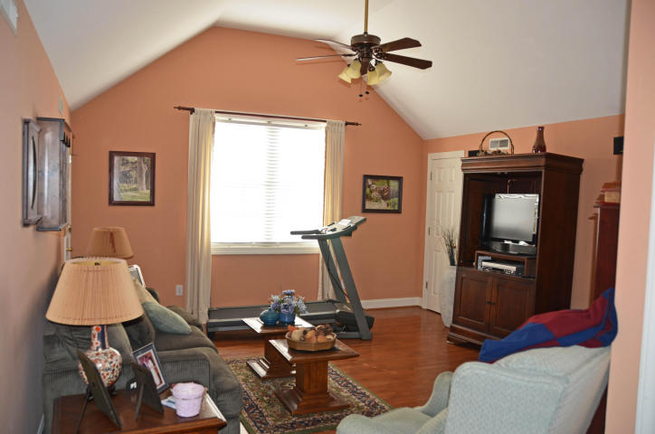
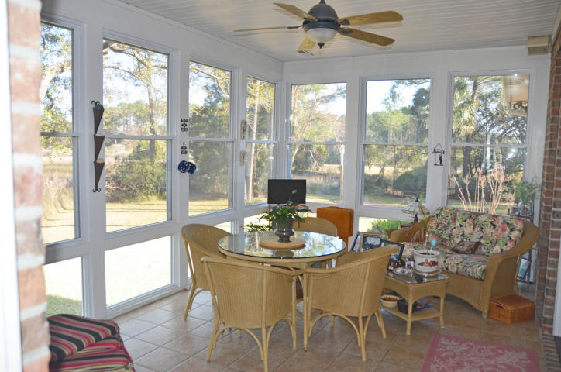
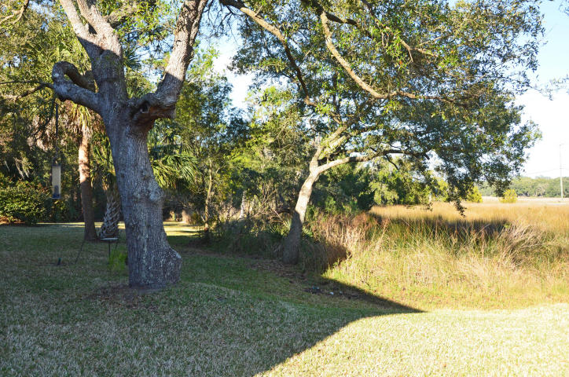
Marsh Lot! Delightful Views!
1198 Moss Bluff
Snee Farm ~ Mount Pleasant, SC 29464 ~ MLS# 17002683 ~ $699,000
Wonderful well maintained home. Beautiful detail work and moldings. Fantastic sunroom overlooking the marsh is heated and cooled. Large room over the garage with full bath. Built in 1996 on one of Snee Farms most unique lots. Perfect condition. You must see this lovely home! Security system. Subject to owner finding suitable housing.
Bonnie Miller 843.884.3901 O ~ 843.693.2647 M
bcm.olddom@gmail.com
Old Dominion, REALTORS · 890 Johnnie Dodds Blvd · Mt Pleasant, SC 29464

