Slide 1
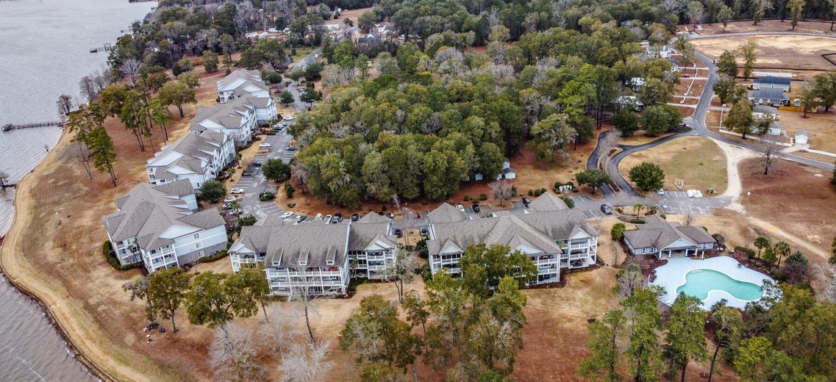
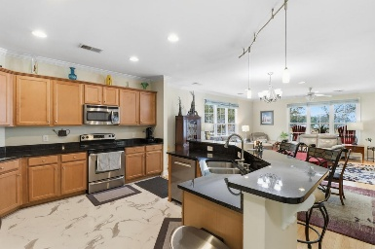
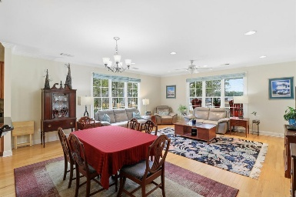
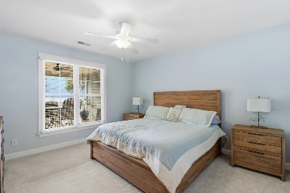
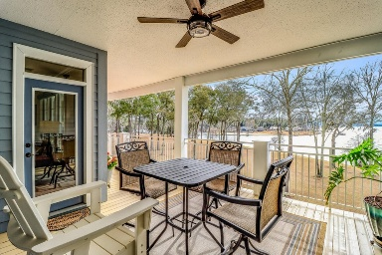
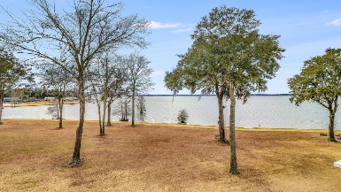


1198 Bridge View Lane E303
North Shore | Summerton, SC 29148 | MLS# 26002679 | $445,000
Just Listed on Lake Marion!
Open House
Wednesday, 7/20
3-5PM
Enjoy deep-water lakefront living in this well-maintained top-floor 3-bedroom, 3-bath condo located in the desirable North Shore waterfront community on Lake Marion. Designed with an open floor plan, this residence offers beautiful lake views from the main living areas and an ideal layout for both everyday living and entertaining.
Recent upgrades enhance both comfort and value, including a new HVAC system (2025), an electric tankless water heater, an upgraded primary bath with a tiled walk-in shower, and luxury vinyl flooring throughout the bathrooms, foyer, and kitchen. The spacious kitchen features abundant cabinetry, a large center island, and clear sightlines to the living and dining areas - perfect for hosting while enjoying the water views. Large windows throughout flood the home with natural light and showcase the stunning scenery of the lake.
The primary suite serves as a private retreat with an en-suite bath featuring a tiled shower with glass doors and a dual-sink vanity. Additional bedrooms are generously sized, each with its own bathroom offering tub/shower combinations, providing comfort and privacy for guests or family.
Step outside to the large waterfront patio, ideal for outdoor dining, relaxing, or taking in breathtaking sunrise and sunset views over the lake. This unit also includes a private boat slip that will convey, along with a storage building - a valuable bonus, as additional storage buildings are no longer being permitted in the community.
North Shore Condominiums offers resort-style amenities including a community pool, dock facilities, marina access, walking trails, and a clubhouse with a workout room, all within a beautifully maintained waterfront setting. Known for its boating, fishing, and year-round recreation, Lake Marion features expansive open water, cypress-lined shorelines, and convenient access to dining and marinas.
Whether you're searching for a full-time residence, weekend getaway, or low-maintenance lake retreat, this condo delivers the best of Lake Marion living.
VIDEO TOUR
Brandon Ray
(843) 499-1928
brandon.ray@carolinaone.com
www.lakelifescstyle.com
Carolina One Real Estate
900 N Main St
Summerville, SC 29483

