Slide 1
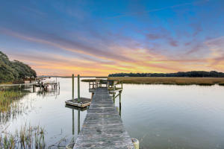
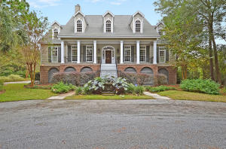


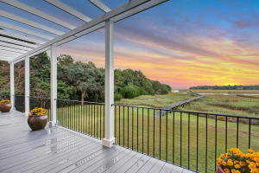
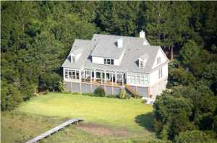


1199 Sea Eagle Watch Seaside Plantation Charleston, SC 29412 MLS# 16001277 $1,850,000
Seller is offering a $15,000 Selling Bonus (with BIC Approval) to any agent who brings an acceptable offer that closes on or before 09/30/2016!
The home is only a few years old but it has the ambience of a timeless early eighteen hundreds home. This home site is a 2.45 acre James Island estate located on Sea Side Creek with a lagoon in the front. The home is custom built with a large front porch with square columns and custom made wrought iron banisters and railings. The square columns and iron work enhance the back deck/porch to. Carolina gas lanterns grace each side of the fan light front door which is an exact copy of an 18th century door found on a home in downtown Charleston and custom built by Southern Lumber of Charleston. The first floor has all random width heart of pine flooring except for the master bath and laundry, beautiful molding and detail are found throughout out the first floor. The first floor consists of a two story entry hall, formal living room with fireplace, formal dining room, master bedroom/bath, office, powder room, very large gathering room with fireplace, sunroom, breakfast room and a gourmet kitchen with gas cook top, double wall overs, built in refrigerator, built in wine cooler and all appliances are professional grade stainless steel. The sunroom, gathering room, and master bedroom have walls of windows overlooking the marsh, creek and views to Folly Island. The second floor of the home has two guest bedrooms with a shared hall bath, a second master suite and a guest/mother-in-law suite composing of a sitting room, walk in closet, full bath and over sized bedroom. The home has beautiful moldings/detail on the second floor as well. There is an abundance of storage in this home. There is a garage space for 3 to 4 vehicles. A separate storage area for lawn and garden equipment. This is a must see property for the discriminating buyer who wants to be close to downtown and beach but wants a very private mini-estate. Termite bond is transferable.
John Stewart REALTOR, ABR, EPRO, GRI, SRES
Office - (843) 414-9066
Mobile - (843) 345-9542
jstewart@carolinaone.com
Carolina One Real Estate
873 Orleans Road, Ste 102
Charleston, SC 29407-5753

