Slide 1
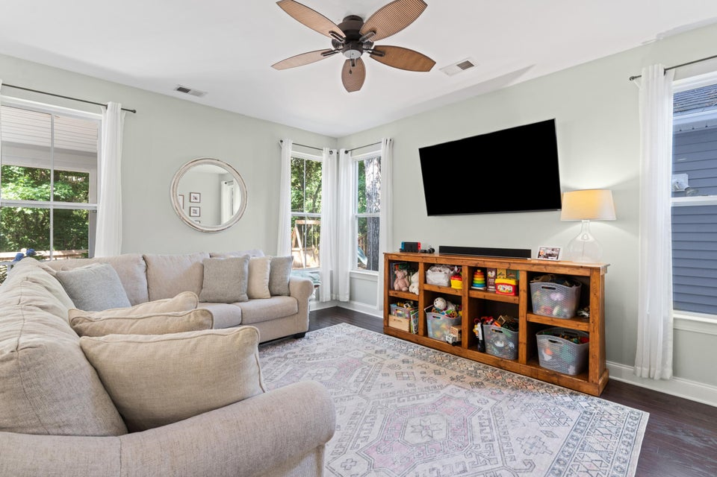
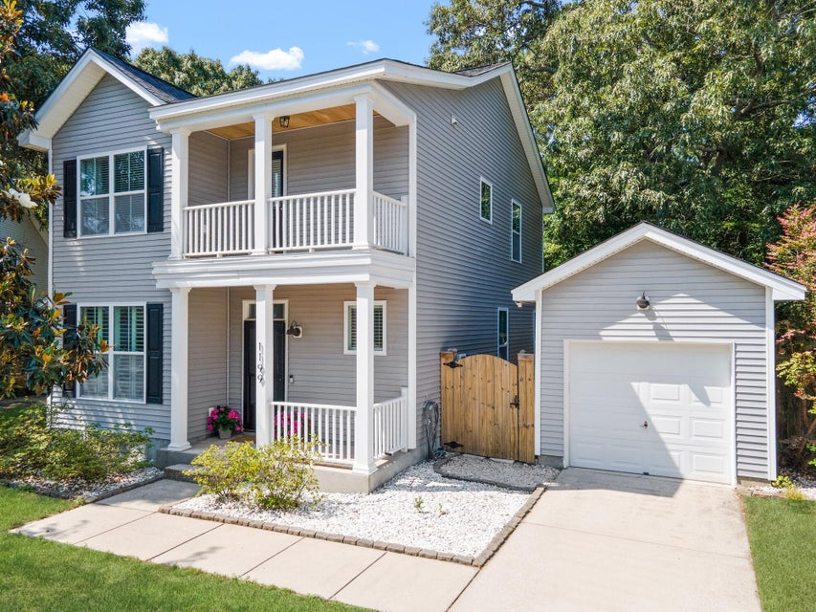
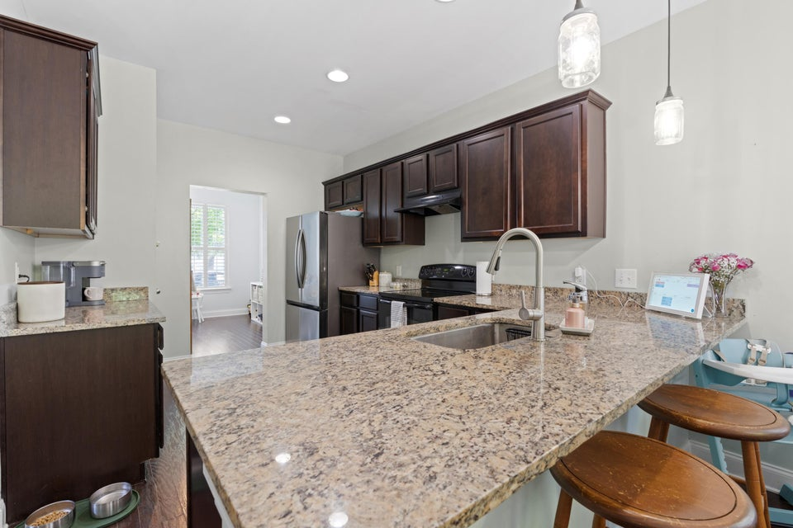
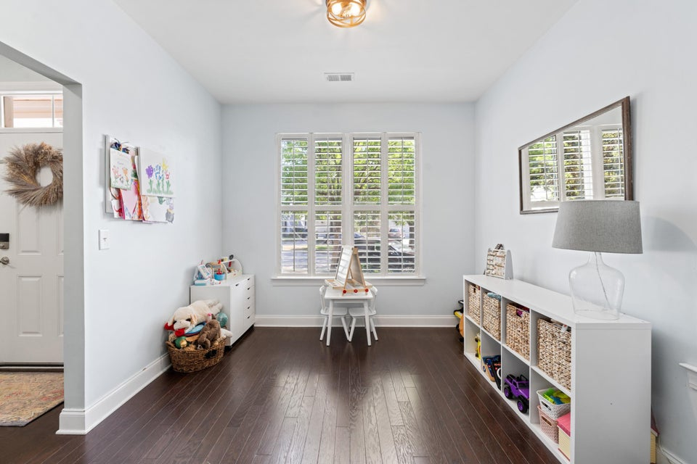
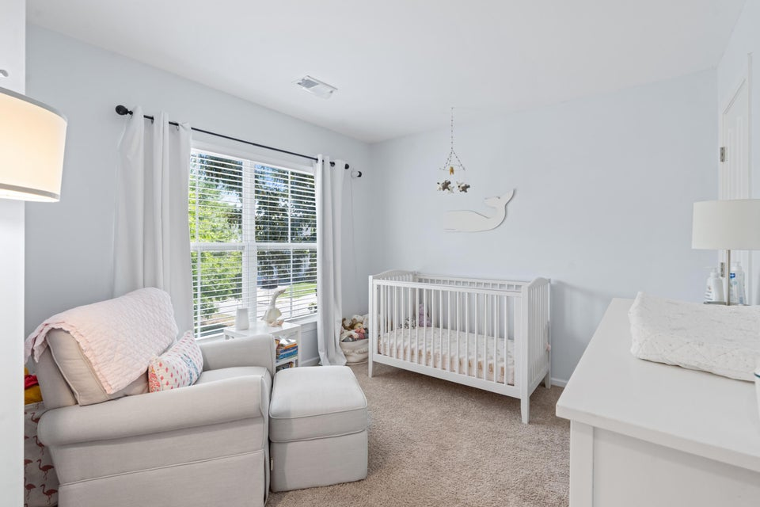
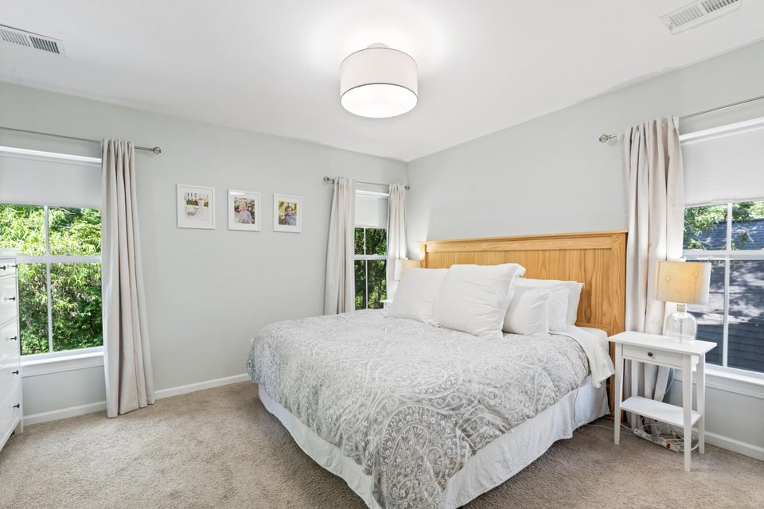
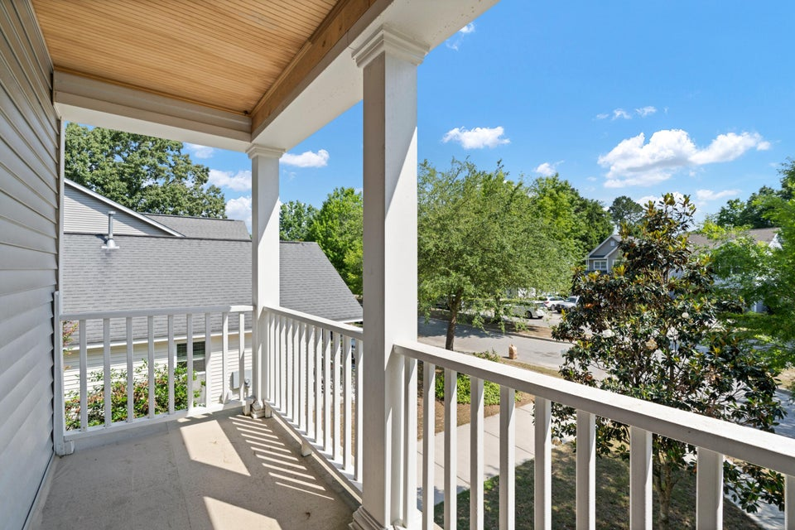
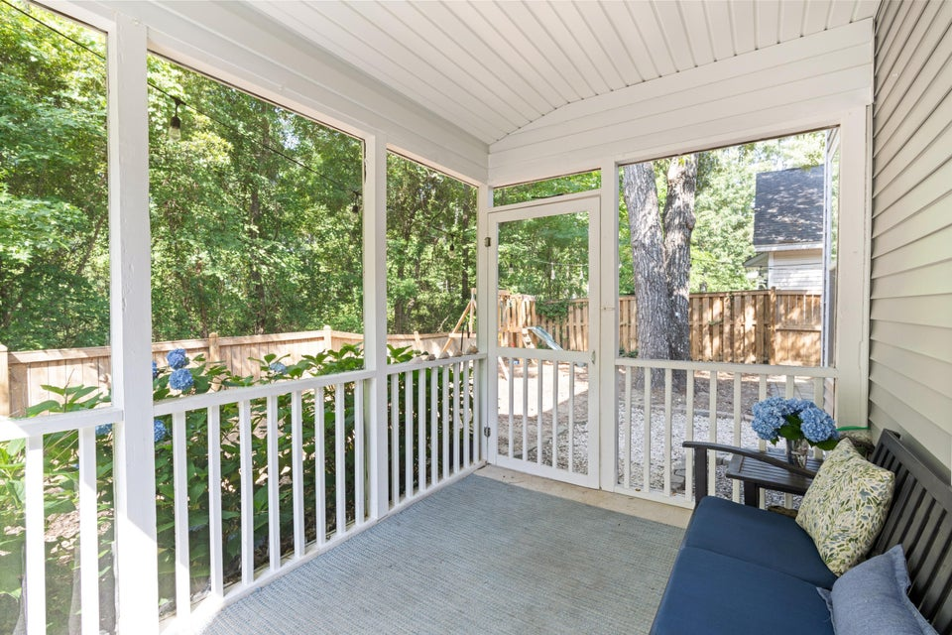
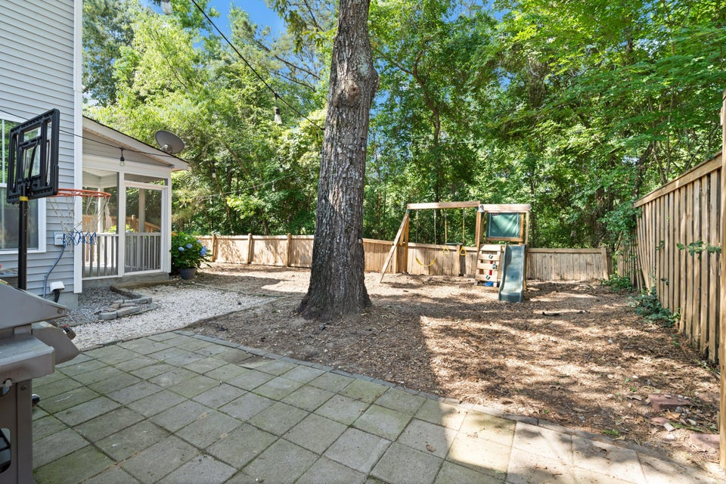

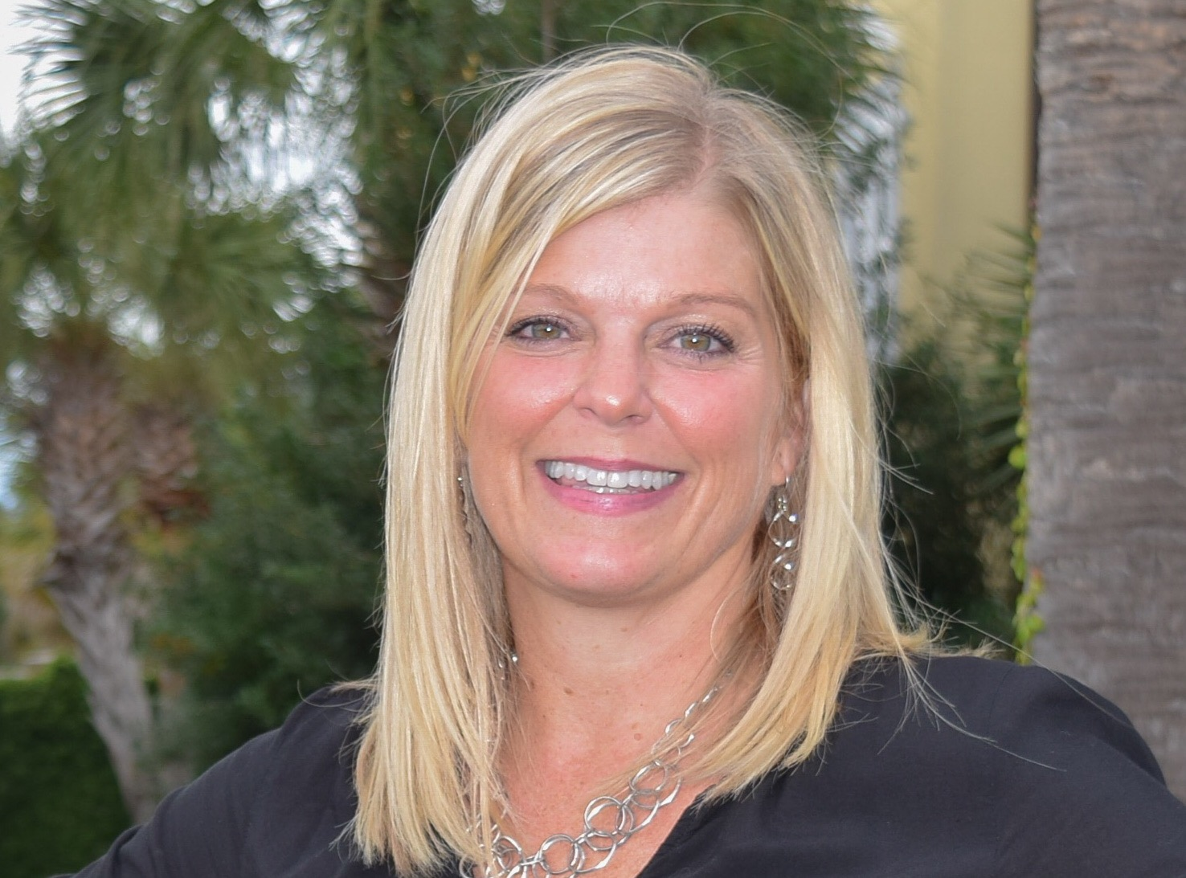

Move In Ready
Priced to Sell in Mt Pleasant | $595,000
1199 Landau Lane
Carriage Hill Landing
Mount Pleasant, SC 29466
MLS# 25013595
3 Bed | 2½ Bath | 1,624 SF
Sweetgrass Capital offering a 1% rate reduction for qualified buyers, but not available with all loan programs.
Call Jason Rosenthal @ 843-901-0668.
Come take a look at this charming well maintained Charleston Single style home with double front porches located on a cul-de-sac. This community is one of the few neighborhoods outside of Carolina Park that is zoned for Carolina Park Elementary. In addition, it's located in close proximity to Park Bend where you can find restaurants, coffee shops, local boutiques as well as Costco. It is also located within walking distance to Home Team BBQ. Upon entering the 3 car driveway you will notice a quaint house with manicured landscaping with mature trees and bushes. This home is fully enclosed by a wood fence with privacy around back with an attached screened in porch. Once you step inside, the wood foyer will lead you to a modern open concept style of living. This home has a spacious living room, informal dining room and a kitchen with an attached porch. The kitchen boasts quality cabinets, granite counter tops, a separate pantry and all stainless steel appliances. The seller has just replaced and installed a new smooth top stove/oven. Located upstairs are three bedrooms. The primary bedroom offers a walk-in closet and an attached private master bath with dual vanities, a stand up shower and a separate soaking tub. The secondary bedrooms are just down the hall with an additional full bathroom. Some additional features to highlight are a second floor veranda, freshly painted interior, renovated 1st floor half bath, smart thermostat, plantation shutters, hardwoods throughout the first floor as well as a keyless entry. Call Showing Time now to make your appointment. Call the listing agent to enquire about a 1% rate for qualified buyers.
For more info, please contact:
Leah Rust
843-709-9211
leahmrust@gmail.com

