Slide 1
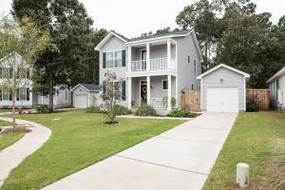



JUST LISTED
Come To An Open House
Sunday From 12-3
1199 Landau Lane
Carriage Hill Landing
Mount Pleasant, SC 29466
MLS# 25013595
$622,500
3 Bed | 2½ Bath | 1,624 SF
Leah Rust
Come check out this lovely, well maintained single family home with a detached garage conveniently located near shopping, restaurants and schools. As you step inside you'll notice an open concept with hardwood floors and a spacious living room with an attached screened in porch off the back. The kitchen boasts quality cabinetry, granite counter tops and stainless steel appliances. Upstairs you'll find the master suite with it's own bathroom, 2 additional bedrooms, another full bath as well as the laundry closet. Don't miss your chance to buy one of that last remaining single family homes under $625,000 in Mount Pleasant with more than 1500 sqft.
For more info, please contact:
Leah Rust
843-709-9211
leahmrust@gmail.com

