Slide 1
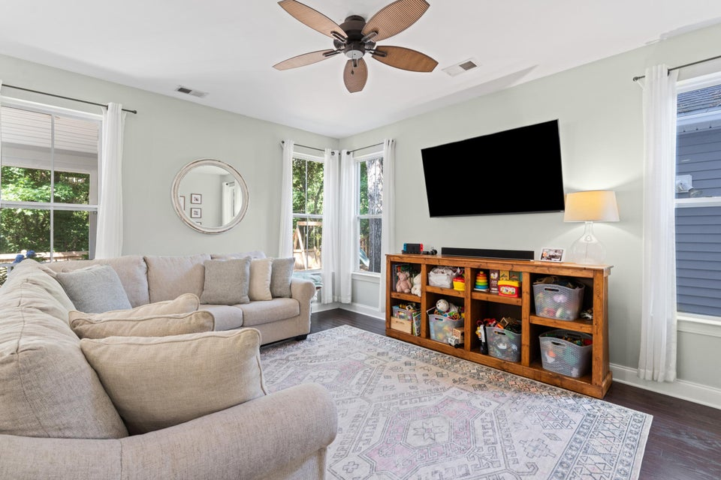
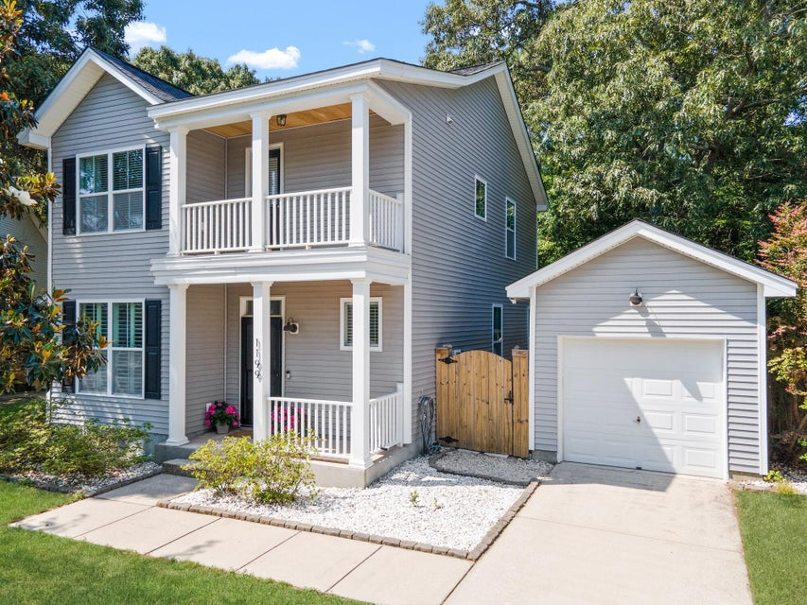
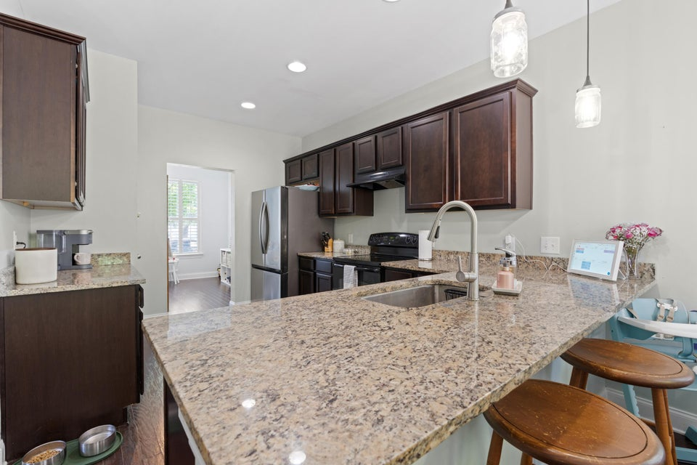
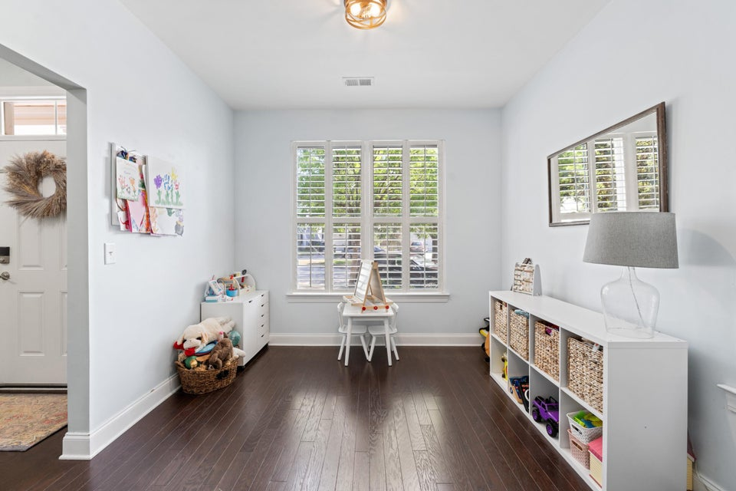
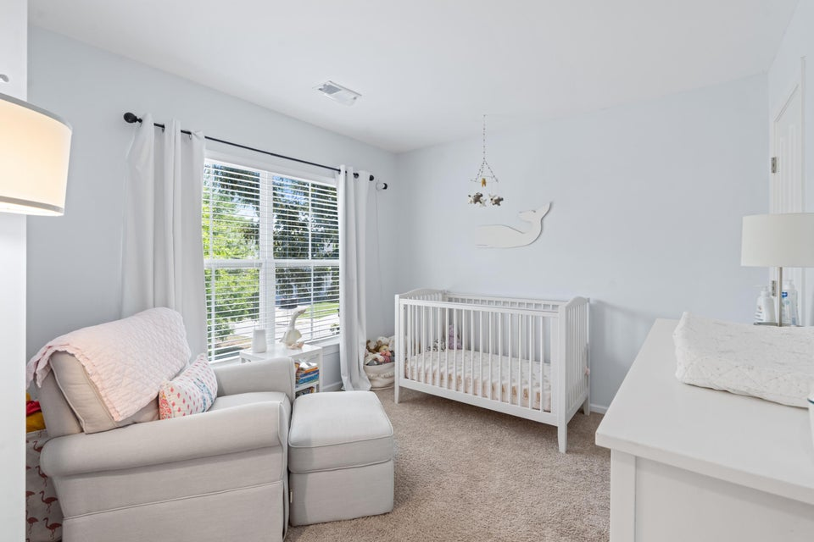
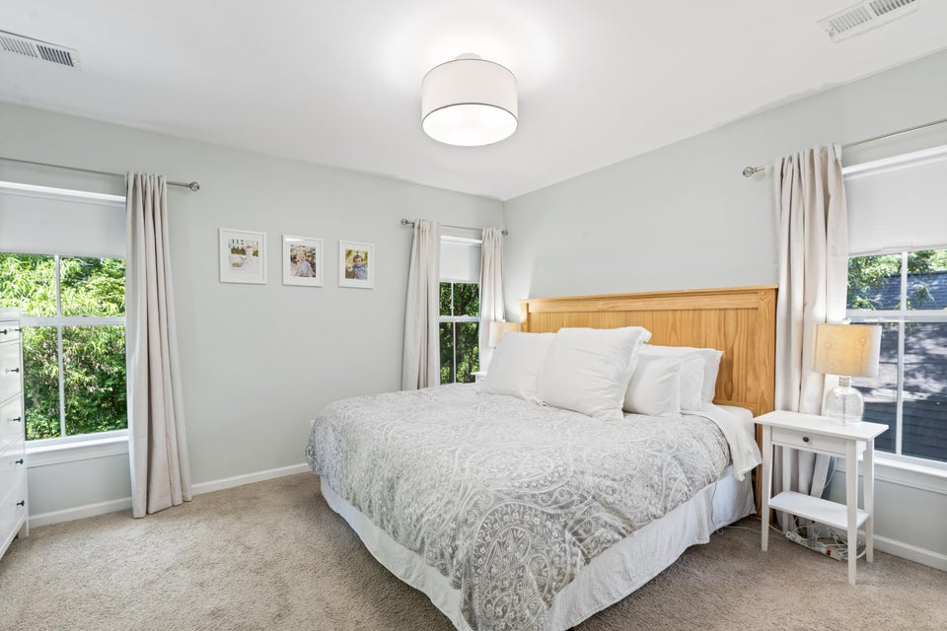
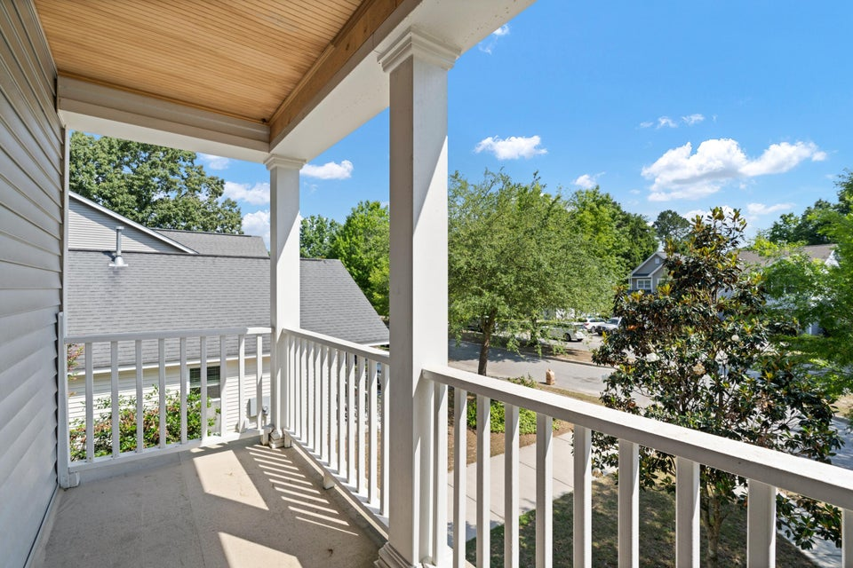
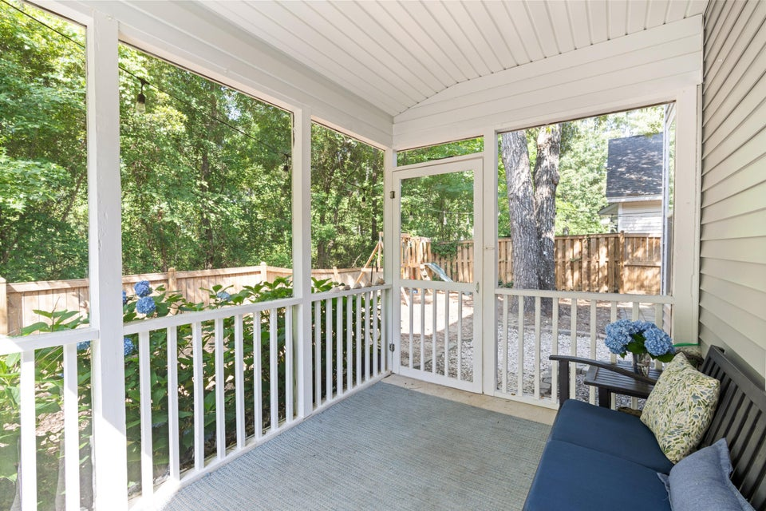
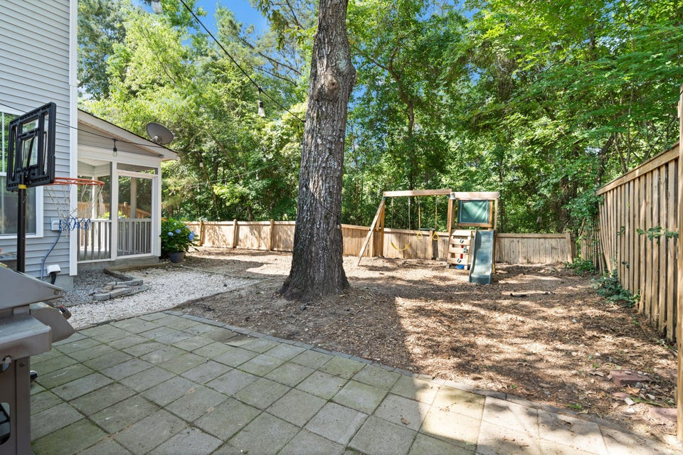

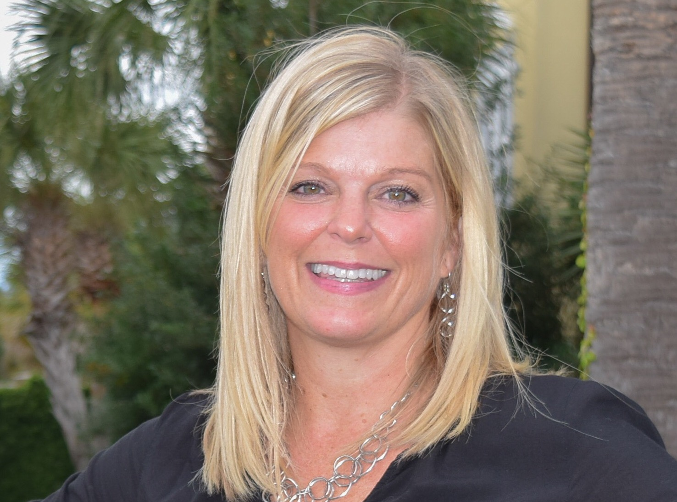

IMPROVED PRICE
OPEN HOUSE SUNDAY 12-3
1199 Landau Lane
Carriage Hill Landing
Mount Pleasant, SC 29466
MLS# 25013595
$617,500
3 Bed | 2½ Bath | 1,624 SF
Sweetgrass Capital offering a 1% rate reduction for qualified buyers, but not available with all loan programs.
Call Jason Rosenthal @ 843-901-0668.
Come check out this lovely, well-maintained single-family home with a detached garage conveniently located near shopping, restaurants and schools. As you step inside, you'll notice an open concept with hardwood floors and a spacious living room with an attached screened in porch off the back. The kitchen boasts quality cabinetry, granite counter tops and stainless-steel appliances. Upstairs you'll find the master suite with its own bathroom, 2 additional bedrooms, another full bath as well as the laundry closet. Don't miss your chance to buy one of that last remaining single-family homes under $625,000 in Mount Pleasant with more than 1500 sqft.
For more info, please contact:
Leah Rust
843-709-9211
leahmrust@gmail.com

