Slide 1
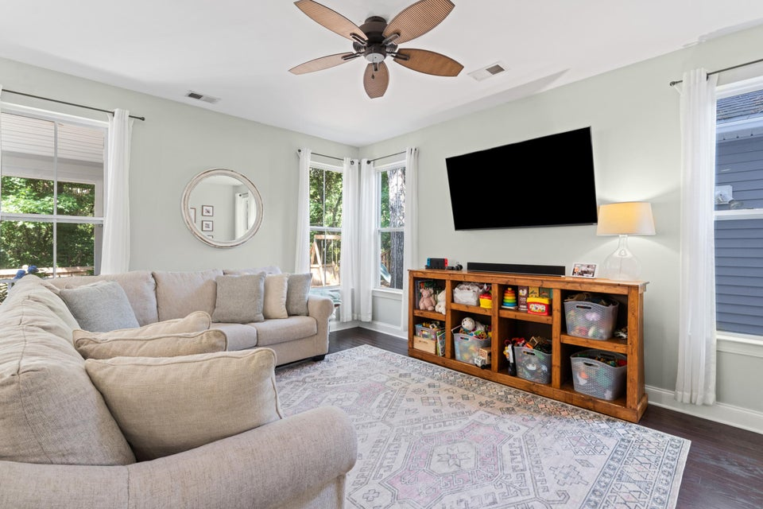
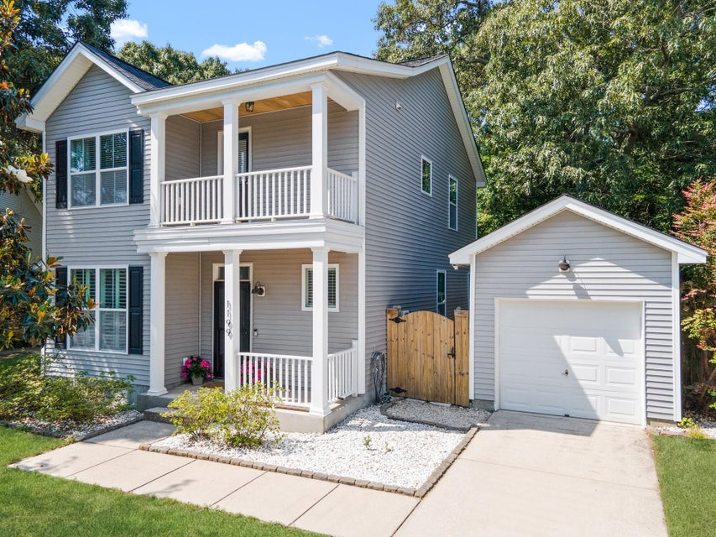
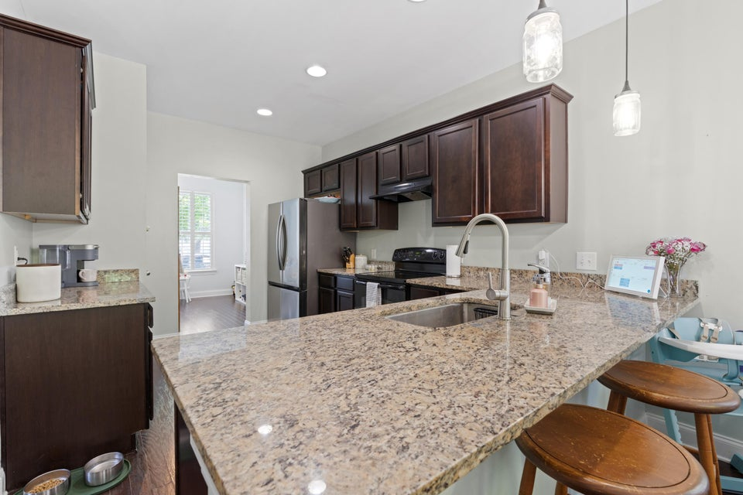
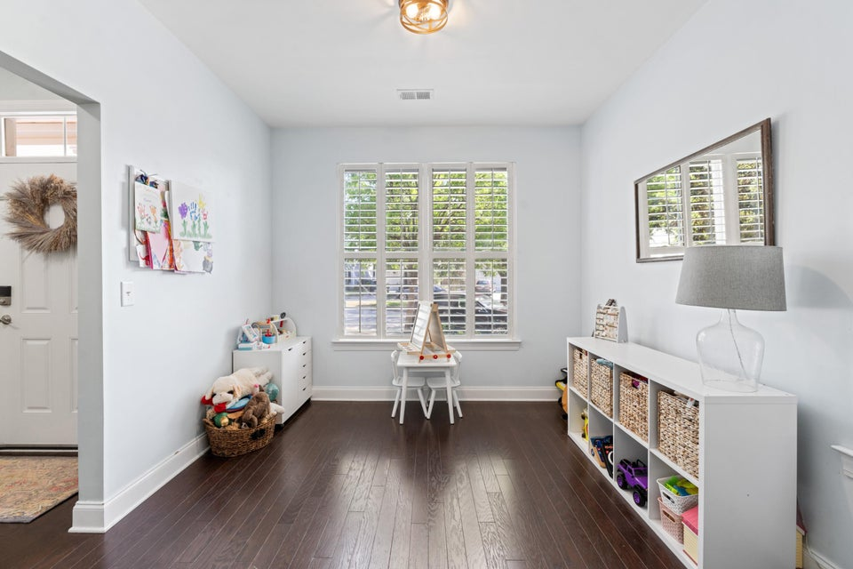
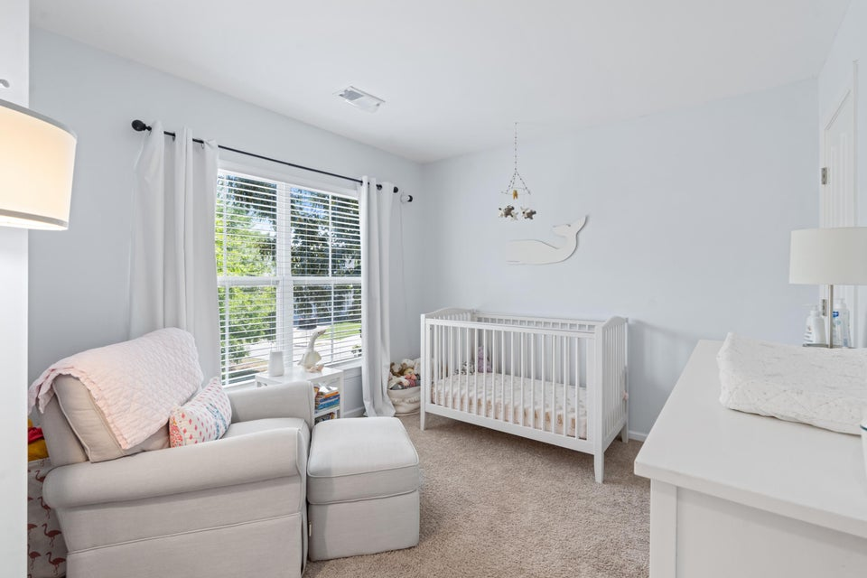
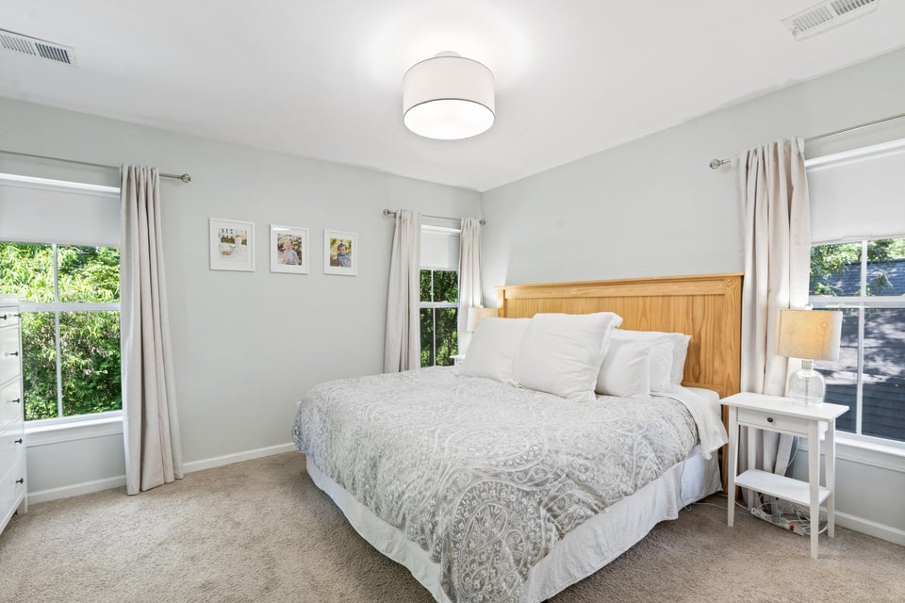
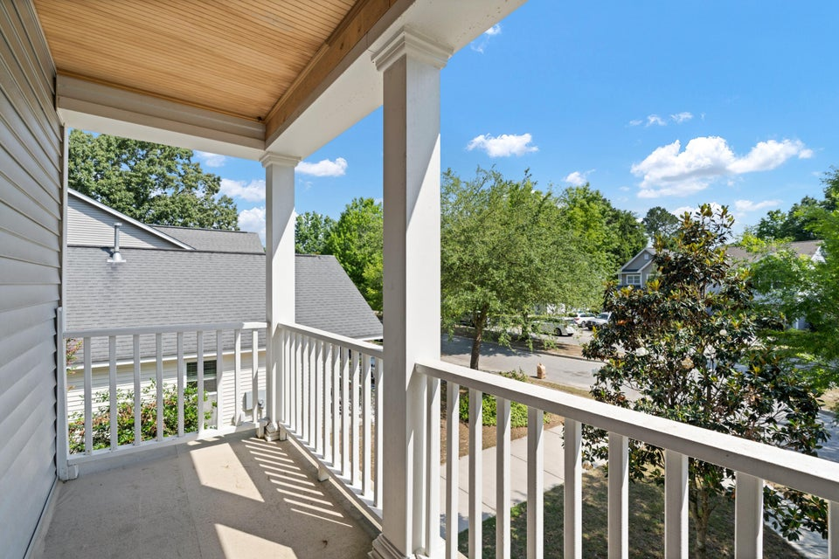
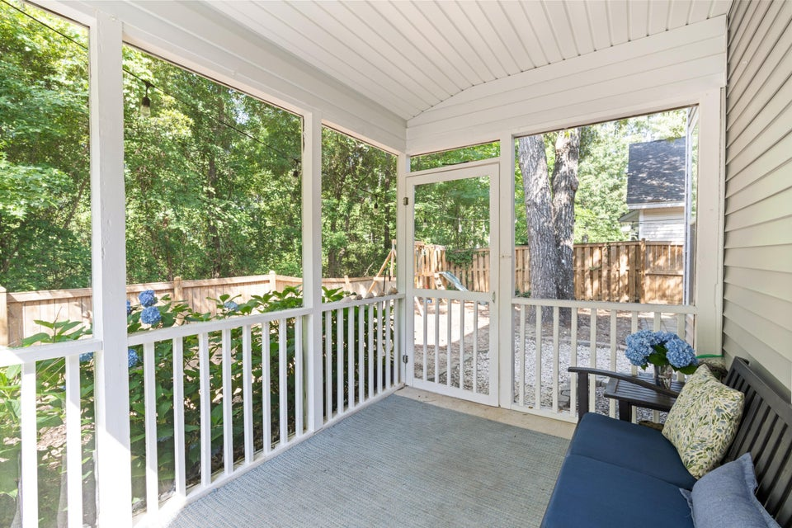
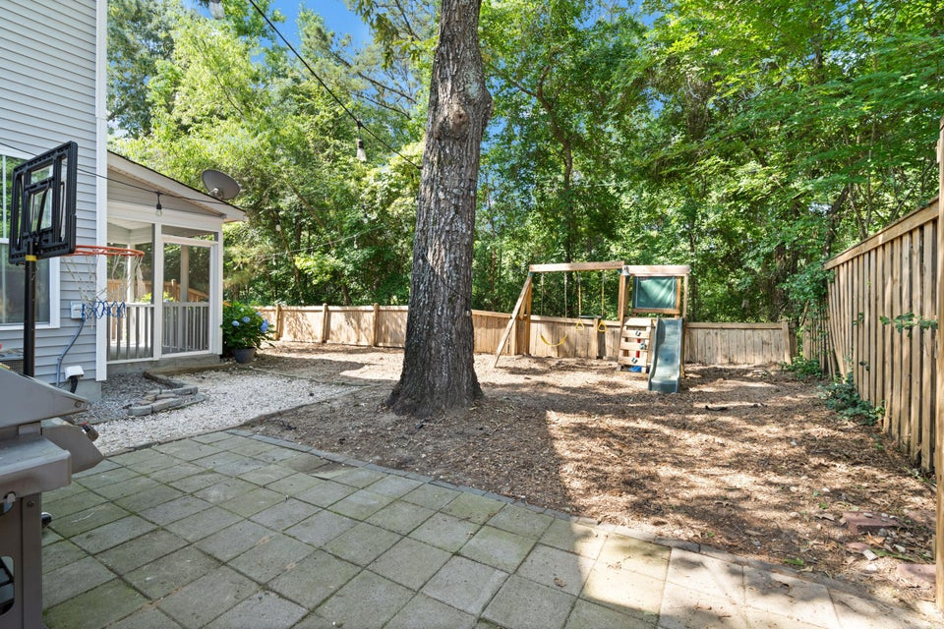

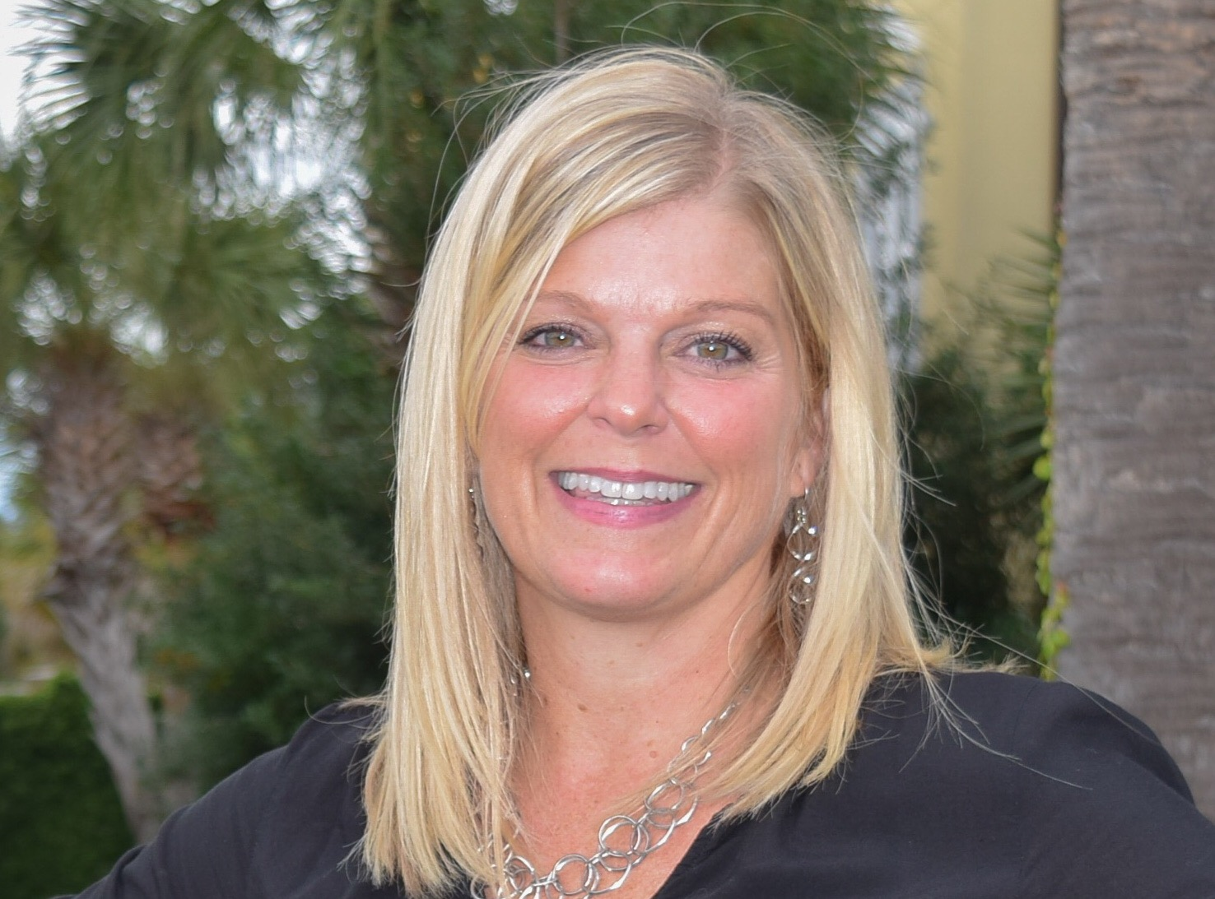

OPEN HOUSE SATURDAY 10:30-1:00
NOW OFFERING AT $610,000
Seller Willing To Pay Co-broke With Appropriate Offer
1199 Landau Lane
Carriage Hill Landing
Mount Pleasant, SC 29466
MLS# 25013595
3 Bed | 2½ Bath | 1,624 SF
Sweetgrass Capital offering a 1% rate reduction for qualified buyers, but not available with all loan programs.
Call Jason Rosenthal @ 843-901-0668.
BUYERS...If this home interests you but you fear you can't afford it with the current interest rate? Give me a call to inquire about a 1% rate reduction with a local lender!! Please....come and view this lovely, well-maintained single-family home with a detached garage conveniently located off Hwy 17. The home is in walking distance to Hometeam BBQ, shopping and other eateries. As you step inside you'll notice an open concept with hardwood floors and a spacious living room with an attached screened in porch off the back. The kitchen boasts quality cabinetry, granite counter tops and stainless-steel appliances. Upstairs you'll find the master suite with its own bathroom, 2 additional bedrooms, another full bath as well as the laundry closet. The home is zoned for Carolina Park Elementary. Some other special features include: some plantation blinds, window treatments, keyless entry, smart thermostat, stainless appliances, updated half bath and a driveway can fit up to 3 cars.
For more info, please contact:
Leah Rust
843-709-9211
leahmrust@gmail.com

