Slide 1
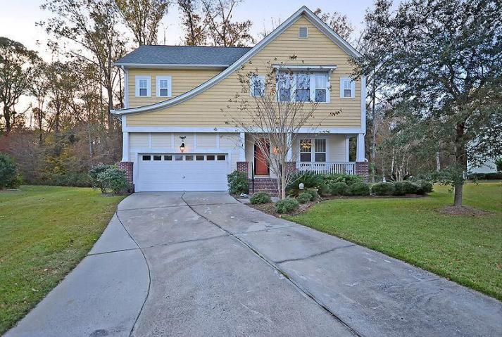
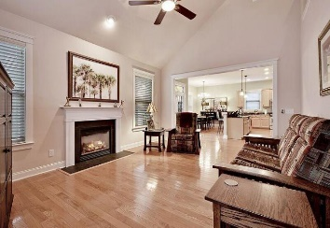
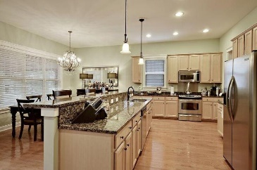
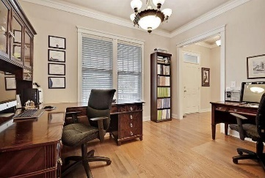
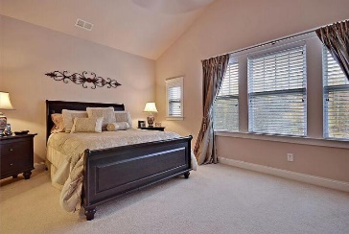
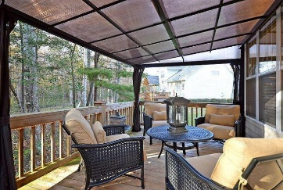


THIS HOME WILL NOT LAST LONG
119 Blackwater Drive
Legend Oaks Plantation
Summerville, SC 29485
MLS# 15030521
$289,900
INTRODUCING 119 BLACKWATER DRIVE.
A Remarkable 2 story Craftsman Style home is situated on a quiet tree-lined street and is surrounded by a large, private landscaped yard. This Incredible, freshly painted home has 4 large bedrooms upstairs including the private and spacious master bedroom suite that offers stylish vaulted ceilings, a huge walk-in closet, and a large master bathroom with selected flooring, double vanities, a valuable soaking tub and a popular stand-alone shower.
The Popular upstairs bonus room can serve as the 4th bedroom, the entire main floor is appointed with selected wood flooring, beautiful crafted molding, 10 ft. smooth ceilings, recessed lighting and offers several large rooms including the exciting family room with a soaring vaulted ceiling and a classic fireplace, the Distinctive Formal Dining Room is perfectly placed and is great for formal dining and entertaining family and friends (currently is used as an office).
The unique Butler Pantry separates the formal dining room from the modern kitchen that is appointed with beautiful 42 inch crafted cabinets, quality granite counter tops, exclusive stainless appliances, the valuable breakfast area is spacious and offers magnificent views of the private wooded area, there is a private French door walk-out to the useful oversized deck and covered deck that is perfect for outside cook-outs, entertaining or relaxing.
This Stunning Home will not last long. Located in the Dorchester District 2 School System. Take advantage of the low interest rates currently available but soon to be increasing. BRING YOUR CHECK BOOK, THE LINE FORMS HERE!
Age, sqft, taxes, hoa fees/dues, schools and acreage are approx. buyer to verify.
Bill Everett, Jr
Broker
843-693-8539
Bill@TheEverettGroup.net
RE/MAX Pro Realty, 9209 University Blvd, Charleston, SC 29406

