Slide 1
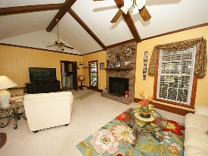
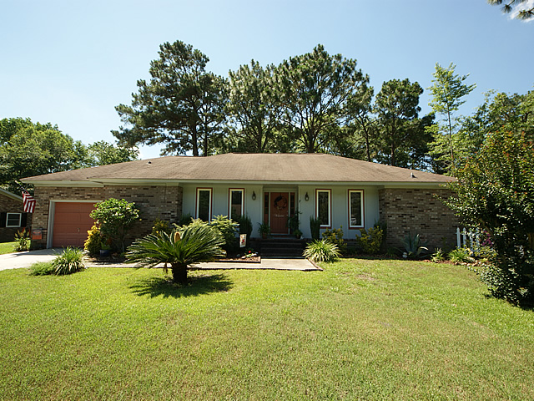
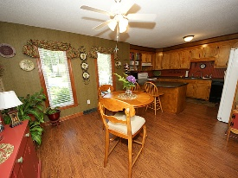
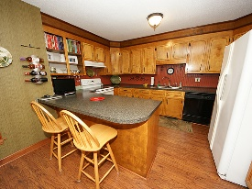
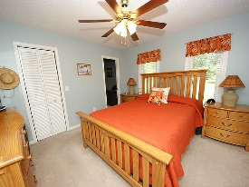
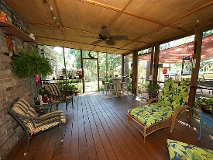
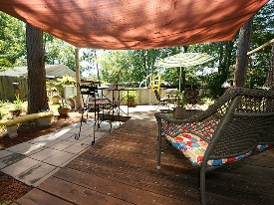
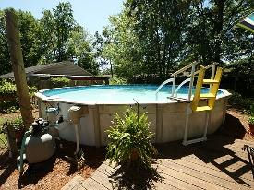


Back Yard Oasis! Just Reduced! Motivated Seller!
119 Canaberry Circle
Corey Woods
Summerville, SC 29483
Open House Canceled!
Under Contract In 3 Days!
MLS# 16015424 | $168,000
3 Bed / 2 Baths
Prettiest home in Corey Woods. Sellers have made upgrades to this 3 bedroom 2 bath home that give you a warm and fuzzy feeling the minute you walk in the front door. Inside is neat, clean with a spacious eat in kitchen featuring wood floors, professional painting and carpet in the bedrooms. Don't miss the garage in the pictures! It is the clean Harley Davidson room perfect as a garage or man cave. Follow the stair case from the laundry room to the bonus area over the garage that the sellers use for storage. The back yard is a relaxing paradise to enjoy the screened porch, deck and pool. This brick home is comfortable and a perfect place to entertain family and friends!
Connie White, Broker
C: 843-532-3356
conniesyouragent@gmail.com
Charleston Homes
111 Spring Hall Dr
Goose Creek, SC 29445

