Slide 1
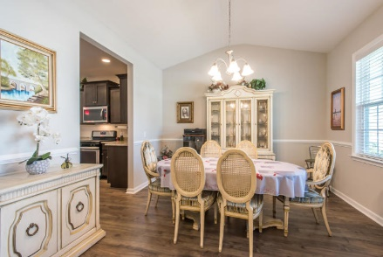
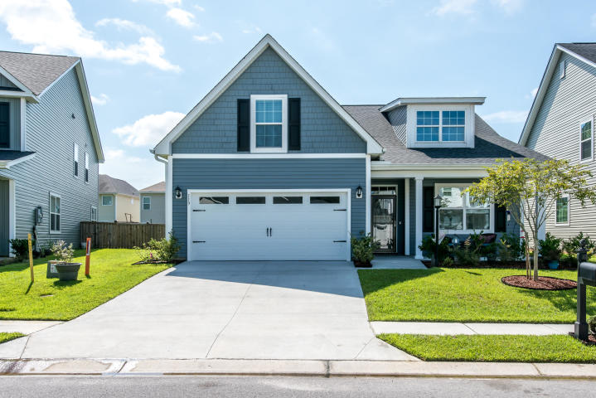
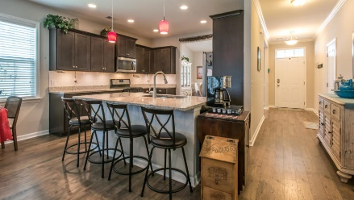
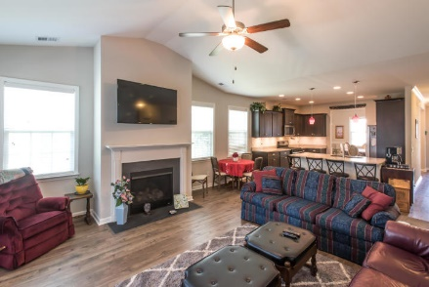
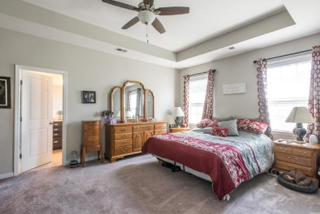
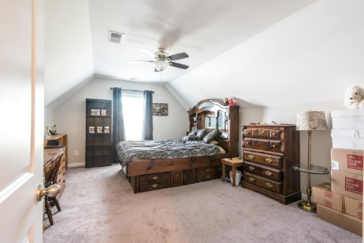
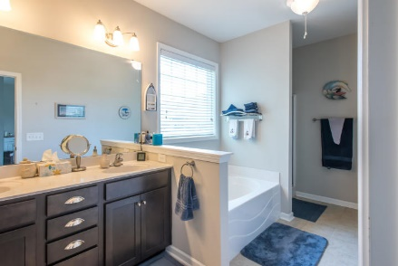
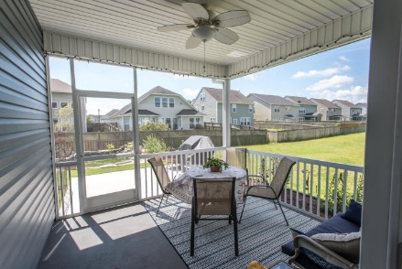
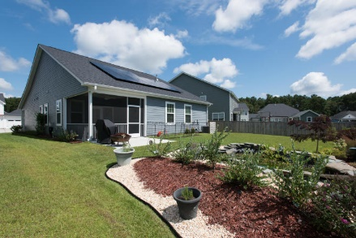


119 Cooks Rest Lane
Moncks Corner · MLS# 19023517 · $282,500
Fabulous In Foxbank...
Sellers Say Sell!
Happy Hour Open House
Friday from 3:30-5:30 ~ Wine Will be Served
Looking for an almost new home without having to wait for the build time? Look no further, this home has LOADS of upgrades!
Spacious kitchen with tons of counter space, under cabinet lighting, 36" staggered cabinets with crown molding, a large island, stainless steel appliances including the upgraded gas range.
ALL rooms have ceiling fans which is a huge plus in this Charleston climate! Beautiful backyard oasis with colorful flowers and a peaceful pond feature. There are solar panels that are paid for in full that will add value as the utility bills are minimal.
Located just 25 miles from Downtown Charleston, Foxbank is a gorgeous community with side walks, a community pool, a huge lawn and open-air pavilion that over looks the beautiful lake that is part of the neighborhood. There is also a new dog park and fitness center right there in the community!
Carey Nikonchuk
(843) 276-1701 M
cnikonchuk@gmail.com
www.palmettoproperty.net

