Slide 1
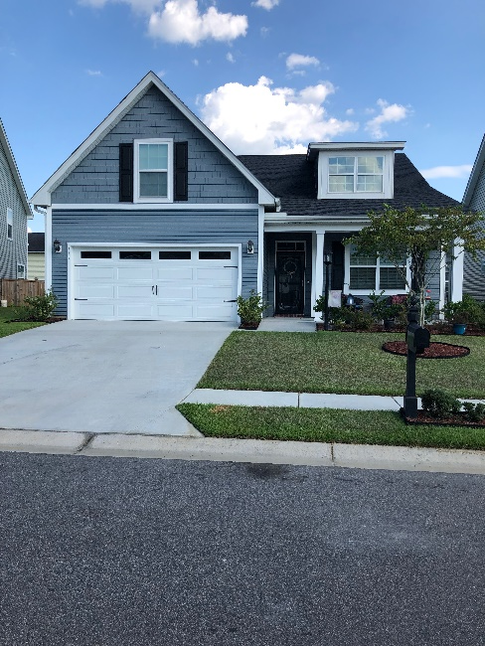
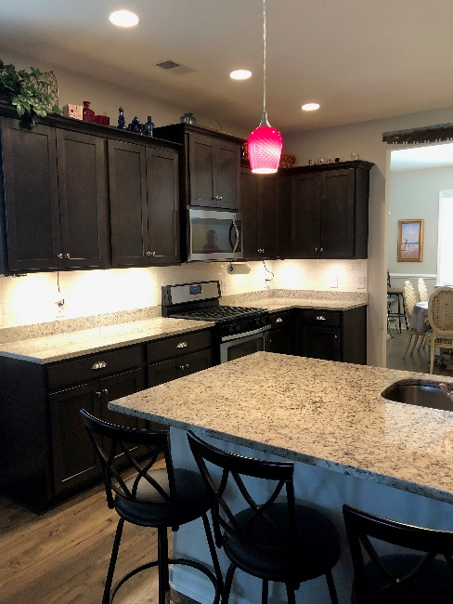
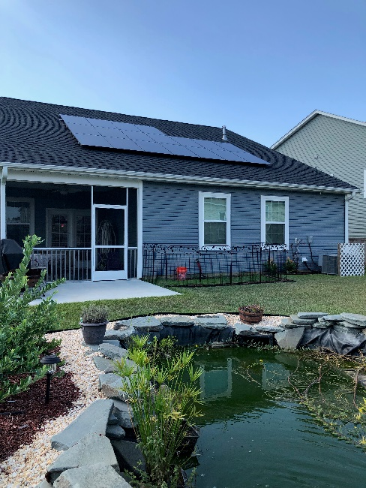


119 Cooks Rest Lane
Foxbank Plantation
Moncks Corner
Pocket Listing Coming Soon!
Built in 2017, there are 4 bedrooms (3 bedrooms downstairs) and the 4th bedroom is a frog.
Gorgeous granite counter tops, gas range, full front porch and screened in porch.
There are newly added and paid for solar panels and the yard is fully fenced with a privacy fence.
The master bedroom is huge and can fit a king sized bed, two dressers and a sitting area!
The home will be listed at $300K but the sellers would love an offer prior to listing on MLS. If you have any questions or buyers in mind please let me know.
Carey Nikonchuk
(843) 276-1701 M
cnikonchuk@gmail.com
www.palmettoproperty.net

