Slide 1
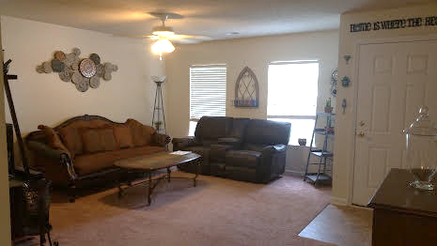
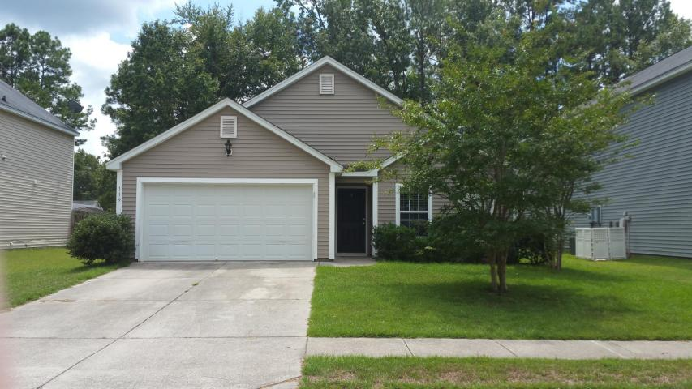
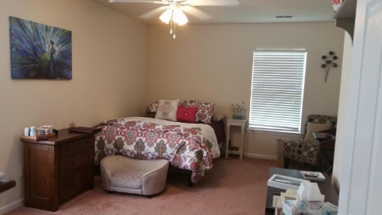
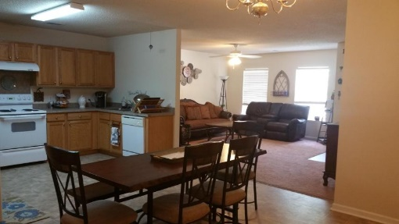
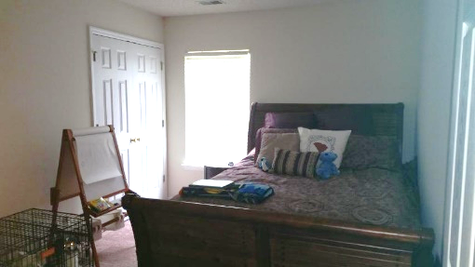
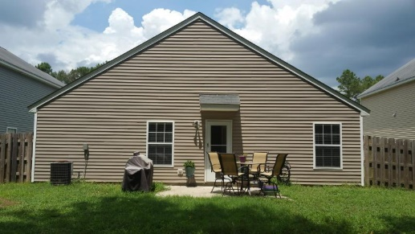
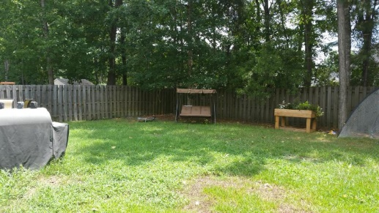
100% USDA Financing
119 Ducane St
Brookwood ~ Summerville ~ MLS# 16021207 ~ $157,000
Adorable one story home located in Brookwood Subdivision. Living room offers plenty of wall space and lots of natural light. Large kitchen and eat in kitchen area great of entertaining. Light and bright master bedroom with walk in closet. Master bathroom offer plenty of counter top and under counter storage. Both secondary bedrooms are great size with walk in closet. Backyard is fully fenced in with a 6ft privacy fence and large patio. Don't miss out on this great buy!
Jennifer Laffey-Foster, MRP
Real Estate Agent
Miler Properties
Office: 843-821-1111
Cell: 843-708-1582
jlfoster86@gmail.com
www.milerproperties.com

