Slide 1
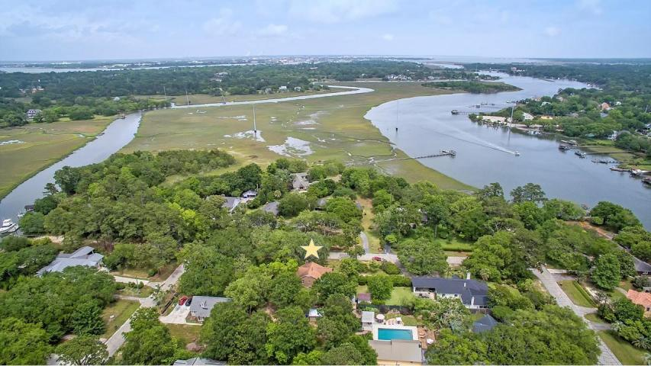
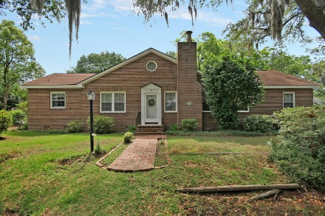
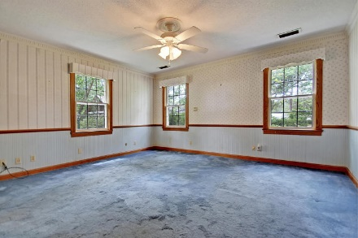
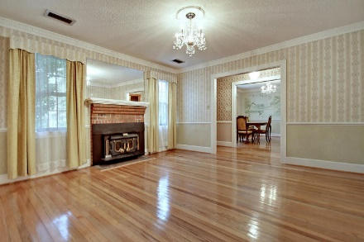
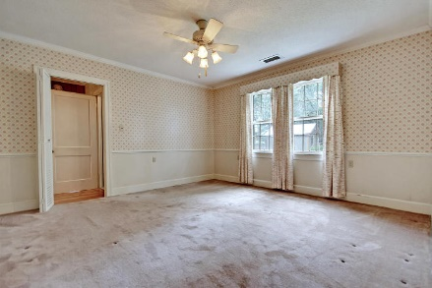
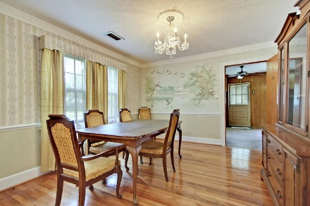
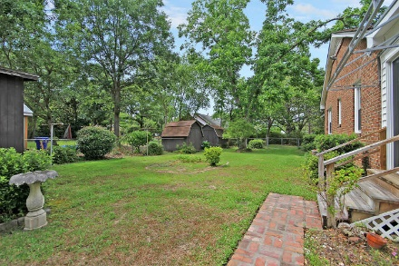
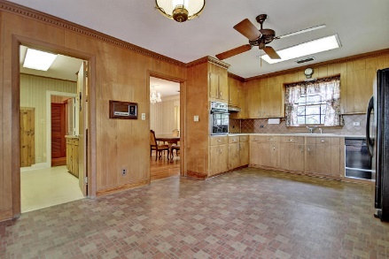
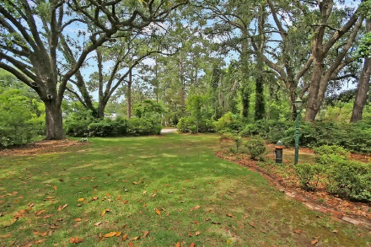
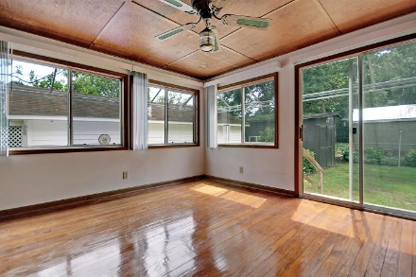
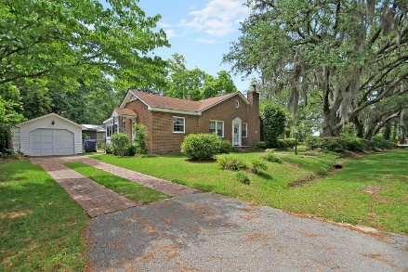
Price Reduced!
GREAT LOW PRICE! GREAT WATER VIEWS!
119 E Edgewater Drive
Edgewater Park ~ Charleston, SC 29407 ~ MLS# 18014832 ~ $524,900
Situated on a unique, tropical island in West Ashley, living in the Edgewater community makes everyday feel like a vacation while keeping you close and convenient to everything in the low country. Driving across the scenic coastal causeway to the home you'll find six grand oaks draped with Spanish moss and two pecan trees on this gorgeous, park-like half acre that boasts Intercostal waterway views from the home. The large lot boasts two driveways, oyster shell tabby stoops and a roomy, 2000+sqft brick, ranch home with plenty of attic storage. No HOA fee means lower cost living, less time worrying about restrictions and more time fishing, crabbing and getting out on the water from the community boat landing. This home, lot and location are a combination that you don't want to miss out on!
Additional features include:
Large, corner lot
Ideal location close to boat landing
"Old Charleston Brick" driveway
Absolutely incredible location
Book your showing today!
Chip Walsh chip@mattoneillteam.com 843-822-4663

