Slide 1
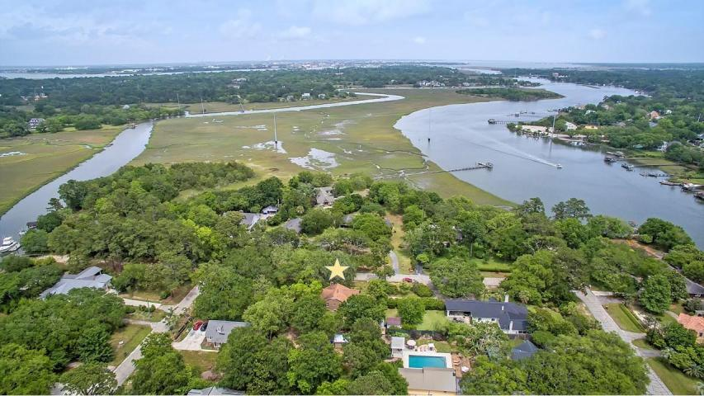
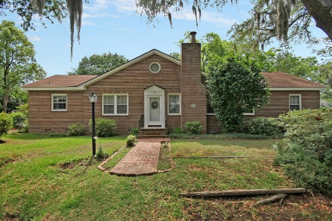
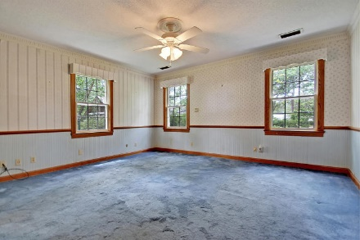
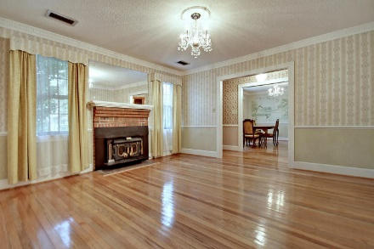
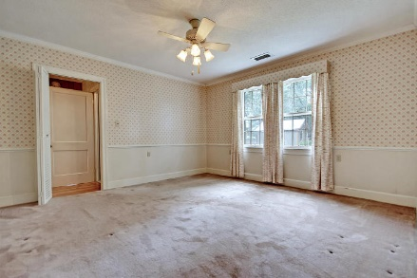
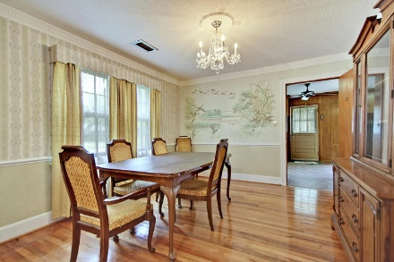
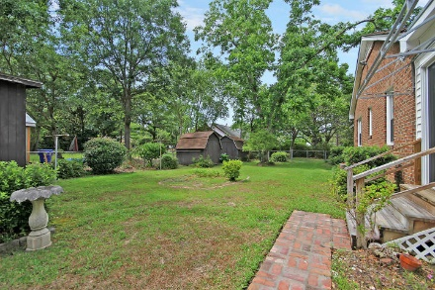
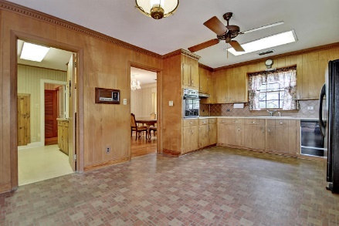
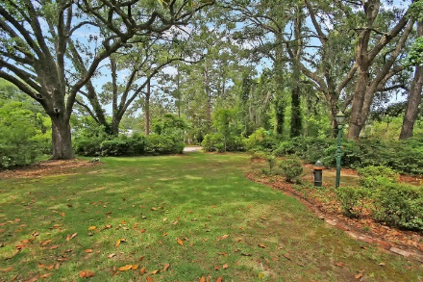
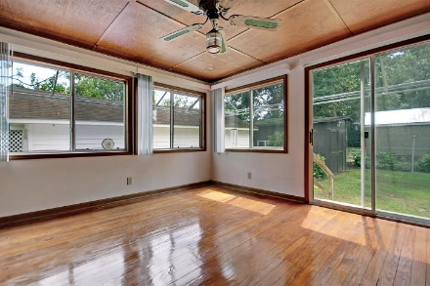
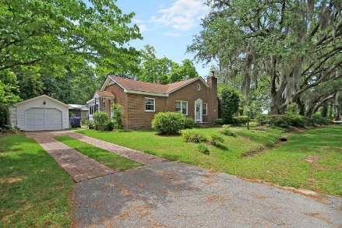
AMAZING LOW PRICE ON THE WATER!
30 SECONDS FROM THE BOAT LAUNCH!!
Price Reduced!
119 E Edgewater Drive
Edgewater Park ~ Charleston, SC 29407 ~ MLS# 18014832 ~ $459,900
Situated on a unique, tropical island in West Ashley, living in the Edgewater community makes everyday feel like a vacation while keeping you close and convenient to everything in the low country. Driving across the scenic coastal causeway to the home you'll find six grand oaks draped with Spanish moss and two pecan trees on this gorgeous, park-like HALF ACRE that boasts water views from the home. The large lot opens up the property to endless building possibilities. Coberg Creek and the Wappoo Cut can be viewed from three side of the interior of the home. Just picture relaxing in your home and watching the large ships traveling through the bend of the Elliott's Cut. Boat lovers will also love that the slip is right across the street! Don't miss out!
Additional features include:
The large, corner lot boasts two driveways, oyster shell tabby stoops and a roomy, 2000+sqft brick, ranch home with plenty of attic storage
No HOA fee means lower cost living, less time worrying about restrictions and more time fishing, crabbing and getting out on the water from the community boat landing
Ideal location close to boat landing
"Old Charleston Brick" driveway
Absolutely incredible location
Book your showing today!
Chip Walsh chip@mattoneillteam.com 843-822-4663

