Slide 1
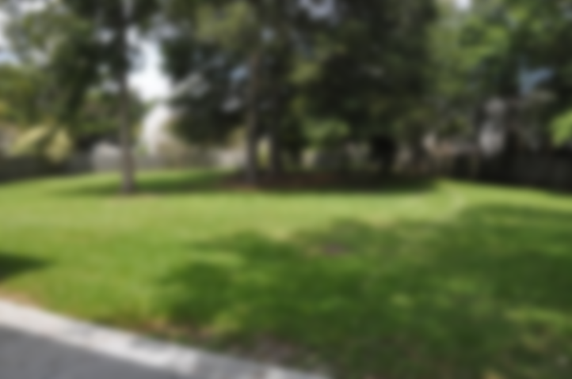
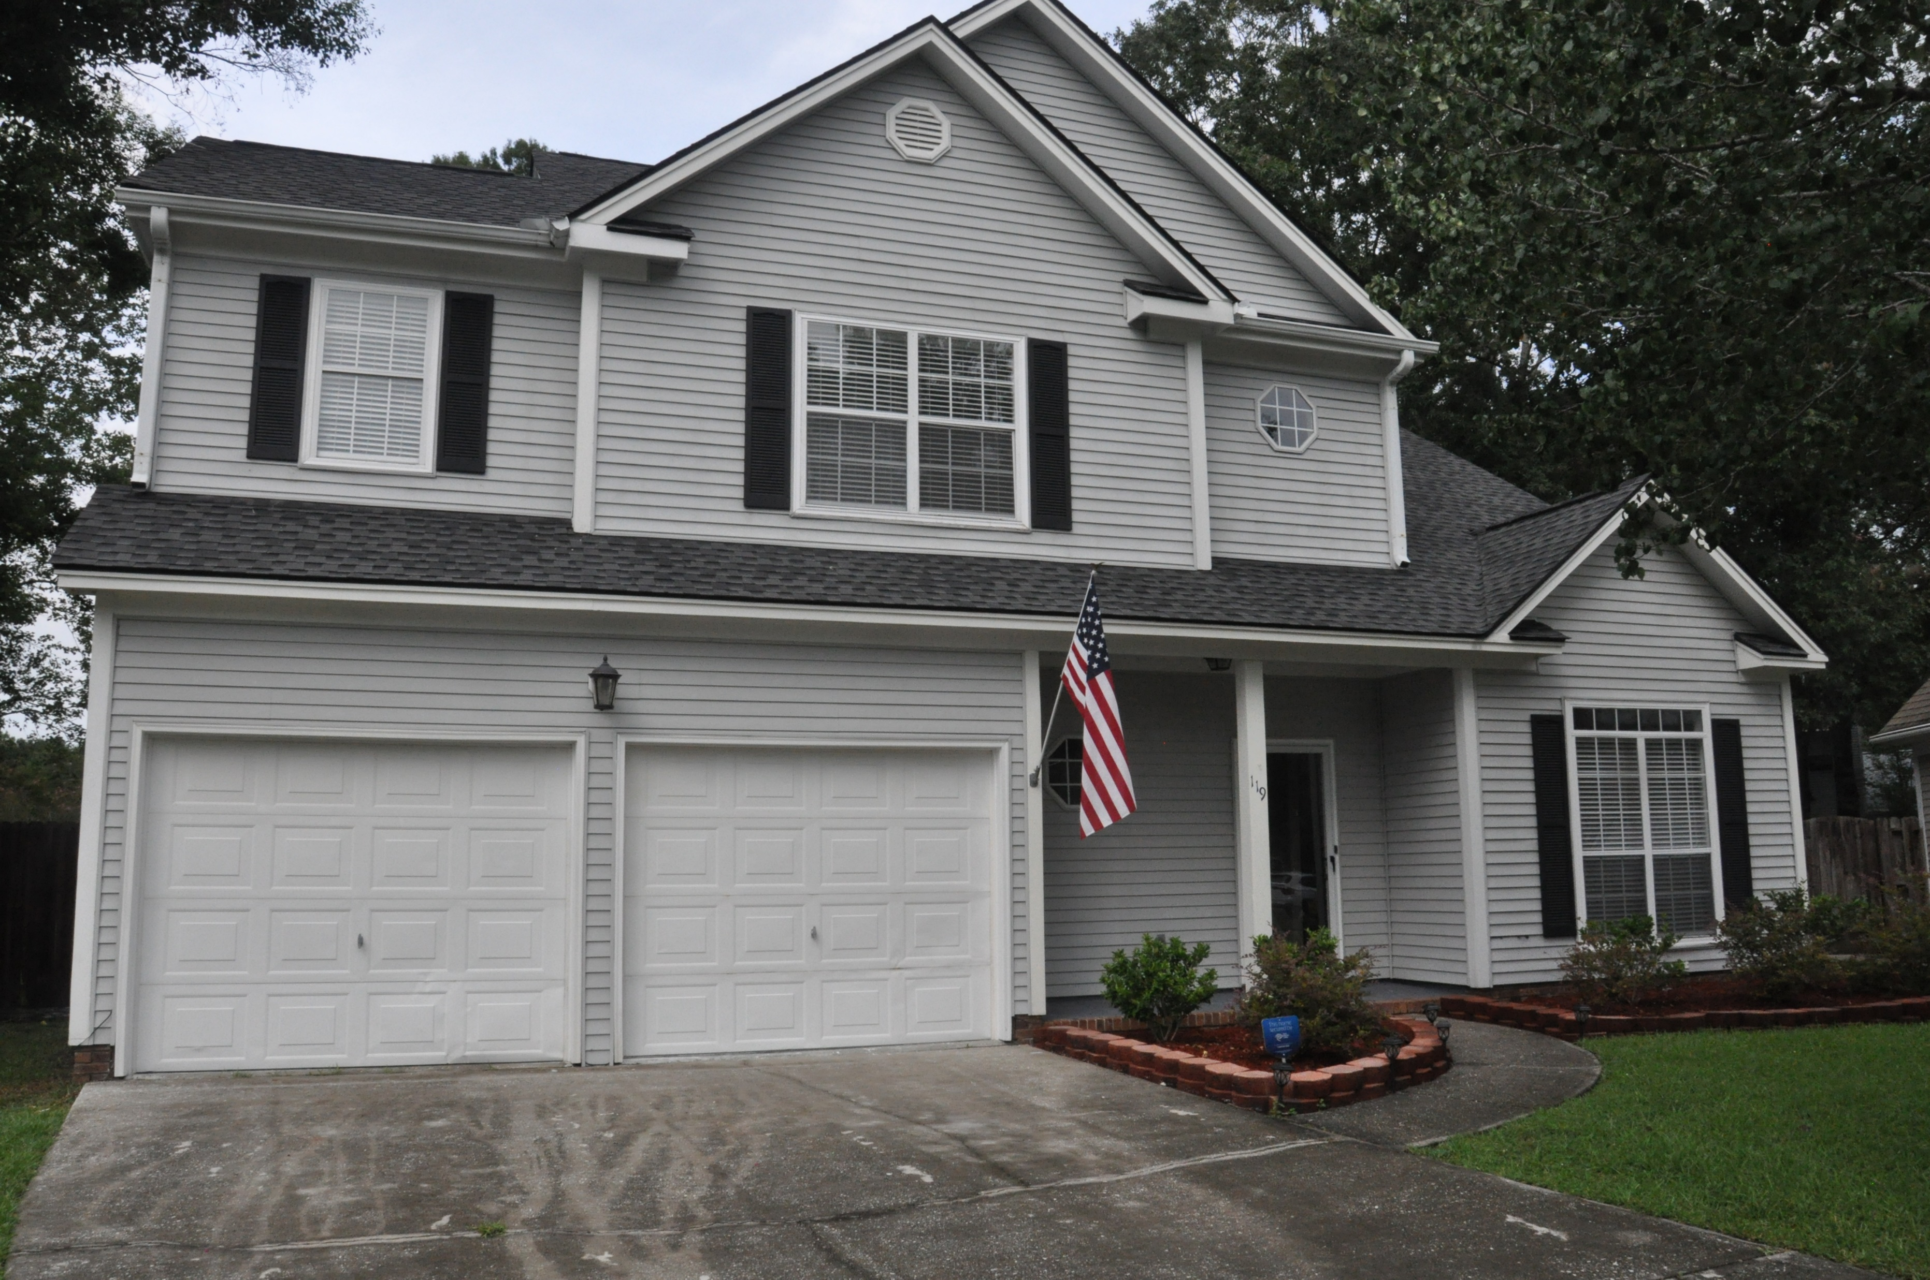
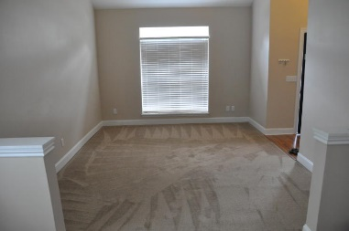
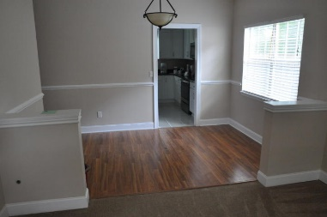
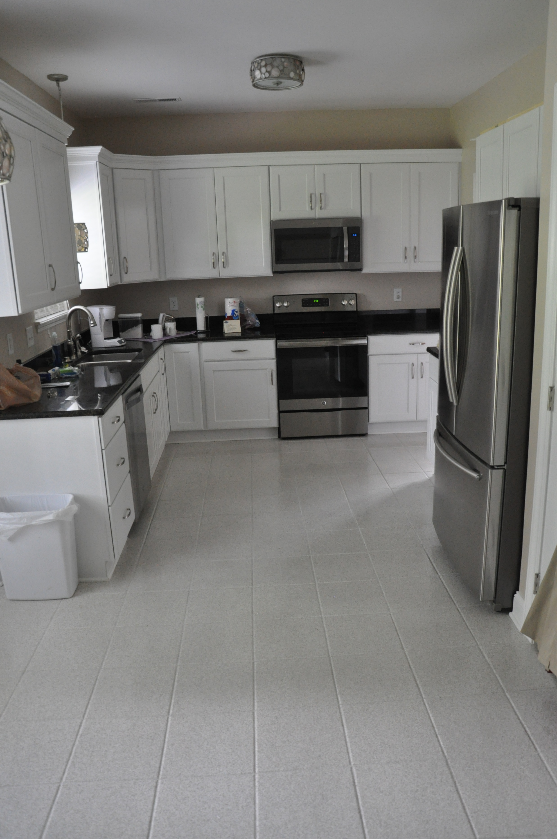
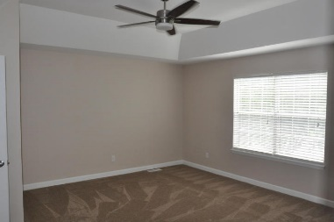
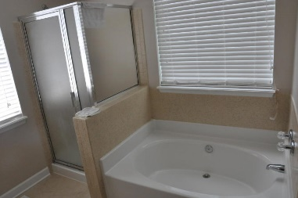
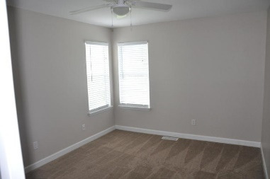
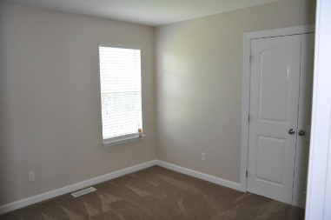
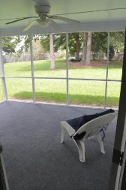
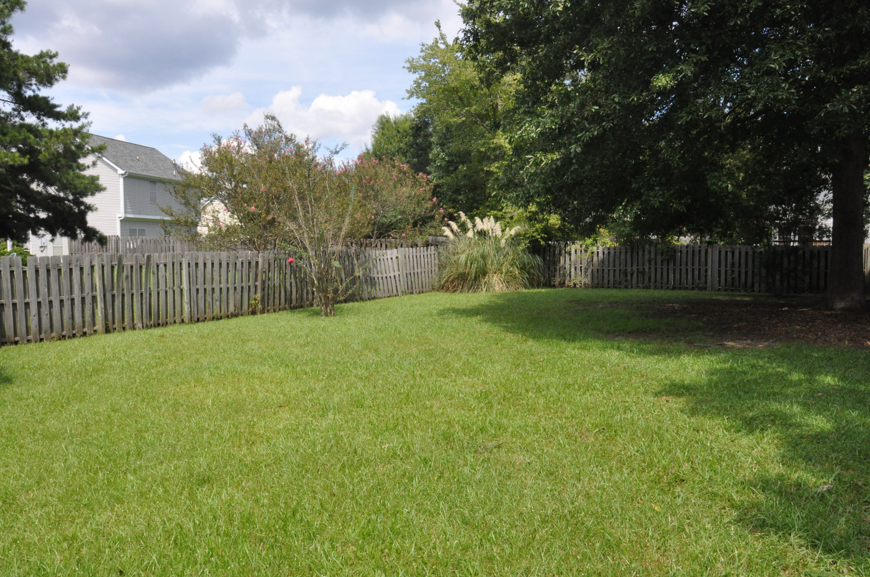
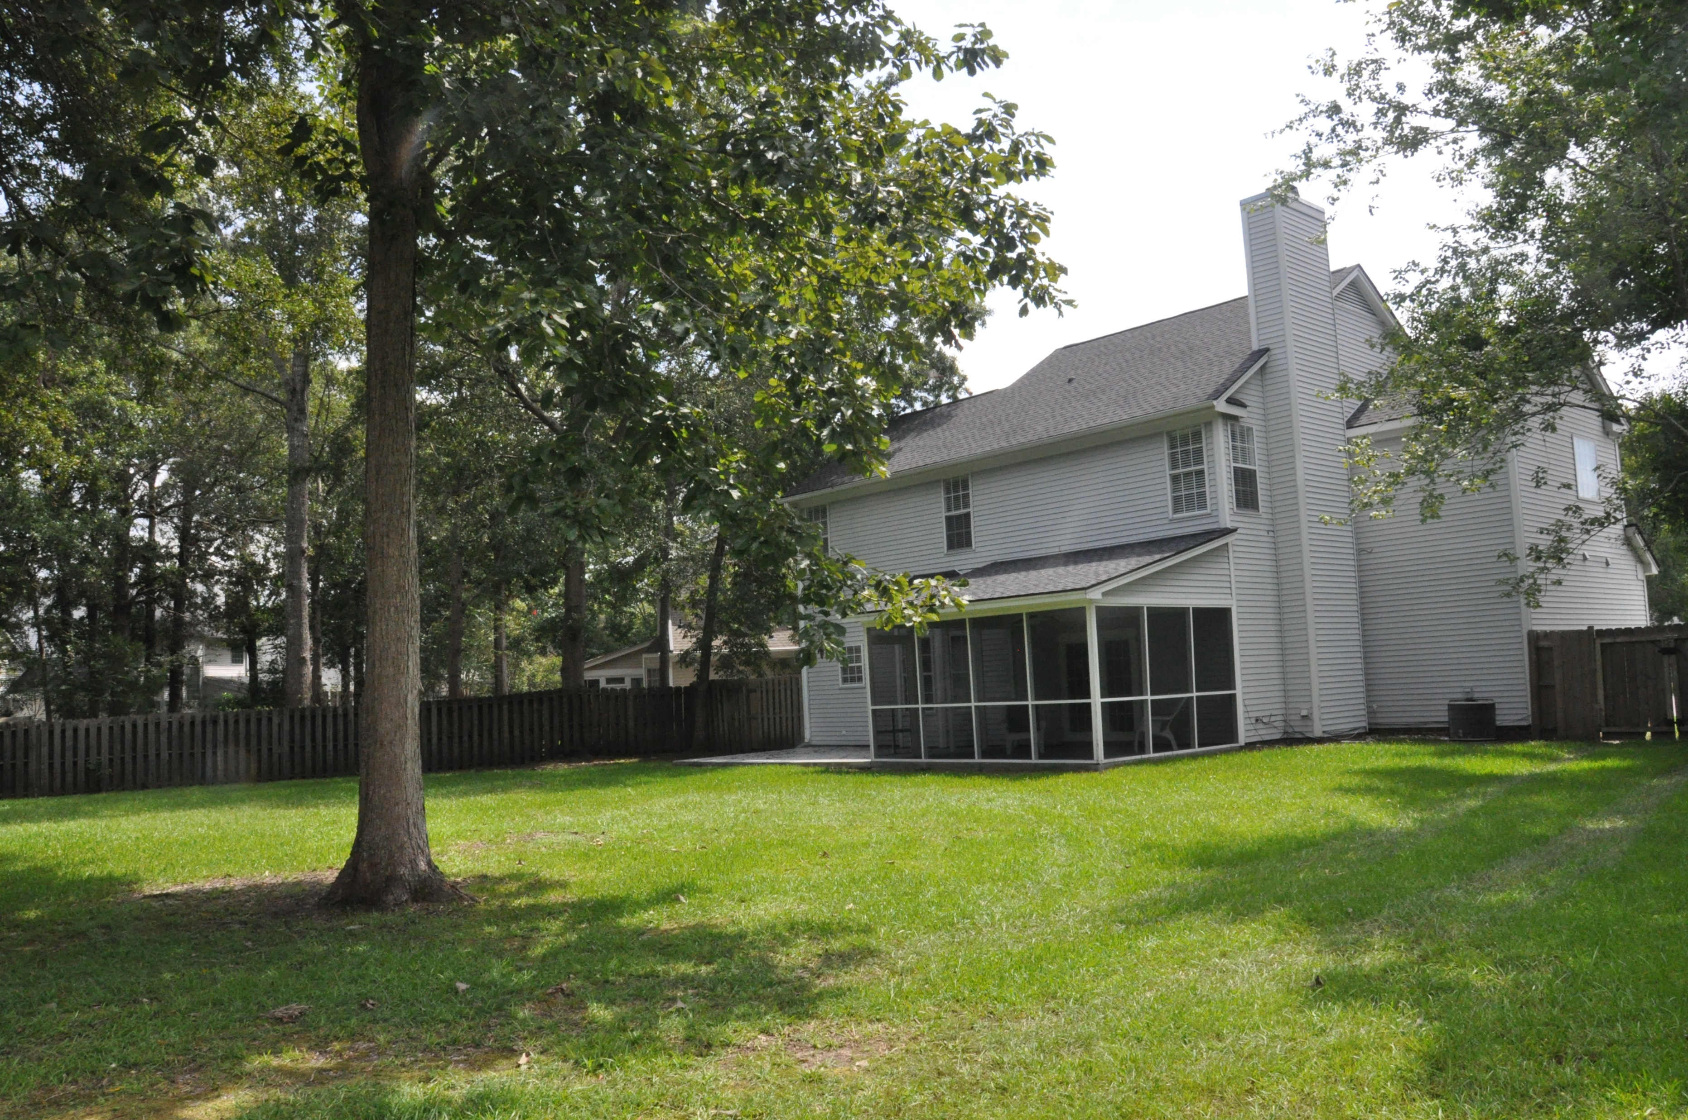

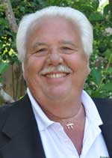
119 Hartley Hall Court Brandymill · Summerville · MLS# 17023926 · $264,900
Beautiful Renovated Home in Brandymill
MUST SEE!! 4BR WITH 2.5 BATHS in Brandymill on cul-de-sac with almost 1/2 AC of land!; Dorch II Schools! major remodeling includes new kitchen cabinets, appliances, new carpet w/memory foam pad, new interior doors, new fiberglass entry door with storm door, new French doors to refurbished screen porch; new double vanity in master with resurfaced tub/shower w/5 yr warranty; all new light fixtures including ceiling fans; new window blinds throughout home; freshly painted with smooth ceilings throughout (including garage); new plumbing fixtures including toilet, vanity, mirror and tile; staircase as new handrail and balusters. All remodeling and renovations are very tastefully done. This home is a must to see. Move in ready. Wont Last Long!!
David Salzinger
(843) 580-4185
charlestonsells@gmail.com
AgentOwned Premiere Group | 1800 Trolley Rd | Summerville, SC 29485

