Slide 1
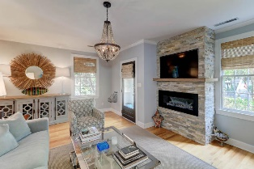
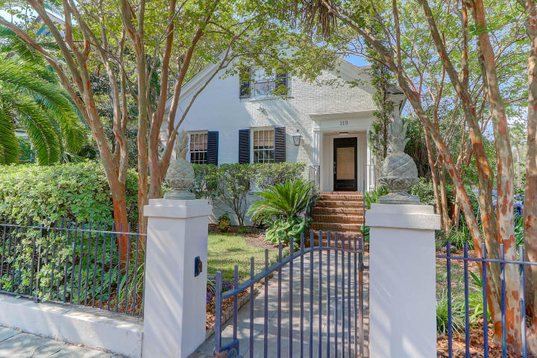
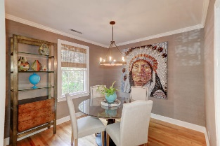
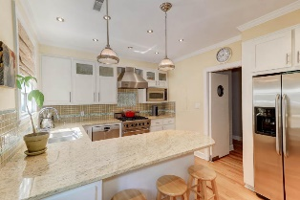
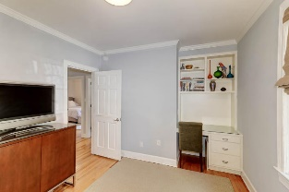
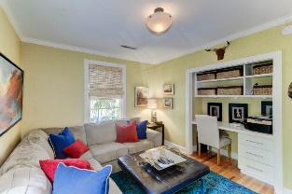
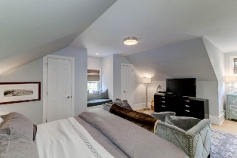
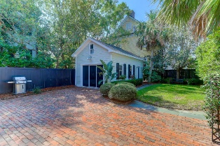
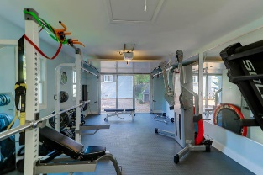
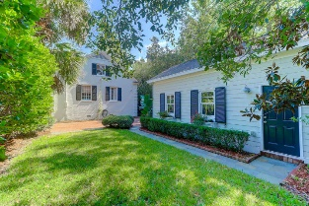


119 Rutledge Avenue
Harleston Village | Charleston, SC 29401
MLS# 19027823 | $1,295,000
Picture Perfect Home
Picture-perfect home with all the right spaces in all the right places. On a lovely corner lot across from Cannon Park and a short walk to the Charleston medical district. The quality of this home's construction was engineered by George Youngblood's high standards as the house sits on 29 forty-five foot pilings. Fully renovated kitchen features granite counters, custom white cabinets and stainless steel appliances including a Viking range. Lovely living room with an exquisite, modern, linear fireplace and opens to a gracious dining room. The main level also includes three full bedrooms and a full bath that could easily be converted to a first floor master suite. A powder room and laundry area complete the first floor. Two bedrooms upstairs, include a large gracious master suite and an additional large bedroom with an updated hall bath and a work or study area. The landscaped grounds include a newer garage with plenty of storage up above, completely fenced landscaped grounds and electric gated parking area on a nice sized lot. This is the perfect home to enjoy everything Charleston has to offer!
Kate M. Dolan
(843) 566-3512
katemdolan@carolinaone.com
www.katemdolan.com
Carolina One Real Estate
49 Broad St
Charleston, SC 29401-3001

