Slide 1
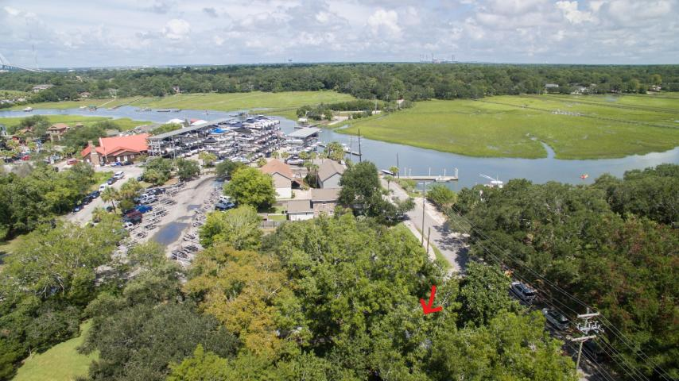
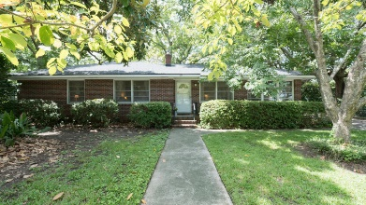
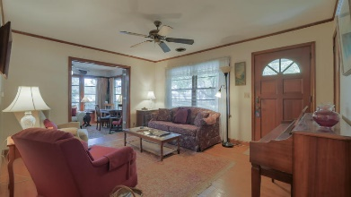
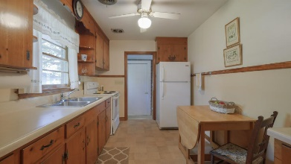
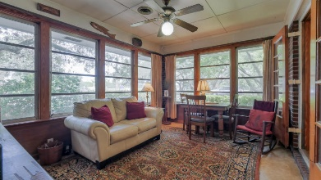
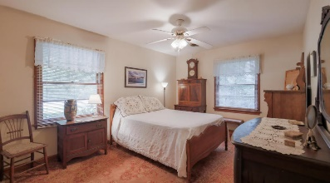
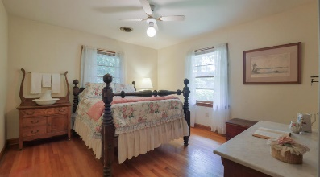
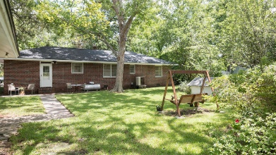
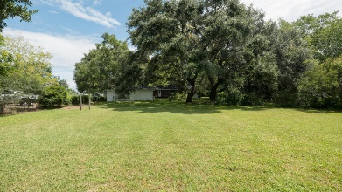


119 Simmons Street
Old Village :: Mount Pleasant :: MLS# 17023012 :: $1,300,000
The Only Deep Water Home On Daniel Island
Open House This Weekend!
Saturday 10:30-2 & Sunday 1:30-4
Special opportunity to purchase 2 street to street lots totaling over half an acre in the Shem Creek/Old Village area of Mount Pleasant, located in the Urban Overlay District. Live in the existing brick ranch home with wonderful views of Shem Creek or build a new home to enhance the views. The oak trees and other hardwoods on this lot are spectacular and reminiscent of what we love most about Charleston. Just across the street from the Shem Creek public boat landing and a 3 minute walk to dining and shopping, this prime location can't be beat! The existing 3 bedroom, 1 full/1 half bath home is in great condition and has a new roof. There is also a garage on the property that could easily be converted to a guest house. Great schools and only 10 minutes to downtown Charleston!
Helen Hudson
843-991-9875
helen.hudson@carolinaone.com
Carolina One Real Estate
2713 Highway 17 North
Mt. Pleasant, SC 29466

