Slide 1
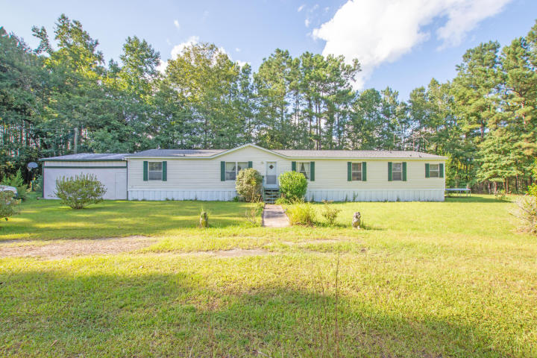
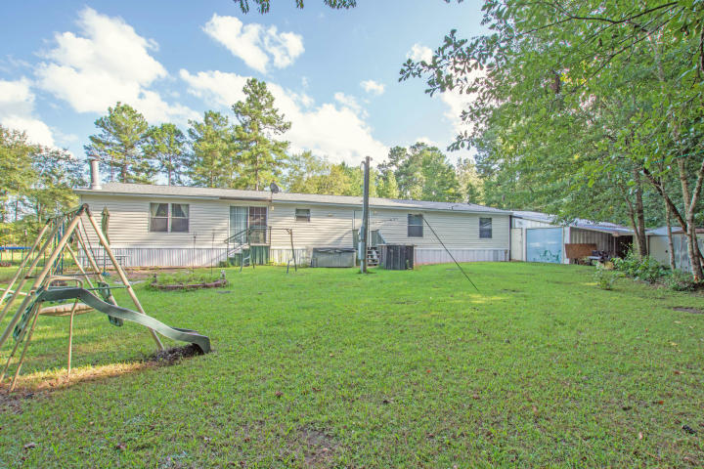
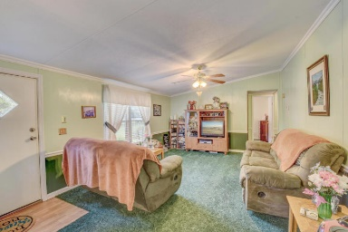
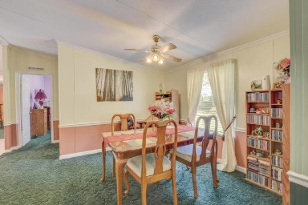
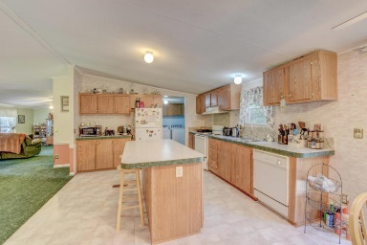
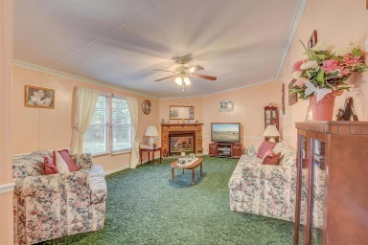
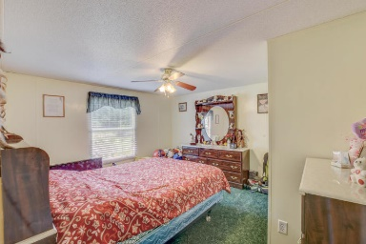
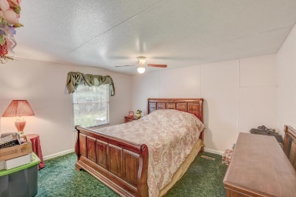
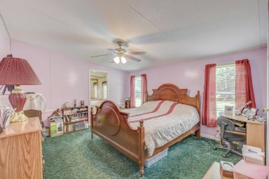
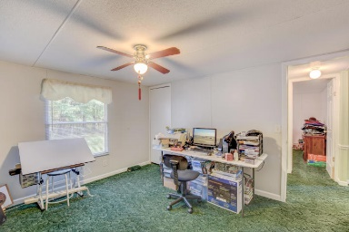


119 Stanfield Lane
Cottageville, SC 29435 ~ MLS# 18023488 ~ $164,950
$500 Visa Card At Closing
If Ratified By 05/01/19
Welcome to your country paradise! Deer and turkey abound out here! Close to town and school but secluded. This very well kept 4 bedroom 2 bath manufactured home has custom steel garage, workshop, aquarium room, green house, fruit trees, and grape arbor. Over 2000 sqft to spread out in this home! Approx 4 acres is still wooded. 30 yr shingled roof with transferable warranty. AC is 2 years young. New well pump.
Christopher McCormick
Office - 843-871-9133
Cell - 843-224-3204
cj.mccormick@agentownedrealty.com
AgentOwned Premiere Group
1800 Trolley Rd
Summerville, SC 29485

