Slide 1

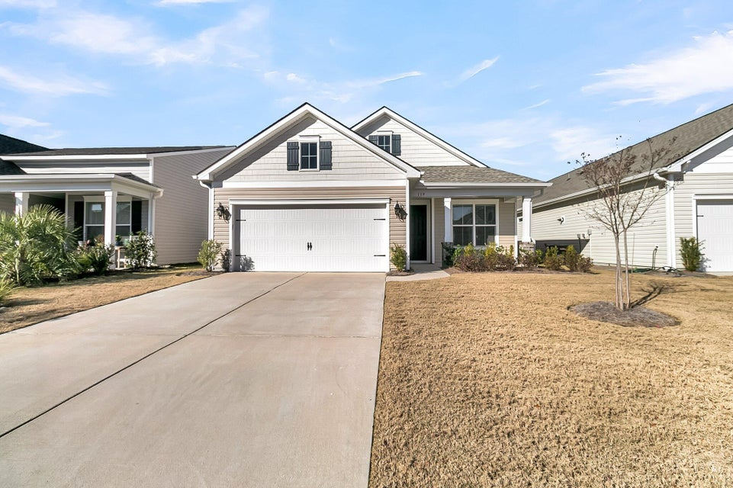
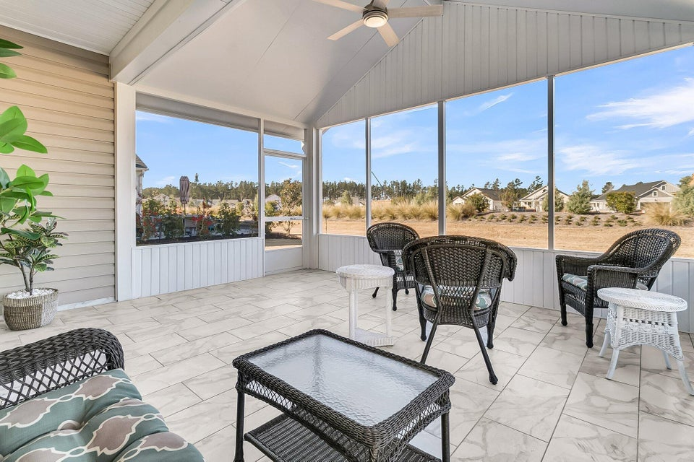
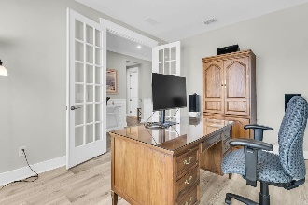
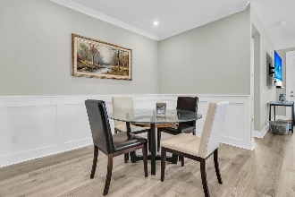
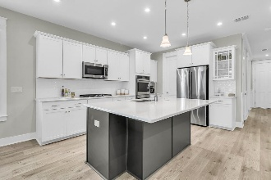
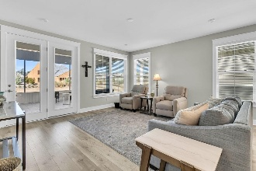
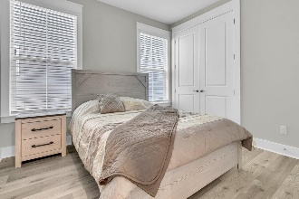

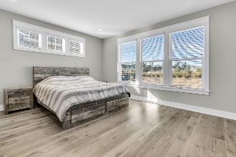
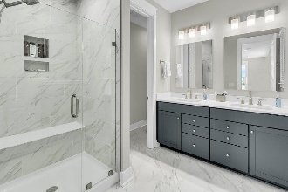
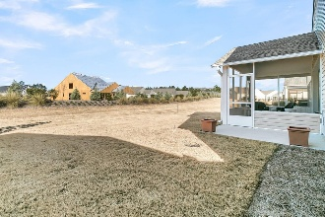
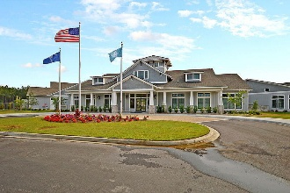
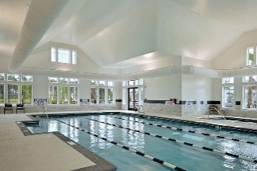
Upgraded Four Seasons Home with Vaulted Screen Porch
Debbie Cromer
ABR, RSPS, REALTOR, CRS
(843) 437-6342
debbie@debbiecromer.com
www.debbiecromer.com
119 Leeward Landing
Cane Bay Plantation | Summerville, SC 29486 | MLS# 25000611 | $500,000
Welcome to this beautifully designed one-story, 2-bedroom, 2-bathroom home w/ an office. This home offers the perfect blend of comfort, luxury, & functionality. Step inside to discover laminate floors throughout the living areas and bedrooms that create a seamless flow. The gourmet kitchen is a chef's delight, featuring quartz countertops, double wall ovens, a gas cooktop, built in microwave and ample counter & storage space—perfect for hosting & everyday cooking. The spacious primary suite is a private retreat, boasting two walk-in closets & luxury master bathroom w/ an oversized shower & modern finishes. The second bedroom is equally inviting, & the second bathroom features a luxury frameless glass shower. Additional highlights include a large laundry room w/ a convenient laundry sink & a two-car garage for all your storage & parking needs. Step outside to relax or entertain on the expansive screened porch w/ a vaulted ceiling...ideal for enjoying the serene surroundings year-round.
This community offers an incredible array of amenities to enhance your lifestyle, including scenic walking & biking trails, serene lake access, tennis courts, a clubhouse, a fitness center, & both indoor and outdoor pools. It's the perfect place to stay active, socialize w/ neighbors, & enjoy everything this sought-after 55+ community has to offer. Don't miss your chance to make this stunning home yours and start living the lifestyle you've been dreaming of.
TAKE A VIRTUAL TOUR
Century 21 Properties Plus | 1090 Park West Blvd; Ste 103 | Mount Pleasant, SC 29466

