Slide 1
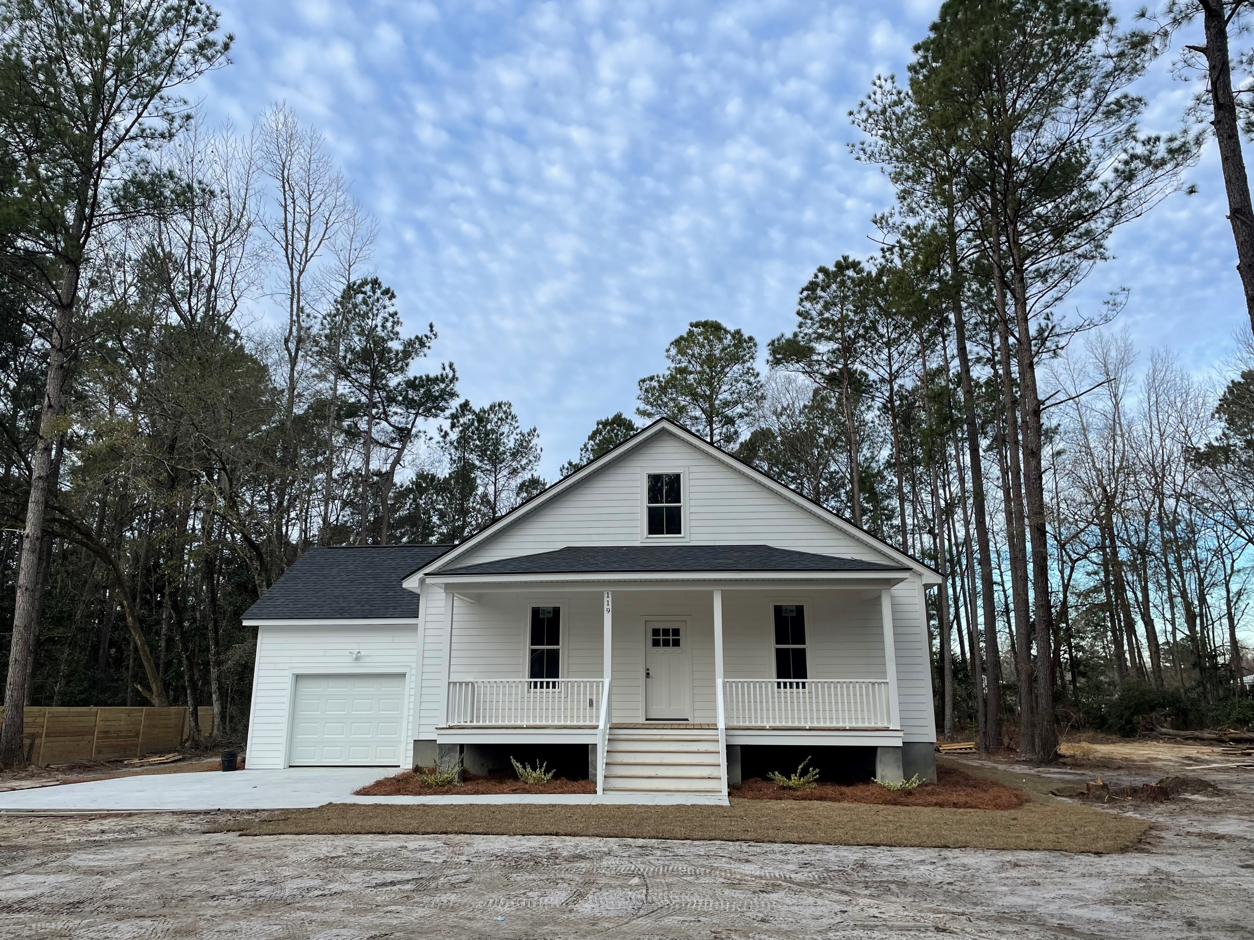
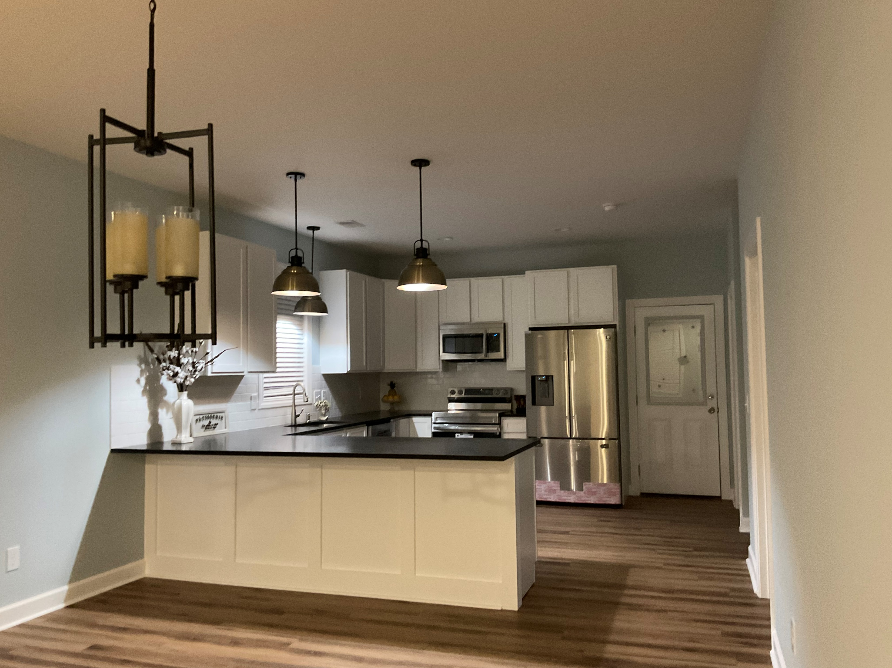
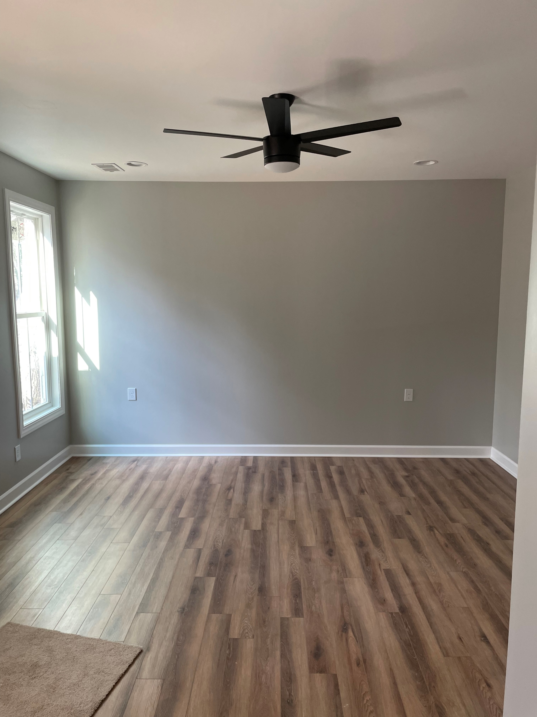
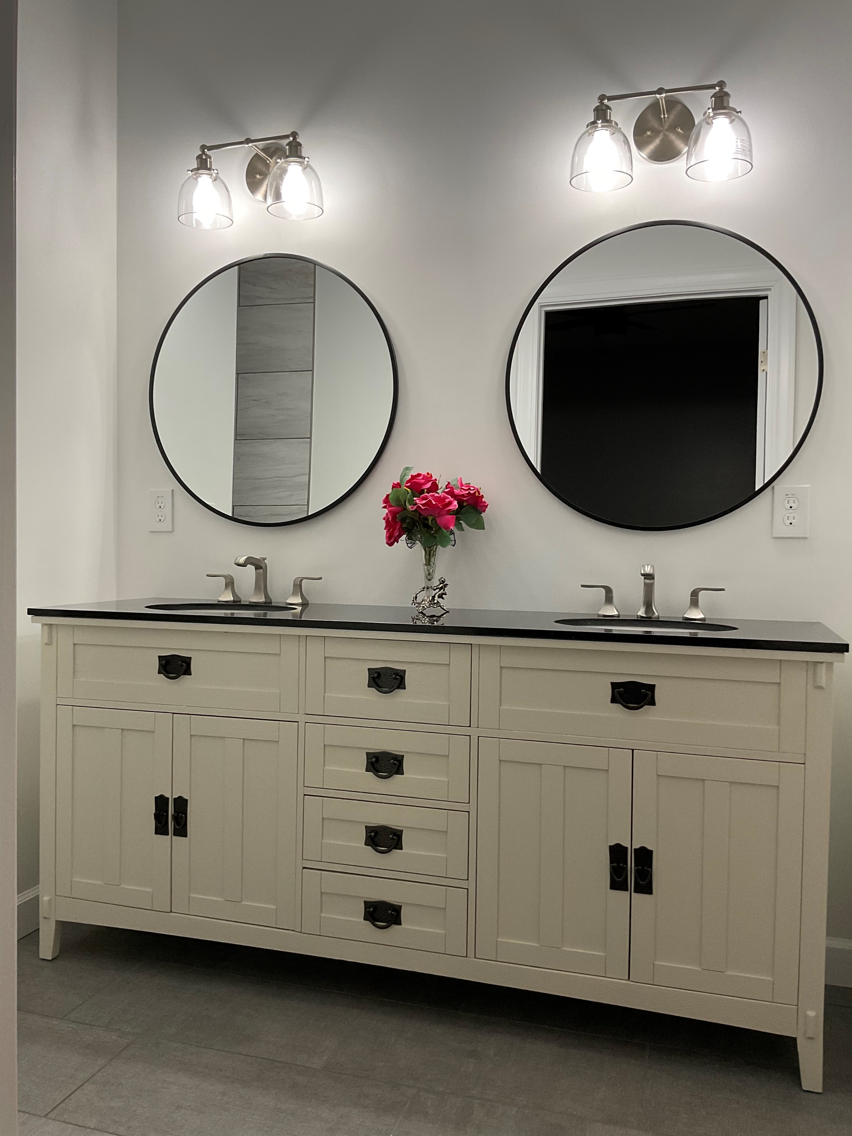
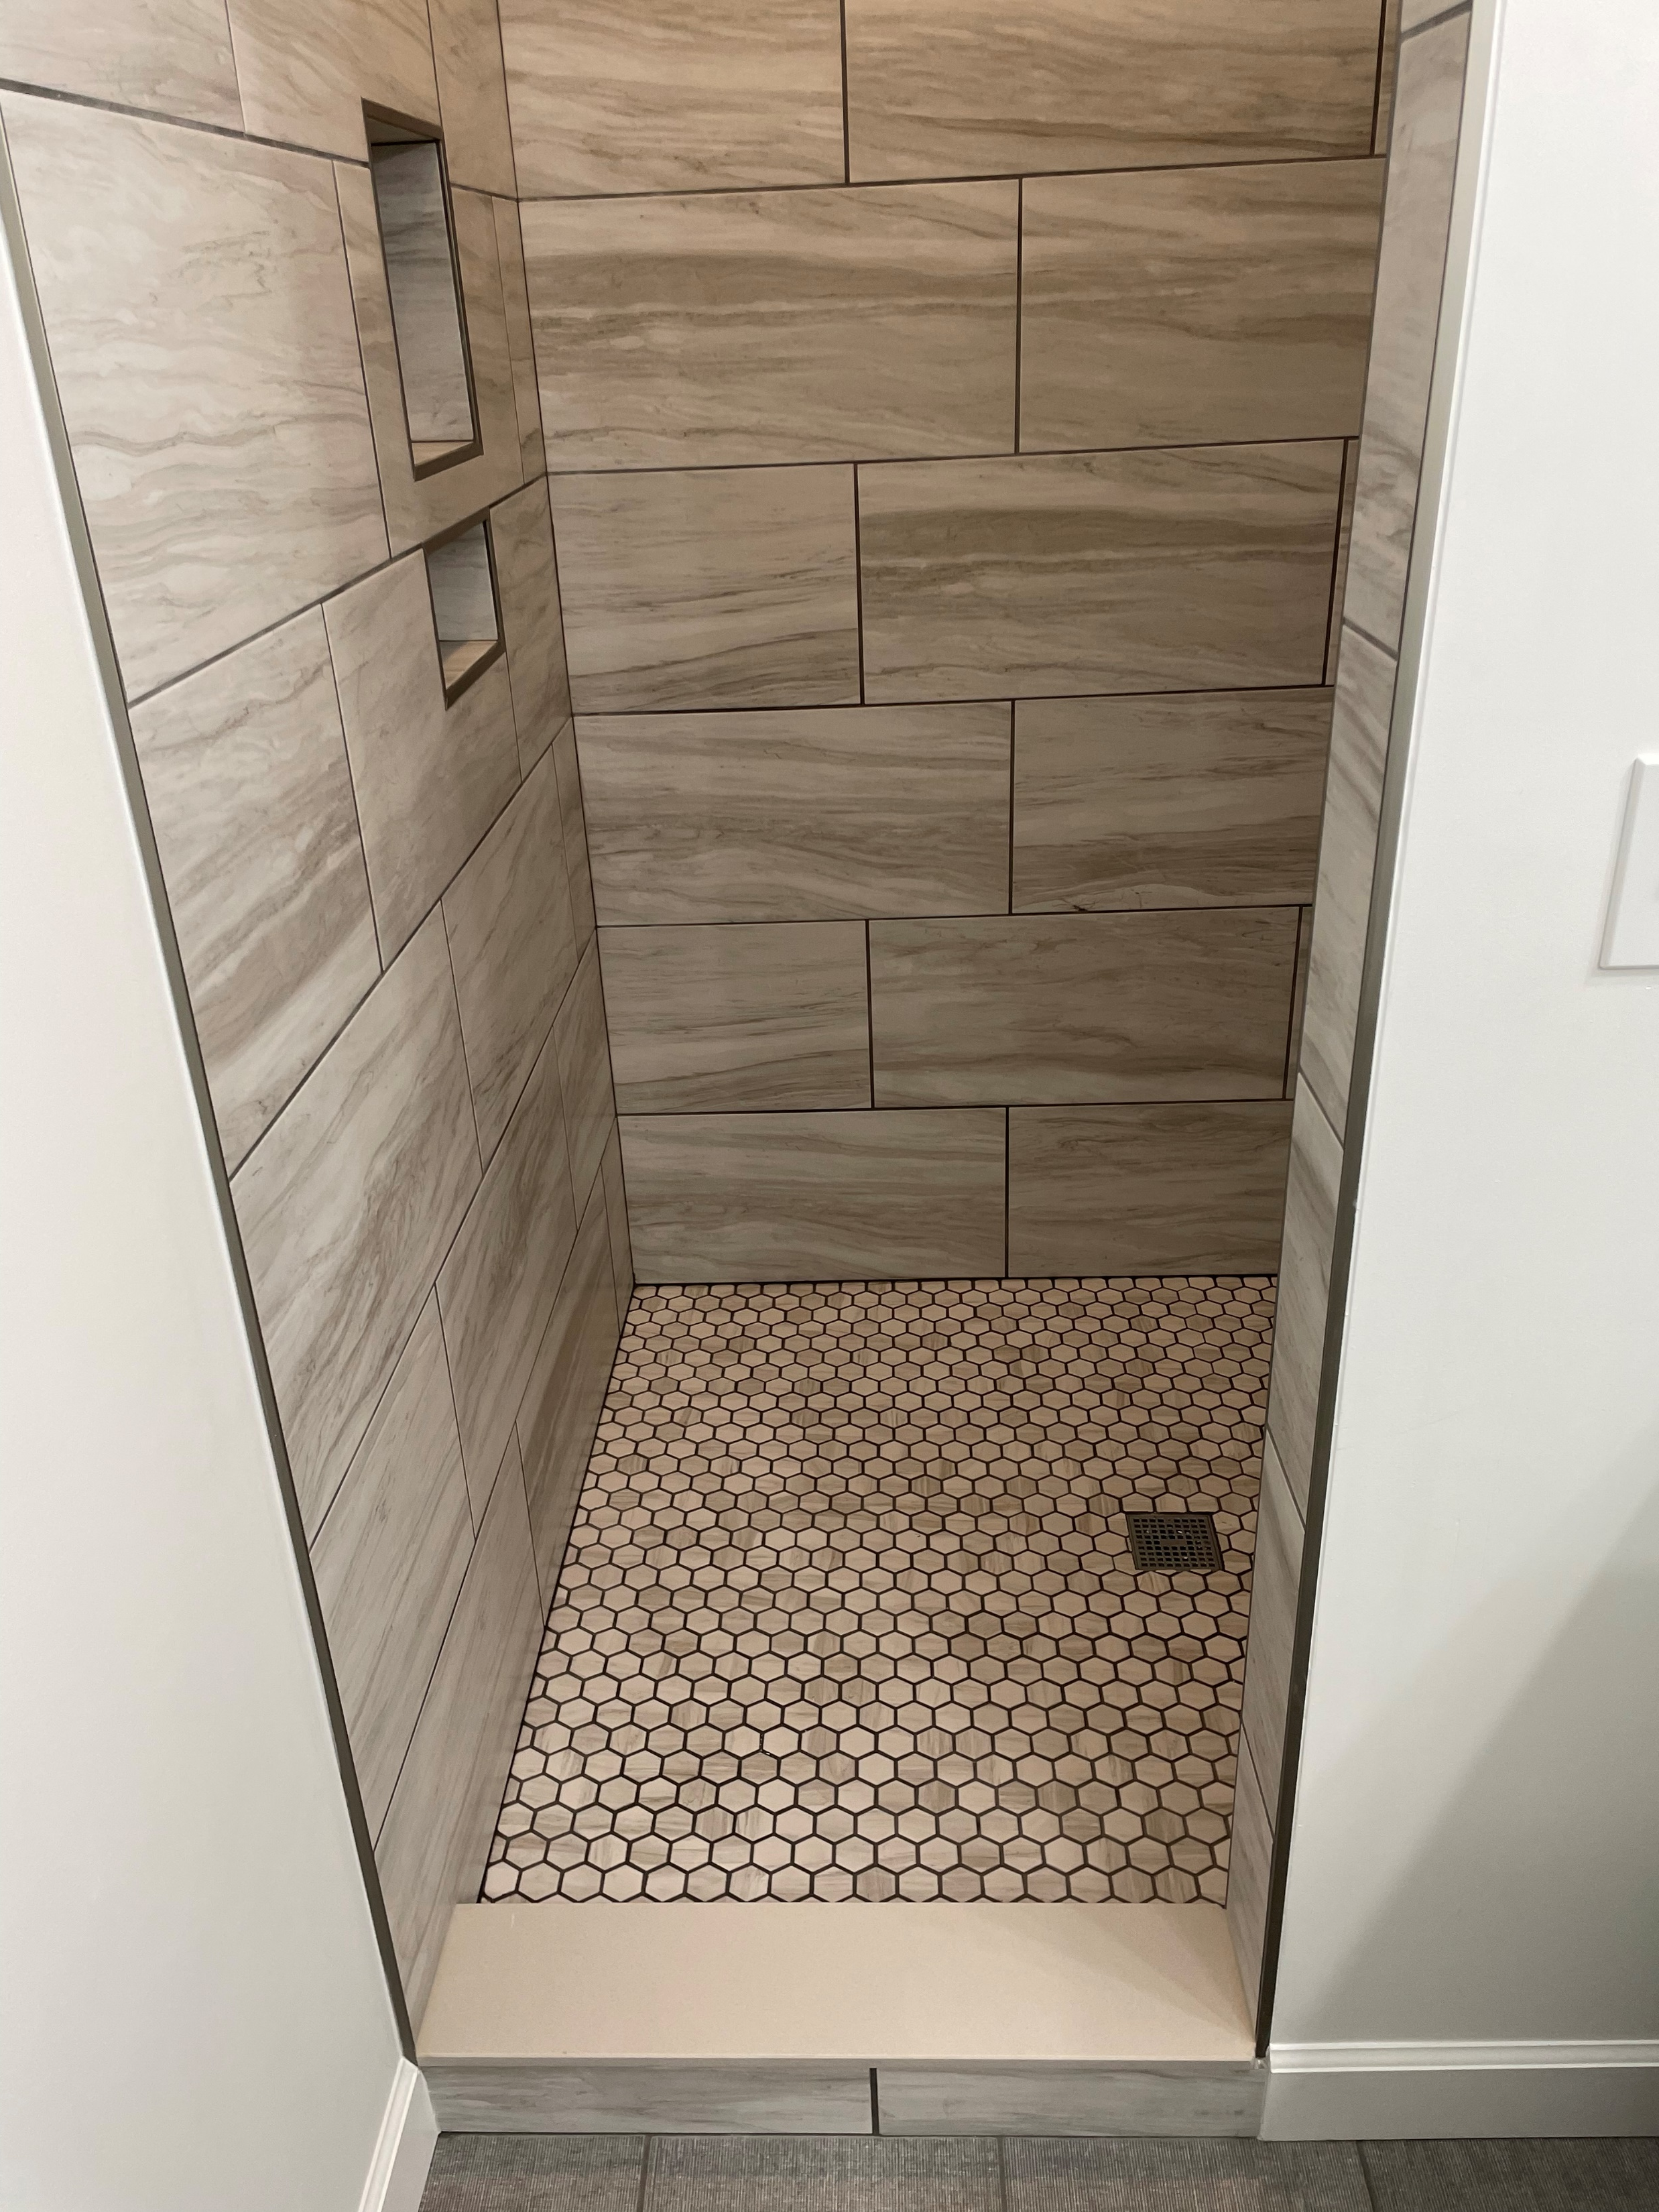
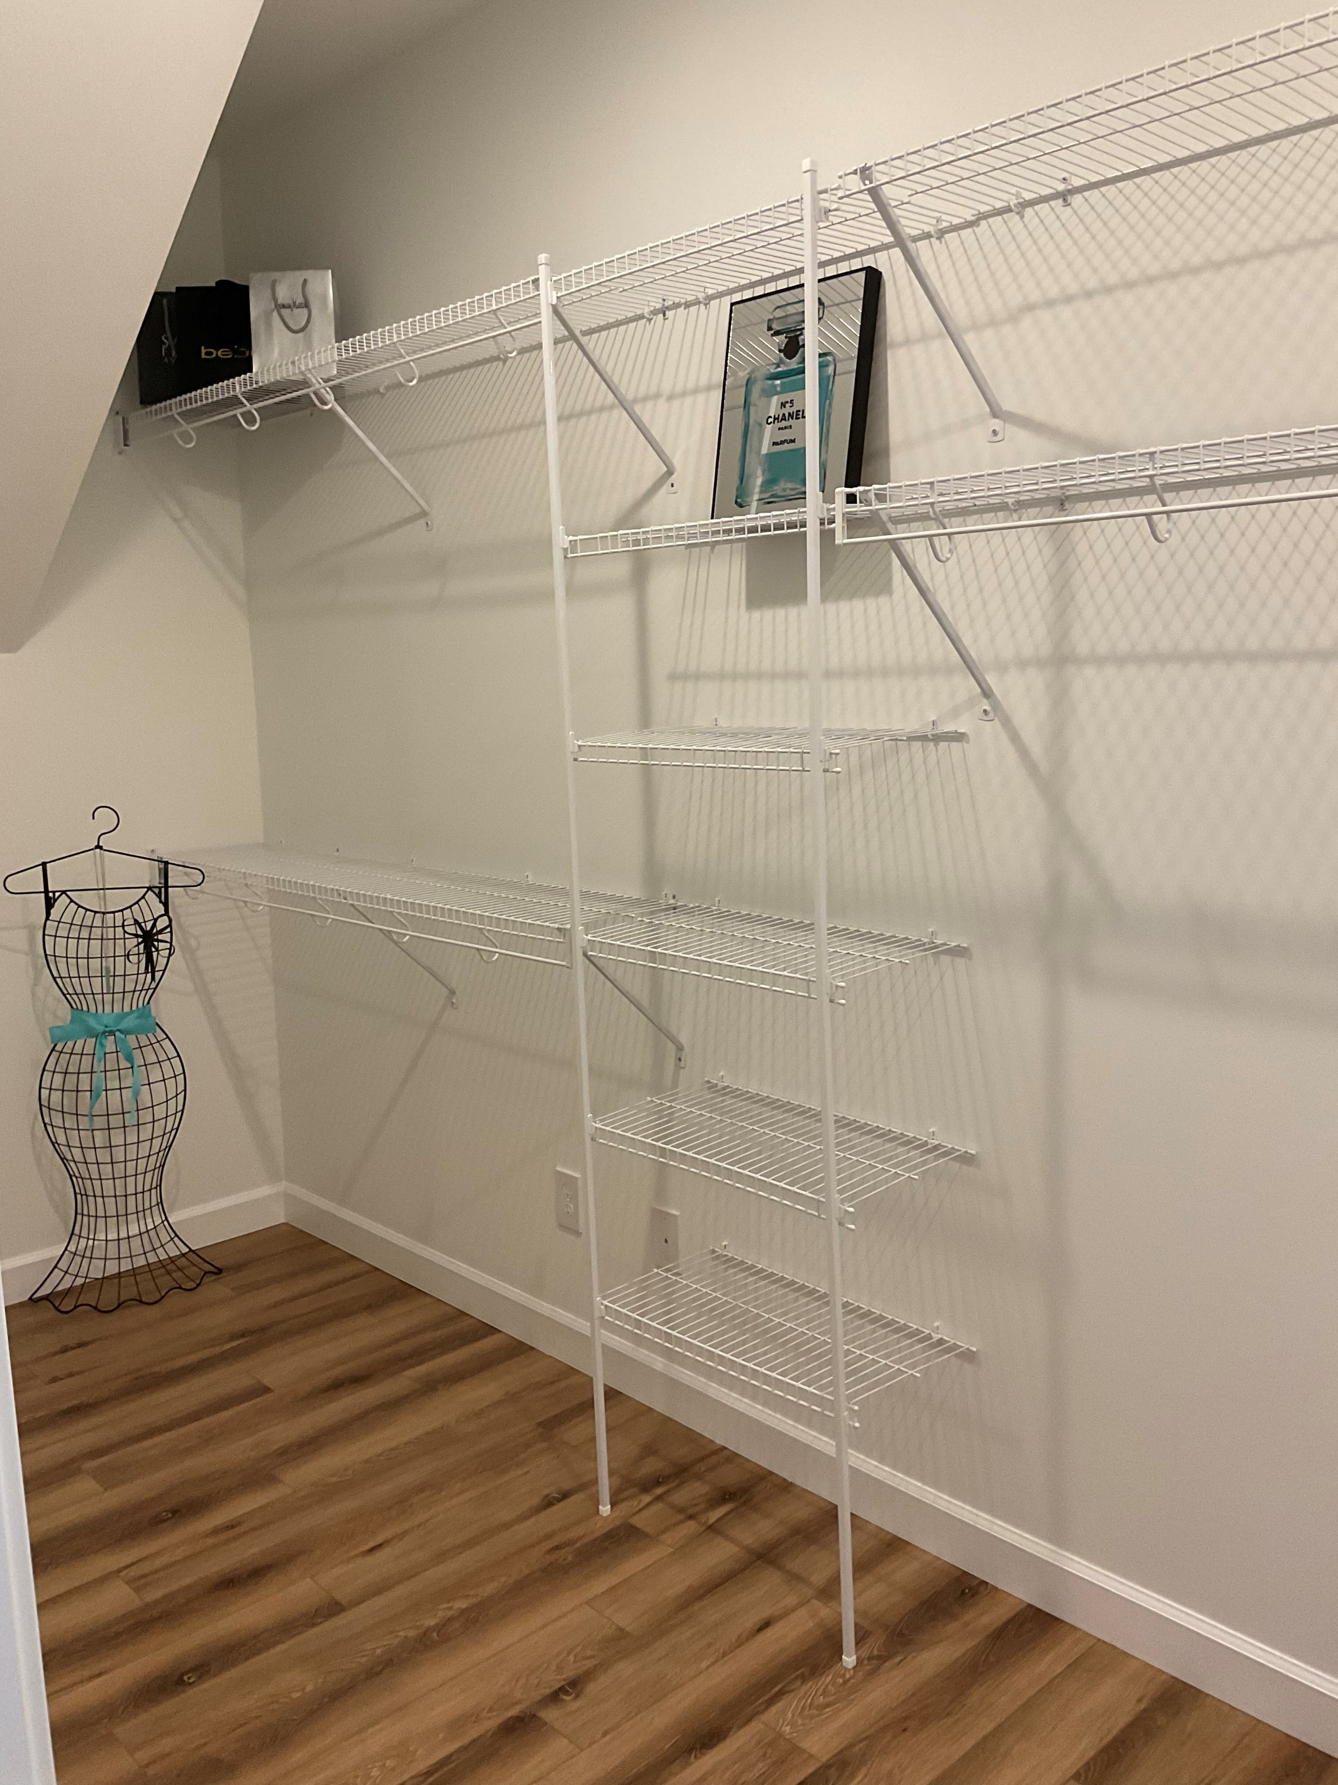
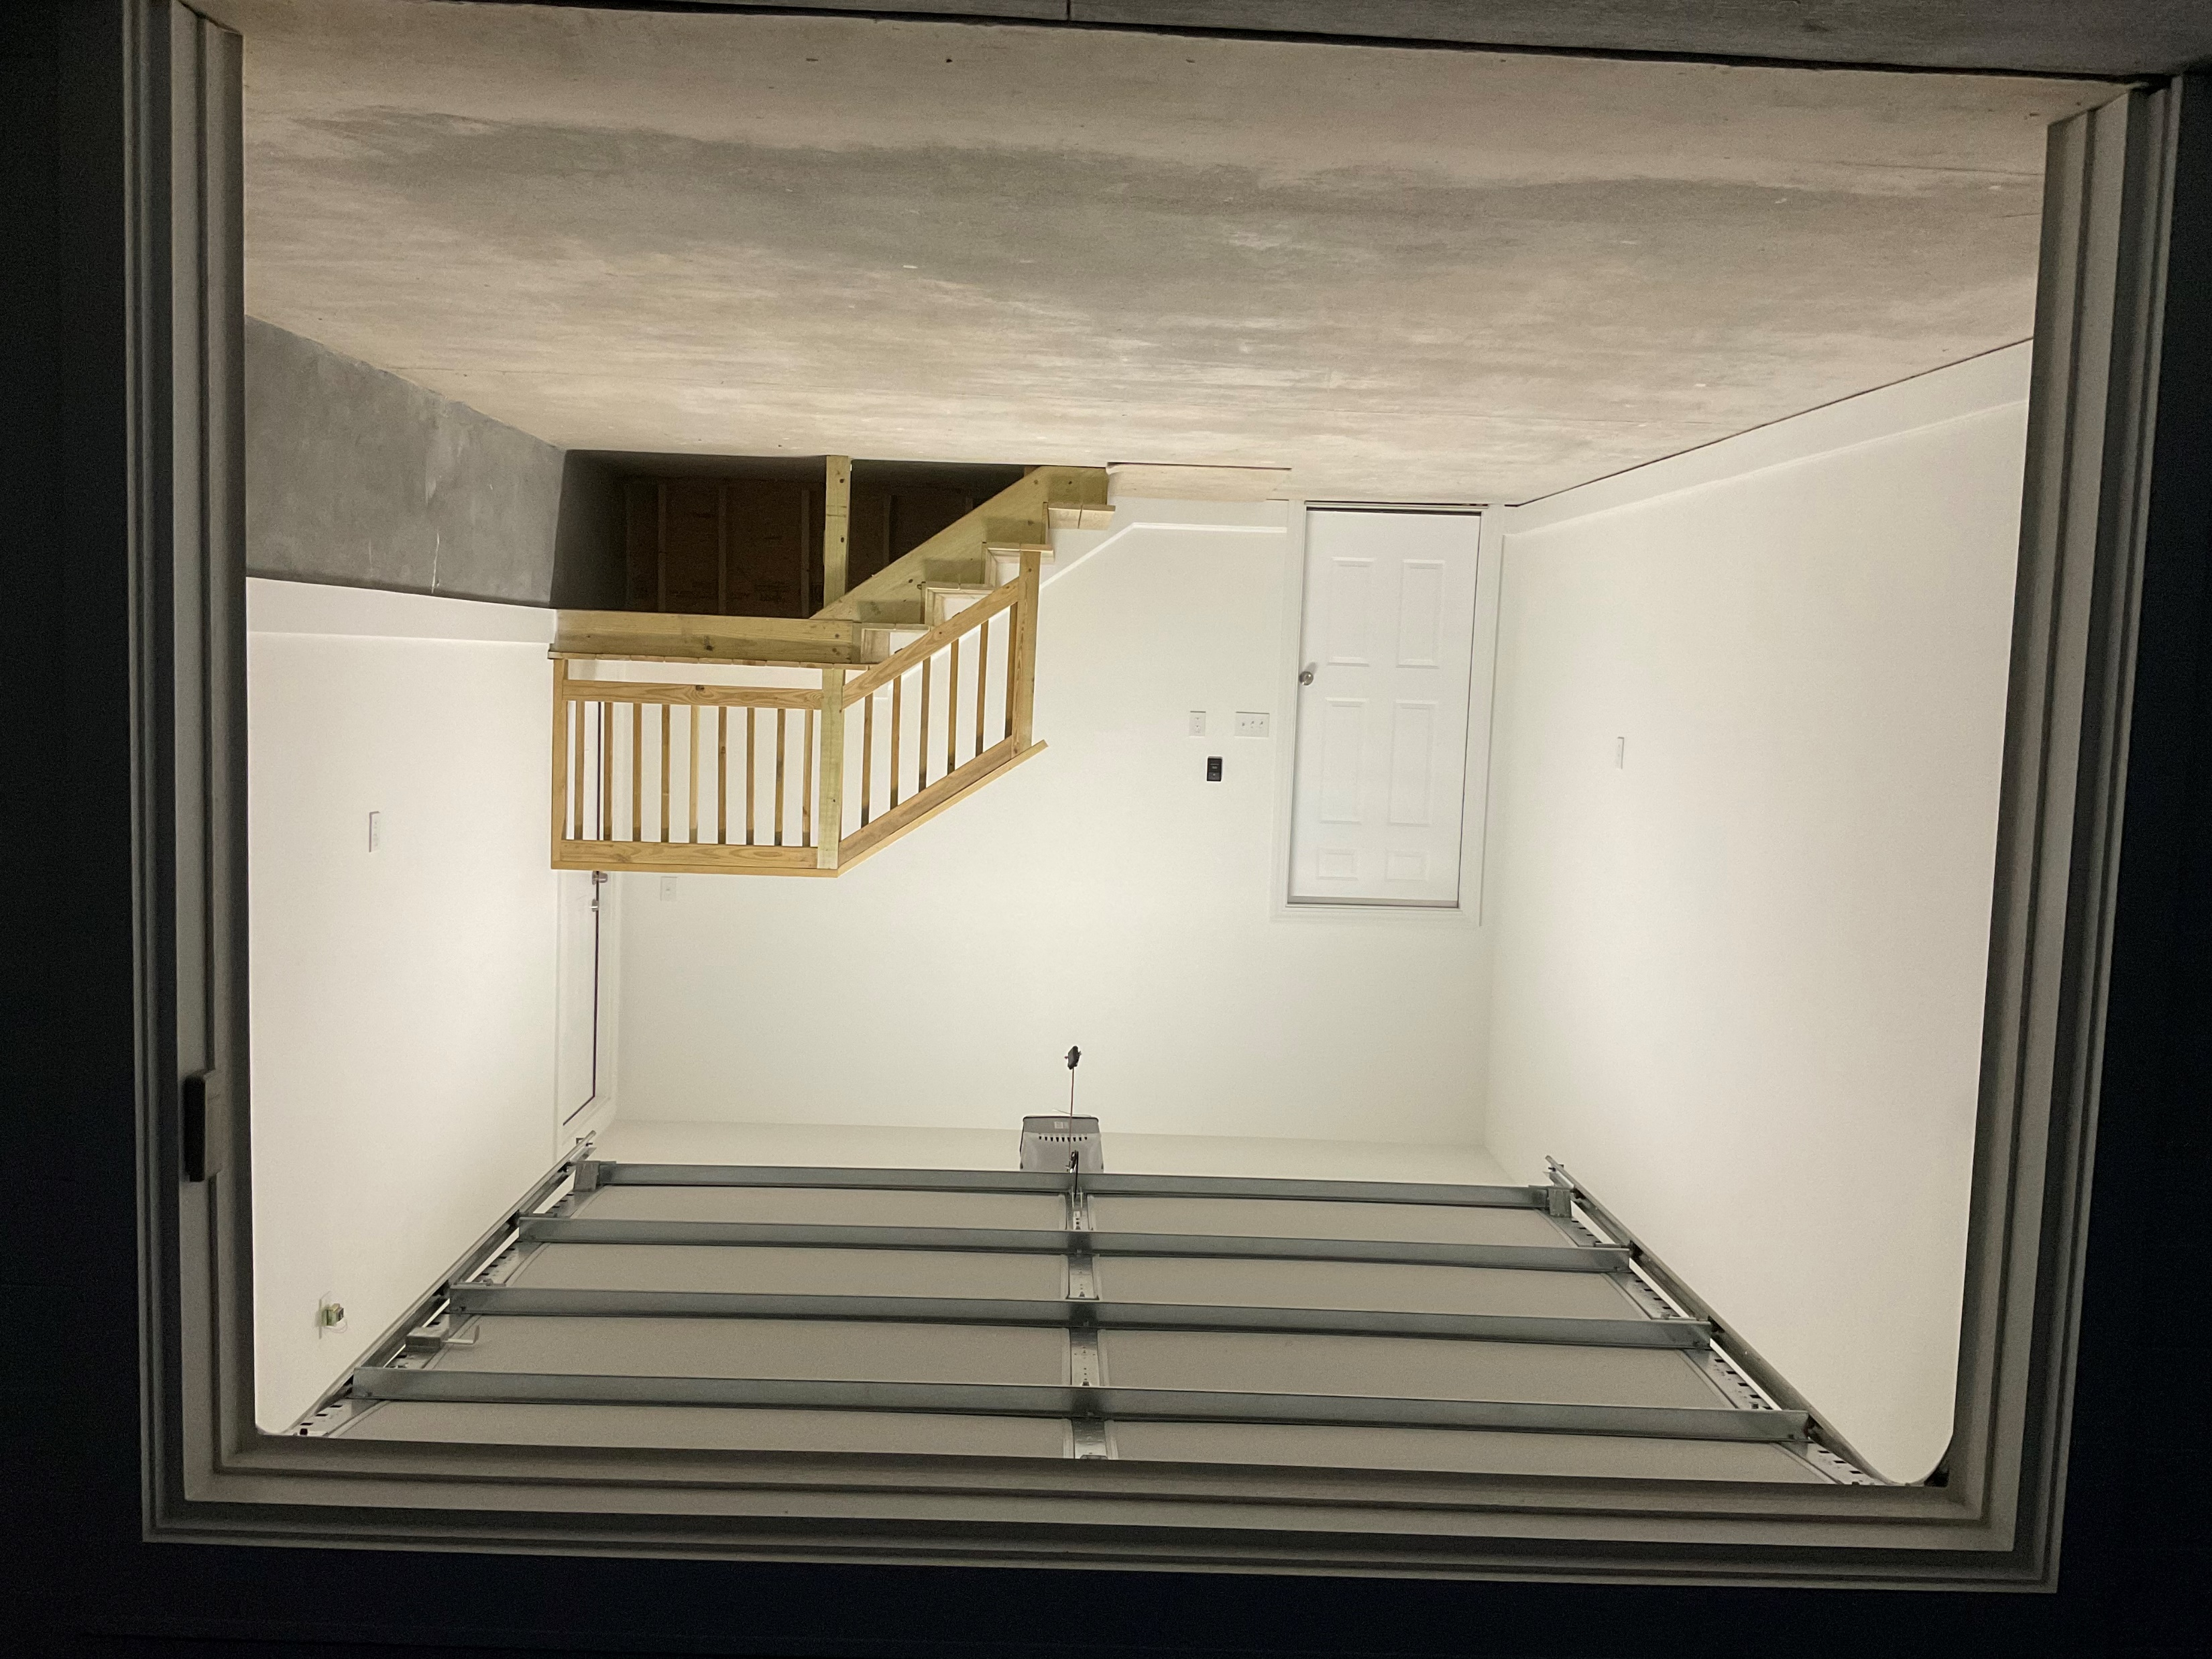


Summerville New Construction
119 White Picket Lane
Summerville, SC 29483 | MLS# 22004803 | $530,000
2022 New construction-Move in ready Close to shopping, schools and town but private large lot without HOA. 3 bedrooms including master on main floor Large bonus room upstairs Large flex room upstairs that can be used as 4th bedroom Open concept Large kitchen with stainless appliances installed Attached garage. Luxury Plank Tile Flooring main level Tiled master walk-in Shower Carpeted stairs, bonus room and flex room. Architectural Shingled Roof Ceiling Fans in all bedrooms Large walk-in master closet Concrete Double Car Parking area with extra gravel parking area Public water with installed septic system Sod Yard Buyers Please confirm deemed important information regarding this property such as square footage, schools, taxes and any other items important.
Sam Swails
(843) 817-1721
samswails@gmail.com
Horne Realty, LLC PO Box 3199
Summerville, SC 29484

