Slide 1
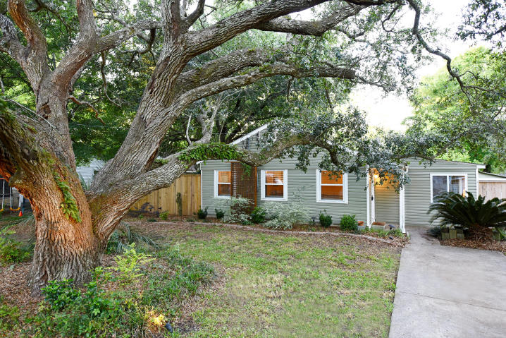
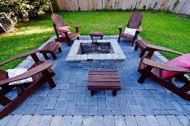
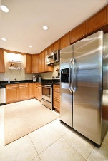
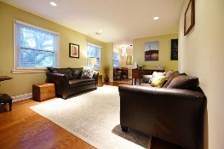
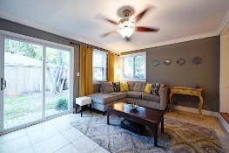
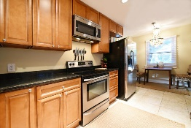
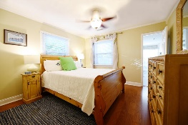
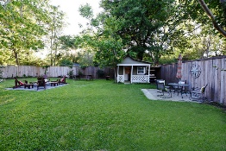
Recently Reduced! Just Steps from Coleman Blvd & Shem Creek Restaurants 11 Joyce Avenue ~ Brookgreen Meadows ~ Mt Pleasant MLS# 17012466 ~ $455,000
Updated house with huge lot right in the heart of Mt P conveniently located to beaches, downtown Charleston, and all of the restaurants and shopping on Coleman! Inside you will find all the desired updates. The kitchen has granite countertops, stainless steel appliances, new flooring and breakfast nook. Bathrooms include new light fixtures and porcelain tile floors. Beautiful engineered hardwoods have been installed throughout bedrooms and dueling living spaces.
Have your very own backyard retreat with this generous-sized yard. The perfect space for outdoor entertaining with a 8' privacy fence, stone firepit, multiple seating areas, and storage house with golf cart coverage. 3 year old roof, HVAC and siding. In a X flood zone so no flood insurance required!
Trey Morrison
trey@landsouthofcharleston.com
Mobile 843-697-6849
Land South of Charleston, LLC | 409 King St | Charleston, SC 29403

