Slide 1

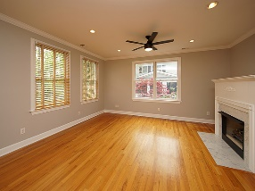
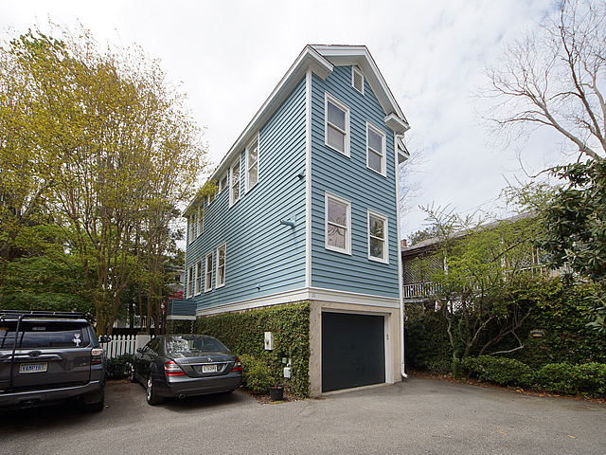
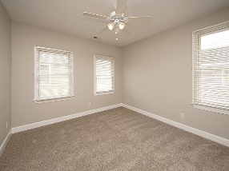
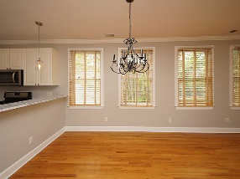
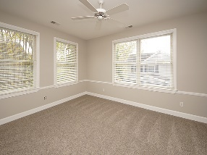
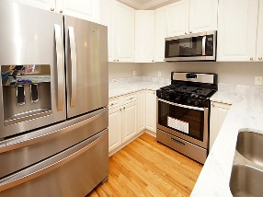
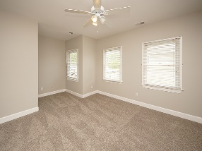
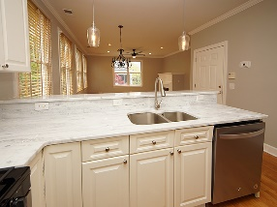
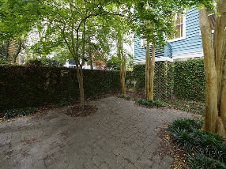


Harleston Village
2 Bedroom + 2½ Bath
Debbie Himebaugh
(843) 324-6959
dhimebaugh@century21properties.com
debbiehimebaugh.c21.com
11 Kirkland Lane | Charleston, SC 29401 | MLS# 18008011 | $575,000
Brand New Flooring!
Slightly North of Broad and just a short stroll from Colonial Lake you will find this unique handsome Charleston Single family home nestled in a convenient private condo regime community. Starting from the top featuring 2 bright and airy bedrooms with NEW CARPET and FRESHLY PAINTED THROUGHOUT each with their own bathroom and ample closet space. A hall linen closet completes that floor. On the main level, an open light floorplan awaits. The NEW QUARTZITE COUNTERTOPS, under mount sink, white cabinets and SPARKLING NEW STAINLESS APPLIANCES makes this kitchen pop. Adjacent to a dining area and nice size great room with new ceiling fan, UPDATED LIGHT FIXTURES, and fireplace to relax on those colder winter days. All this sits above a 2-car garage, with rm for storage, plus 1 extra assigned space.
The small community consists of 5 buildings, private garden area and an additional parking space for one car per unit. The RENAI ENDLESS HOT WATER TANK, NEW (Summer 2017) HVAC UNIT and GAS appliances are an added bonus! Between Wentworth and Beaufain you can walk to the multiple coffee shops, within a few block radius are churches, College of Charleston, MUSC, or even downtown King Street. This is a unique find, move-in ready.
Century 21 Properties Plus
3301 Salterbeck Ct Suite 100
Mt. Pleasant, SC 29466

