Slide 1
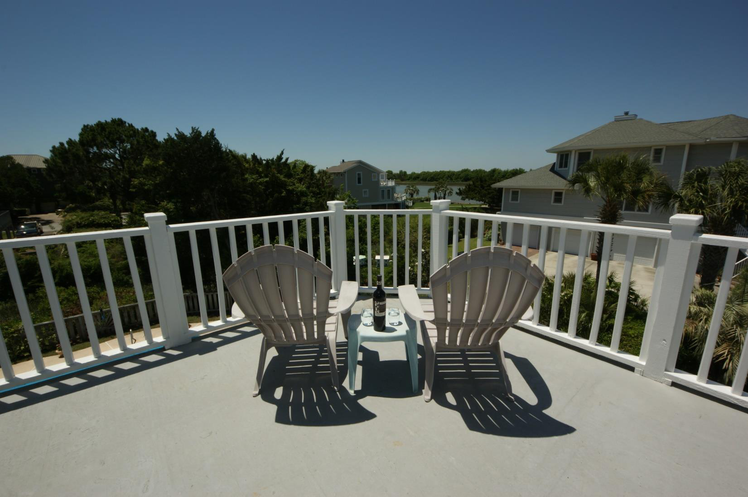
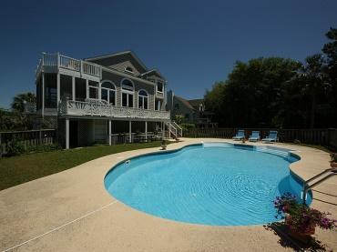
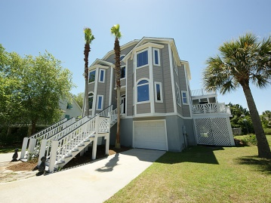
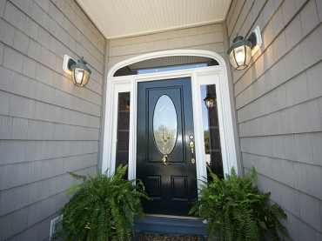
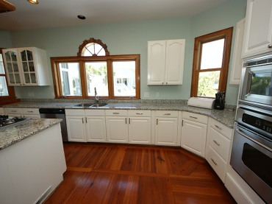
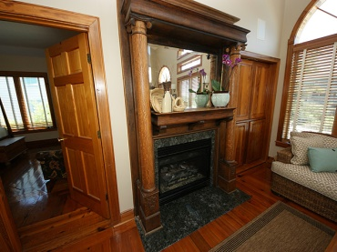
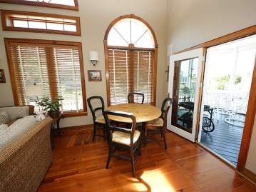


11 Seahorse Ct Isle of Palms, SC ~ MLS# 1413084 ~ $1,074,000
Views Of Intracoastal Waterway
Do you want to live on the IOP away from the crowds? Come and see this one of a kind, custom Isle of Palms home. Completely updated with sunset views of the intra coastal waterway, this home is a mix of modern day convenience with a touch of history. Located on a cul-de-sac, this home is on a quiet street, one block from the Isle of Palms recreation center and a short golf cart ride to the beach. Wild Dunes golf and tennis with many other amenities are nearby. As you enter the home your buyer will appreciate the antique hard wood floors and the sunlight filled rooms, and the open living space with great views. The antique mantel is from the Saluda Gap railroad station and provides a beautiful focal point. Downstairs is a dining room, study and a flexible room that is currently used as a guest room. This room has been used a guest bedroom, an office and a kids TV room in the past. The updated kitchen has granite countertops and stainless appliances and is open to the living area. There is also a full bath on the first floor. The unique staircase splits with 2 bedrooms and a Jack & Jill bath on one side and a master suite on the other. The master bedroom also has waterway views and a private balcony to watch the sunset at the end of the day. The outside is a place where memories are made. There is a great screened in porch that is used year round, a nice grilling deck and another deck overlooking the pool area. This home is a great place for entertaining family and friends but is also a nice place of solitude and rest.
Chuck & Edy Mimms
Cell 843-224-9507
Office 843-530-8100 www.sanddollarsc.com
www.facebook.com/Sanddollarsc
Sand Dollar Real Estate Group | 2205 Middle Street | Suite 203, Mailbox 2 | Sullivans Island, SC 29482

