Slide 1
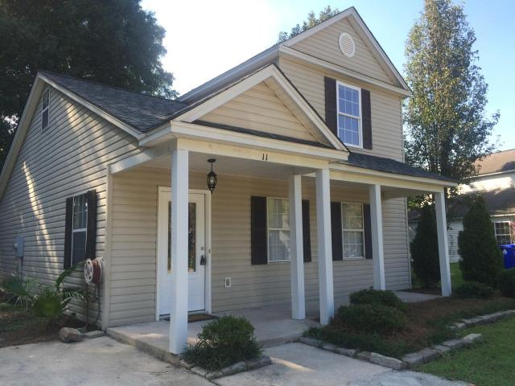
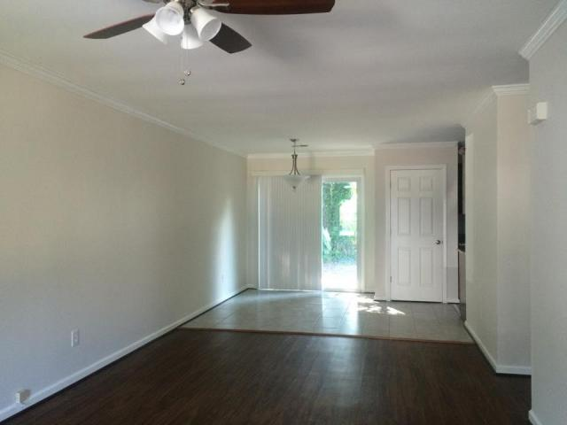
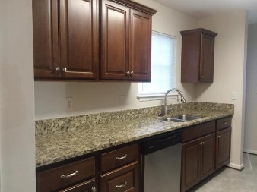
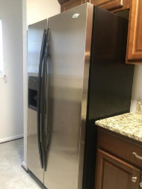
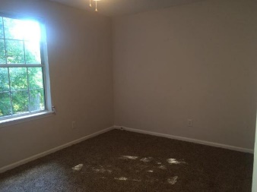
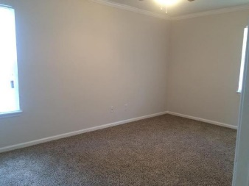
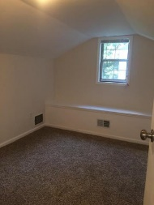
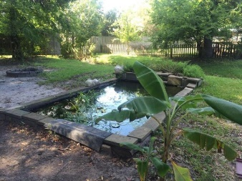
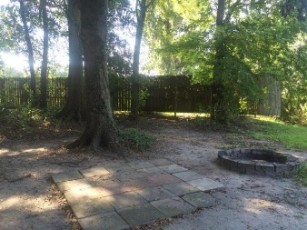
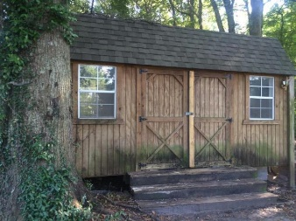
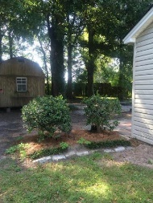



11 Timberleaf Court
Woodlands
Charleston, SC 29407
MLS# 15024766
$199,999
3 Bedrooms
2 Bathrooms
1,230 Sq Ft
Upgraded and Updated low maintenance floor plan. Open and full of natural light. You can't beat the location in West Ashley for convenience and shopping. Hardwood floors and brand new carpet go well with the marble counter tops and stainless steel appliances.
Small oasis in backyard for enjoying your home to the fullest. Coy pond, 2 patios, fire pit and still plenty of room to add your own personal features. Not included in the square footage is a small bonus room upstairs that is very unique and can be used as a small kids room/playroom, home office or additional storage. Not to mention that there is a decent sized walk-in storage in the attic space that will come in handy.
This home will not last past this week! Shed behind the house conveys with acceptable offer.
Bobby Shealy
Office (843) 900-4000
Direct (843) 442-7373
bobby@redefy.com
Lindsay Pennell
Office (843) 900-4000
Direct (843) 830-6004
Lindsay@redefy.com
Redefy Real Estate | 12 Carriage Ln | Charleston, SC 29407 | redefy.com/Charleston

