Slide 1
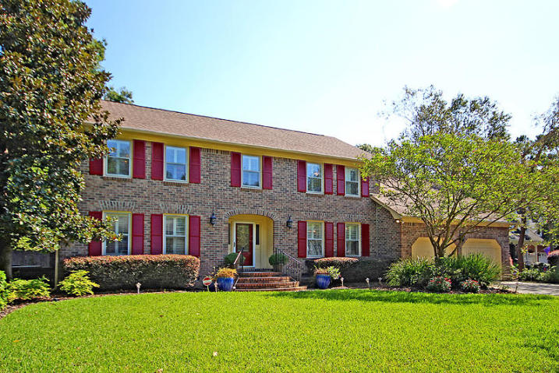
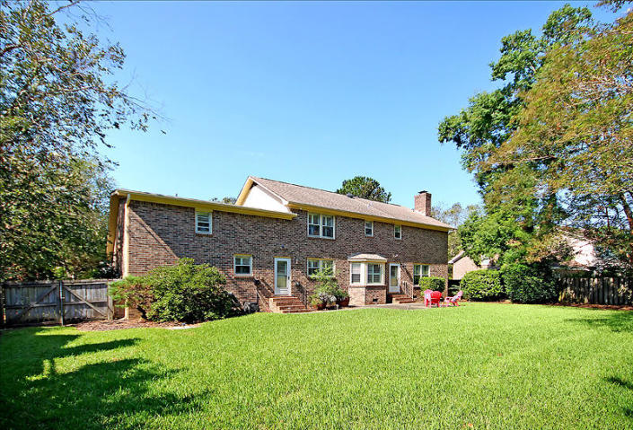
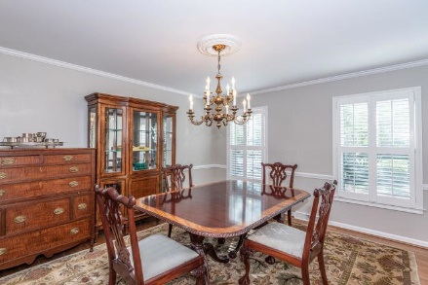
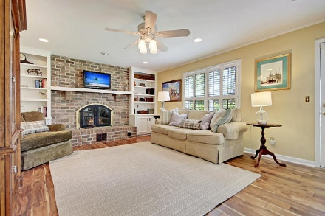
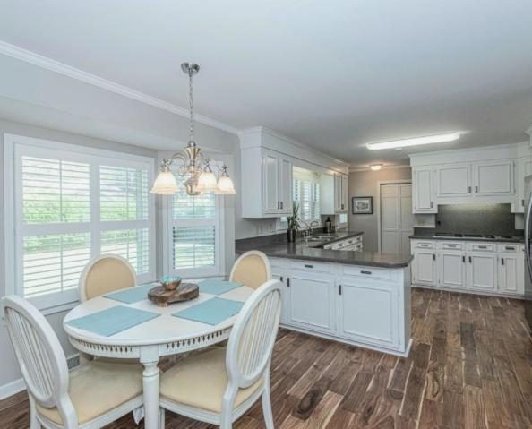
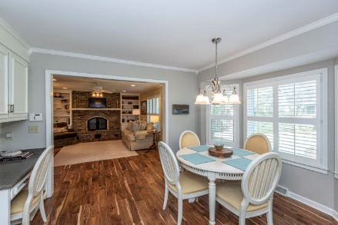
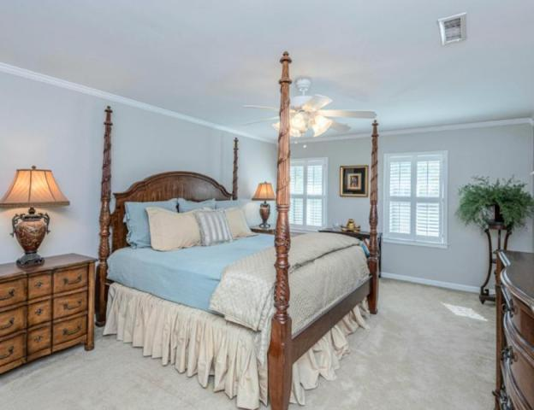
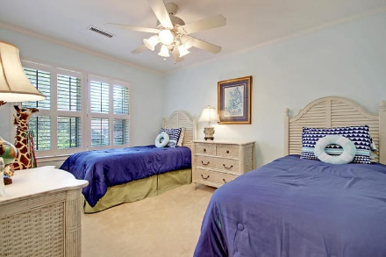
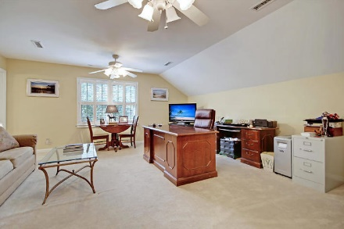
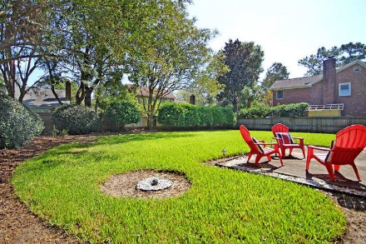
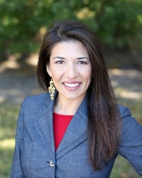


Fresh Paint! Fresh Price!
Immaculate Home in Ashley Hall Plantation
A $2100 Lender Credit is available and will be applied towards the buyer's closing costs and pre-paids if the buyer chooses to use the seller's preferred lender. This credit is in addition to any negotiated seller concessions.
11 Casa Bianca Drive Charleston, SC 29407 | MLS# 19027312 | $435,000
Situated on a quiet cul-de-sac, this all-brick Ashley Hall Plantation home has been well maintained by its original owners. The plush landscaping and elevated lot give it a stately presence. Inside you will find 5 bedrooms, 3.5 bathrooms a 2-car garage and over 3000sf of living space. Multiple upgrades throughout including new hardwood floors on the 1st floor, an open kitchen with Corian counters, stainless appliances, plantation shutters and smooth ceilings. The welcoming foyer is a wonderful space to greet your guests. Immediately to the left there is a sitting room that could also be used as an office. To the right there is a formal dining room. At the back of the home there is a spacious kitchen with extensive counter space for food preparation and entertaining a walk-in pantry, dining area with a bay window, built-in desk and a separate laundry room with additional storage space. The kitchen overlooks a large family room with built-in bookshelves and an elevated brick fireplace. The second floor offers a flexible floor plan and ample storage with 5 bedrooms and 3 full bathrooms. The 5th bedroom has a full bathroom en-suite and could be a 2nd master bedroom or bonus room.
Enjoy being part of a well-established neighborhood without sacrificing the convenience of an ideal location. Whether you want to catch a plane, go to the beach, or head downtown for dinner reservations - you are a short drive or Uber ride away. Don't miss out on being part of this charming neighborhood. Welcome home to 11 Casa Bianca Dr!
Whitley Boyd
(843) 324-4761
WBoyd@CarolinaOne.com
www.PropertiesofCHS.com
Carolina One Real Estate | 628 Long Point Rd. | Mt Pleasant, SC 29464-3032

