Slide 1
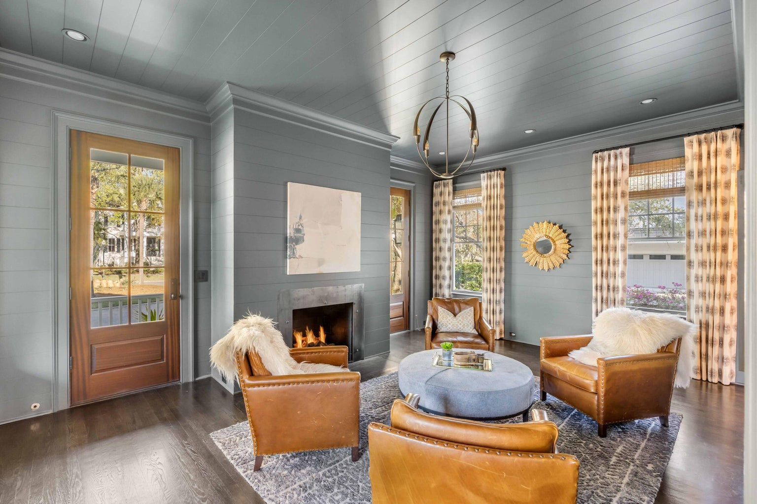
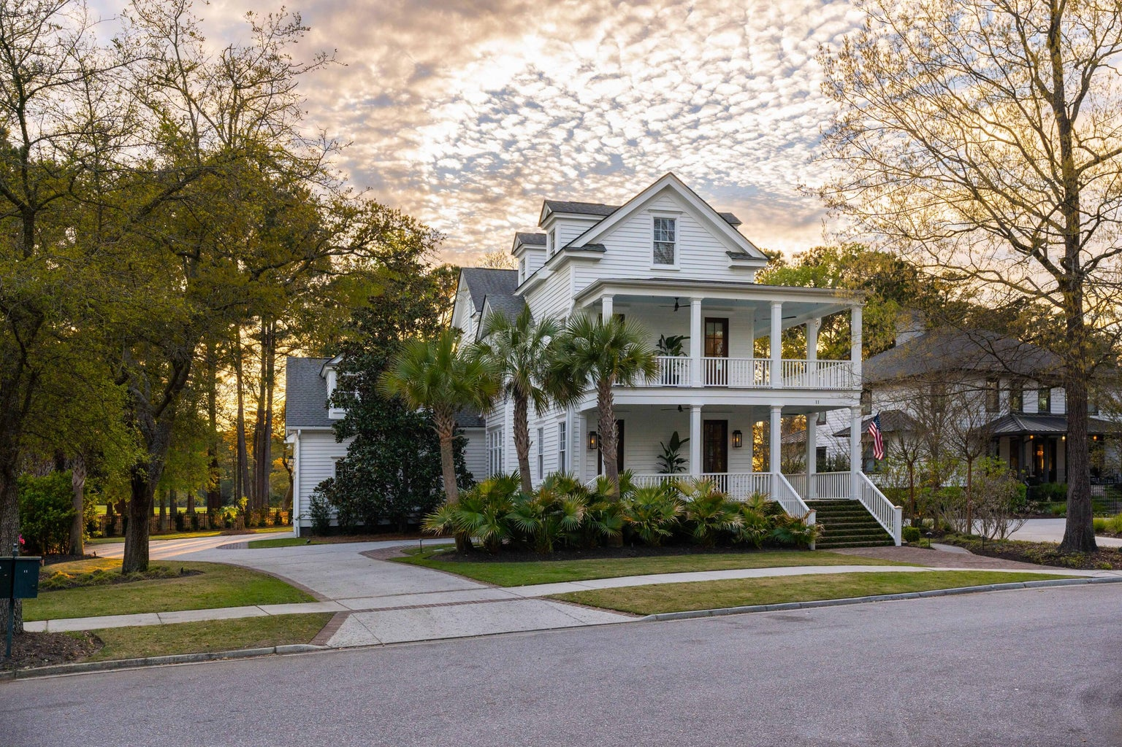
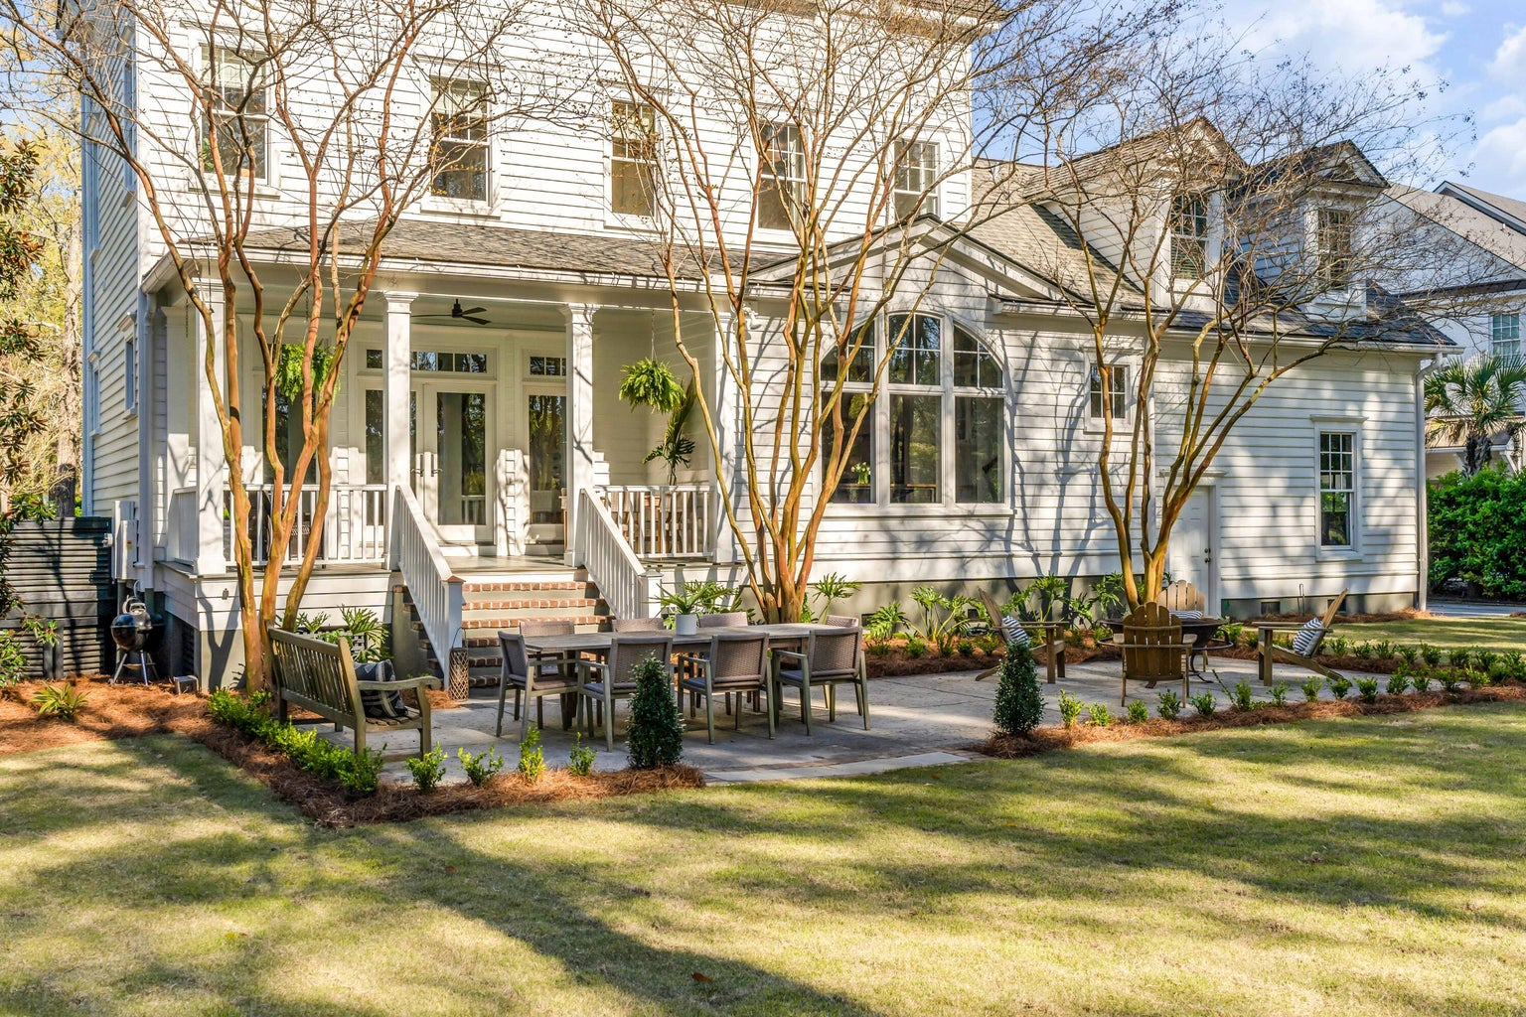
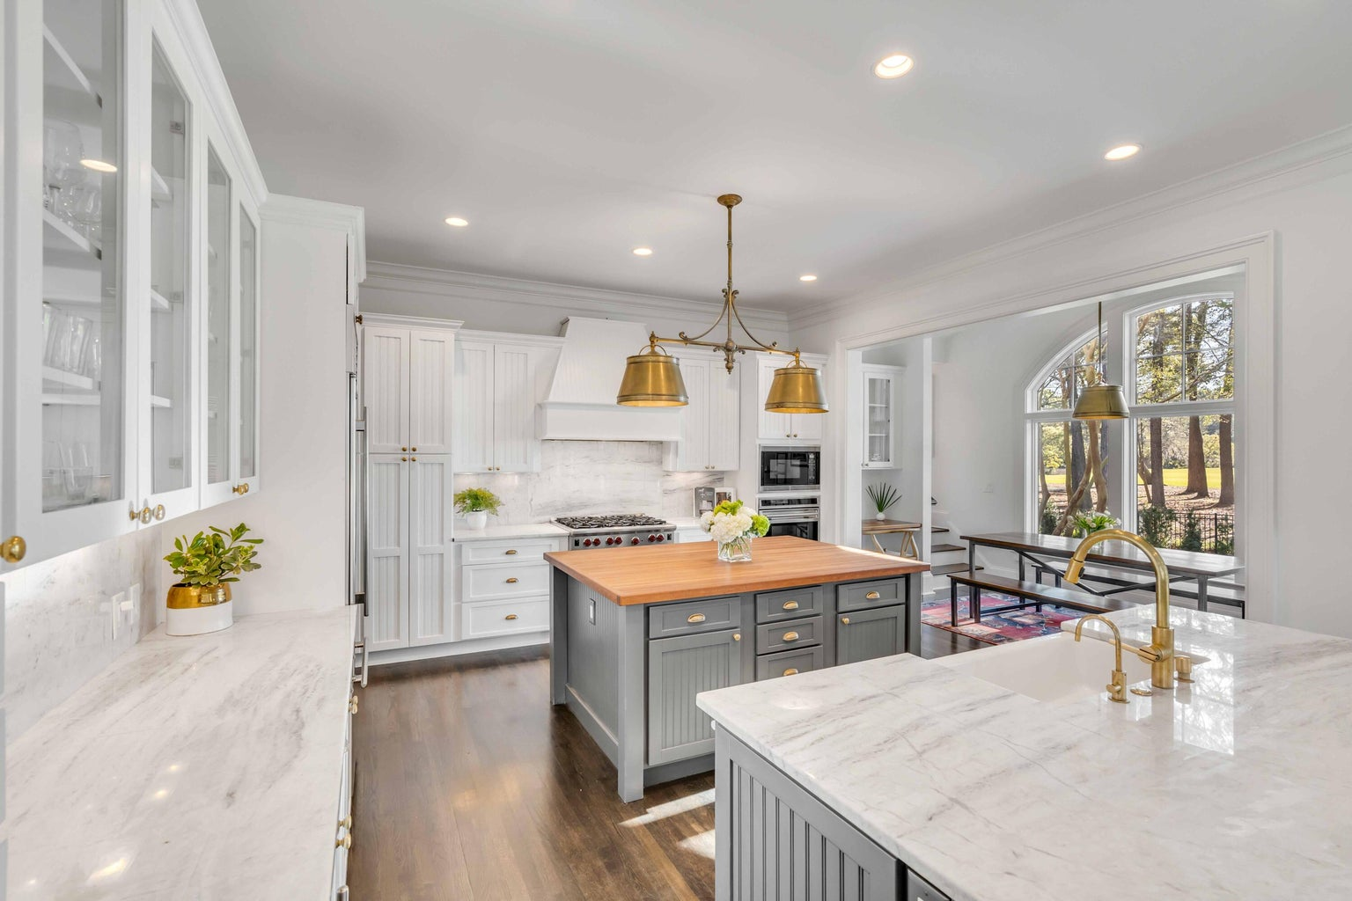
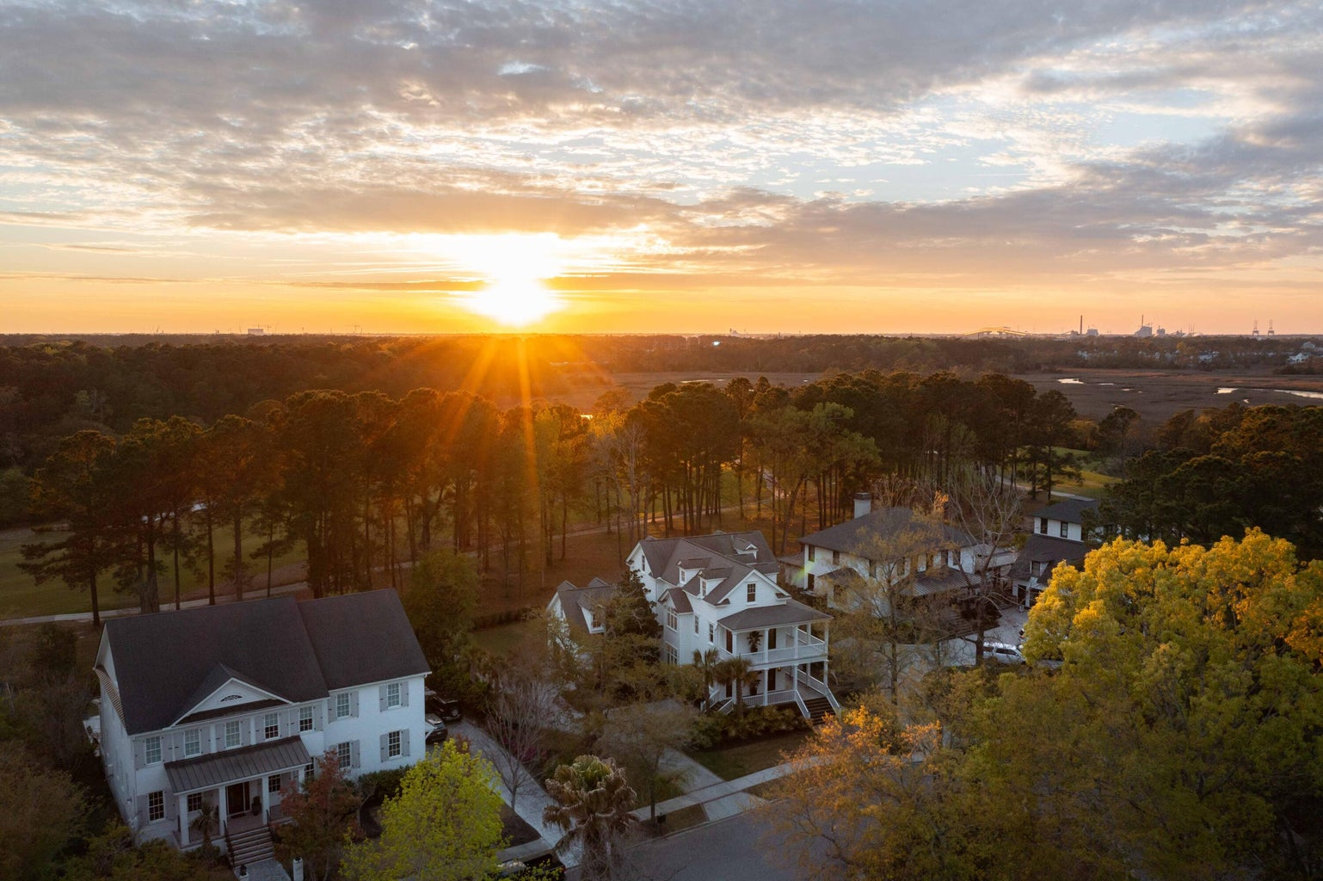




Open House Thursday
Stop by 11a-1pm
11 Dalton Street
Daniel Island Park | Charleston, SC 29492 | MLS# 23006087 | $3,050,000
Nestled in a charming cul-de-sac within Daniel Island Park, you'll find 11 Dalton Street filled with luxe finishes, modern details, and great natural light. The gas lanterns and sweeping porches boast the charm and style of the Lowcountry. Mahogany exterior doors and beautifully finished white oak floors transport you into the into the heart of the home. The open floor plan showcases an oversized family room with a gas fireplace that leads to the gourmet kitchen and breakfast area, drenched with natural, southwest sunlight. The wall of windows offers a private view of the golf course lined with mature trees overlooking the 14th fairway of the Beresford Creek Course. The back porch and patio are an inviting space to have morning coffee or dinner parties while enjoying the breathtaking sunsets.
The grand kitchen boasts high-end SS appliances, two large islands, quartz and butcher block counter tops, custom cabinetry with pull out drawers and built-in wine fridge. There is a secondary stairway from the breakfast room to a spacious bedroom which has a large, full bathroom for complete privacy. The oversized dining room leads to the sophisticated, cozy study/den with fireplace where you can relax and unwind. Custom ceiling fans, draperies, roman shades and plantation shutters complement the shiplap walls and hardwood floors that are on every level of the home.
Take the stairs or the 3 stop elevator to the primary bedroom located on the second floor. Double doors have access to the wraparound sun-swept porch. The newly renovated master bathroom exudes luxury with a custom soaking tub and designer lighting that showcases the homeowner's attention to detail. The laundry room with gorgeous custom tile and two additional bedrooms with newly renovated en-suite bathrooms complete the second floor.
On the third floor you'll find another bedroom, full bathroom and a large flex space currently used as a workout room. There is also an office which can be converted into a bedroom if desired. There are plenty of closets and storage space throughout the home.
The attached side load garage and large driveway accommodate numerous vehicles. Newly landscaped backyard. Crawl space encapsulated. This property includes a Daniel Island Club FULL GOLF MEMBERSHIP for purchase. Surrounding the home are the wonderful Daniel Island Club amenities located within walking or biking distance: clubhouse dining, pools, tennis and pickleball courts and fitness facilities in a lush, resort-style setting.
The seller also has an updated master landscape plan with architectural drawings for a beautifully designed pool in the backyard. Come experience the best of Daniel Island living at 11 Dalton Street.
4
3
1,844
Elise Rivers Kennedy
843-452-1408
elise.kennedy@carolinaone.com

