Slide 1
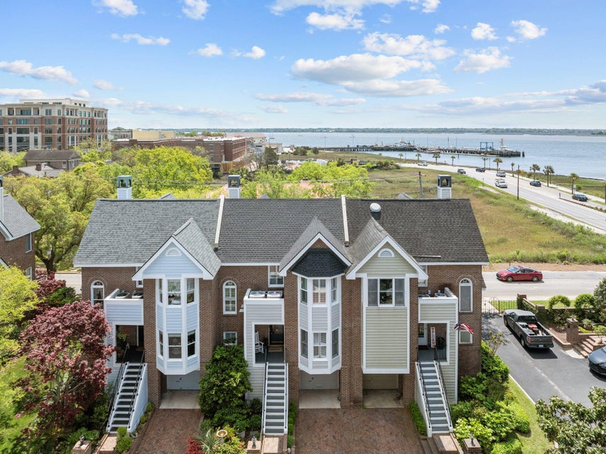
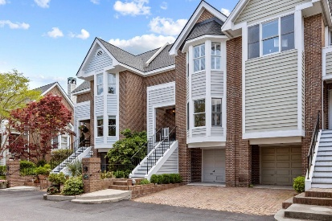
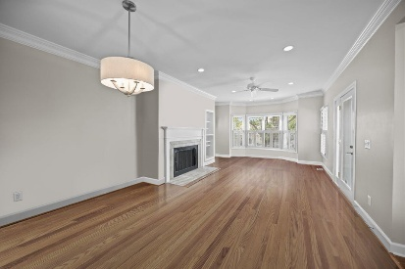
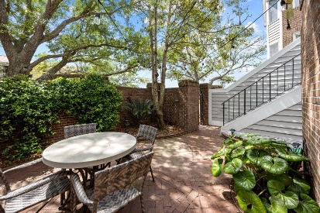
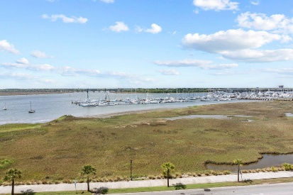

MOVE IN READY! LIVE AND WORK DOWNTOWN! 3% Buyer Commission With Ratified Contract By July 31st
11 Harleston Place
Harleston Place | Charleston, SC 29401 | MLS# 25019652 | $1,375,000
Live downtown while enjoying stunning harbor views from your newly renovated townhome! With 2,116sf, there's plenty of space to entertain or simply relax and watch the boats go by. Located within walking distance of MUSC, Colonial Lake, restaurants, tennis/pickleball courts, and The Battery. This 3-bedroom, 3-bathroom home boasts breathtaking harbor views and numerous upgrades, including: A beautifully renovated kitchen featuring a ceramic sink, Miele dishwasher, induction stove/range, and quartz countertops. A newly renovated master bath. A new roof, hot water heater, and attic dehumidifier. A freshly painted ext./interior. An electric garage. A spacious downstairs room that opens to an outdoor patio and dining area. Hardwood floors, except for the kitchen which features elegant tile.
Lisa Deaton
843-224-7878
lisamdeaton@comcast.net
AgentOwned Charleston Group
902 Savannah Hwy
Charleston, SC 29407-7802

