Slide 1
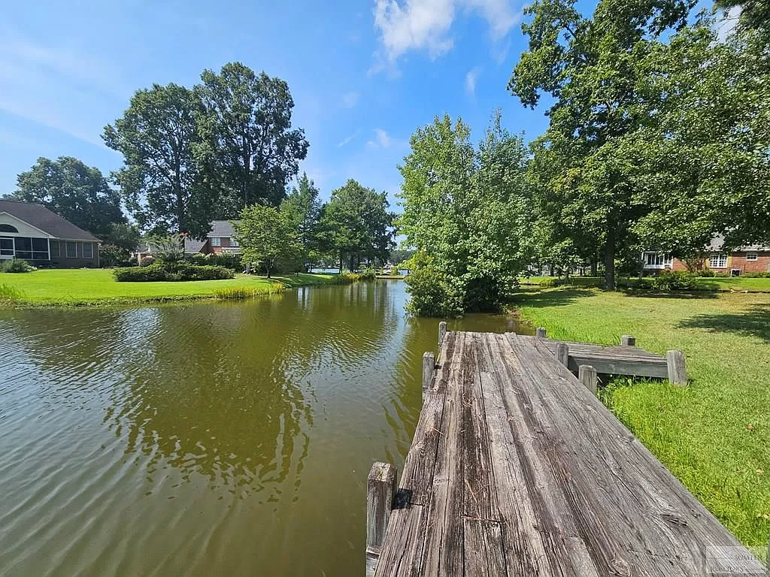
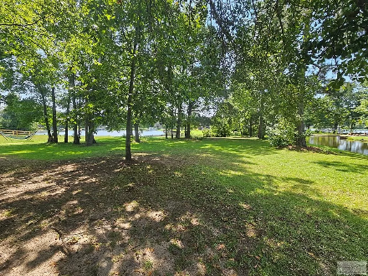
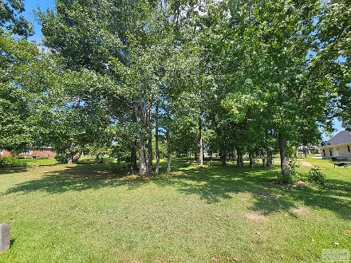
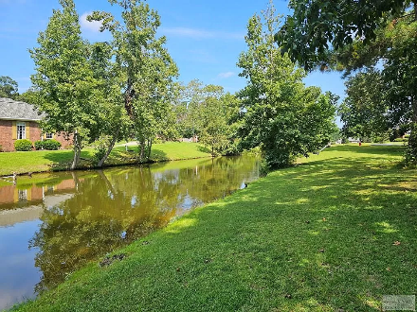
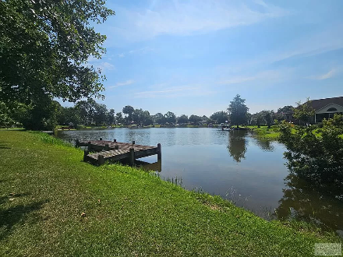

Ready to build lot in Wyboo
11 Ridge Lake Dr
Manning, SC 29102
MLS# 157851 ~ $109,000
Can you picture it? Sitting on your porch over looking water feeling the fall breeze. Build the home of your dreams on this custom build lot in Wyboo Plantation on Lake Marion. Travel from your very own dock to Charleston for the day or the weekend. This lot is pond front with water access via a boat lift to the main lake.
Lake Homes Realty, LLC
Elloree, SC 29047
www.SCLakeLife.com
Kristie Anderson
(803) 387-9459
kristie@sclakelife.com

