Slide 1
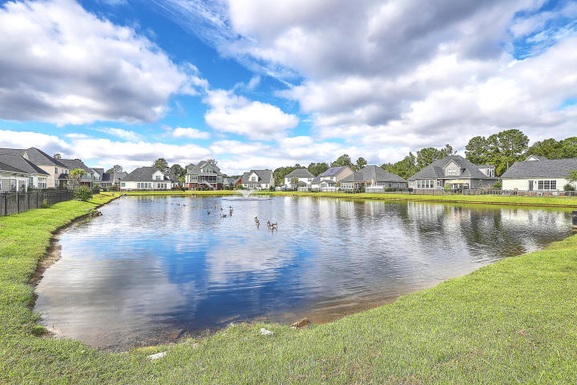

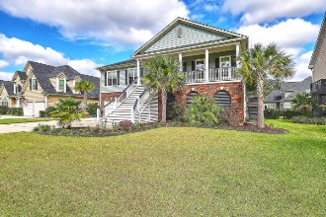
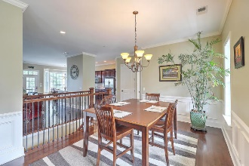
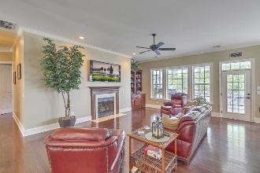
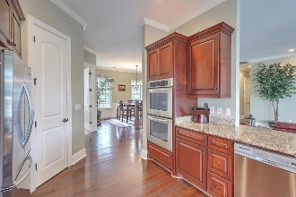
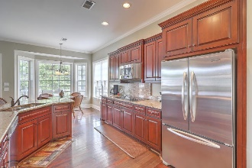

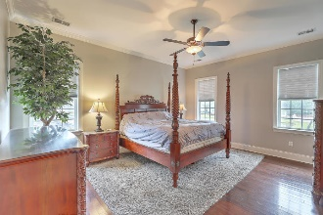
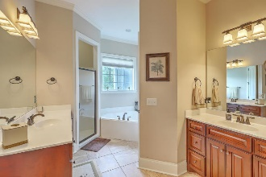
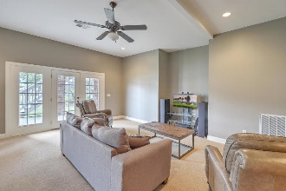
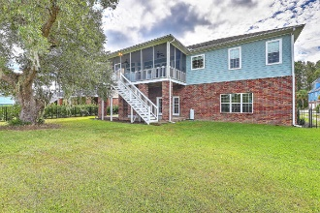
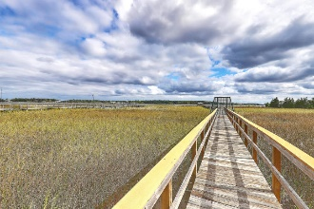
Kent Susong
M (843) 324-0190
O (843) 856-0021
larrykentsusong@gmail.com
Pondside 4 BR Home with
Community Dock Access
1200 Rivers Reach Drive
Rivers Reach Pointe | Charleston, SC 29492 | MLS# 19028550 | $629,000
This is a beautiful 4 bedroom, 3 bathroom home in a community that shares a deep water gated dock. Home has gourmet kitchen, double oven, KitchenAid appliances, open floor plan with granite and wood floors, breakfast area, formal dining room, and office. Downstairs features huge family room/movie room. Mother-in-law suite plus another bedroom with en suite. Fenced backyard with pond views, large covered porch and also large covered screened porch. Large tiled mudroom. New Philip Simmons schools and new Publix Grocery and shopping center. SELLER PROVIDING 2-10 HOME WARRANTY.
Century 21 Properties Plus | 1090 Park West Blvd; Ste 3 | Mount Pleasant, SC 29466

