Slide 1
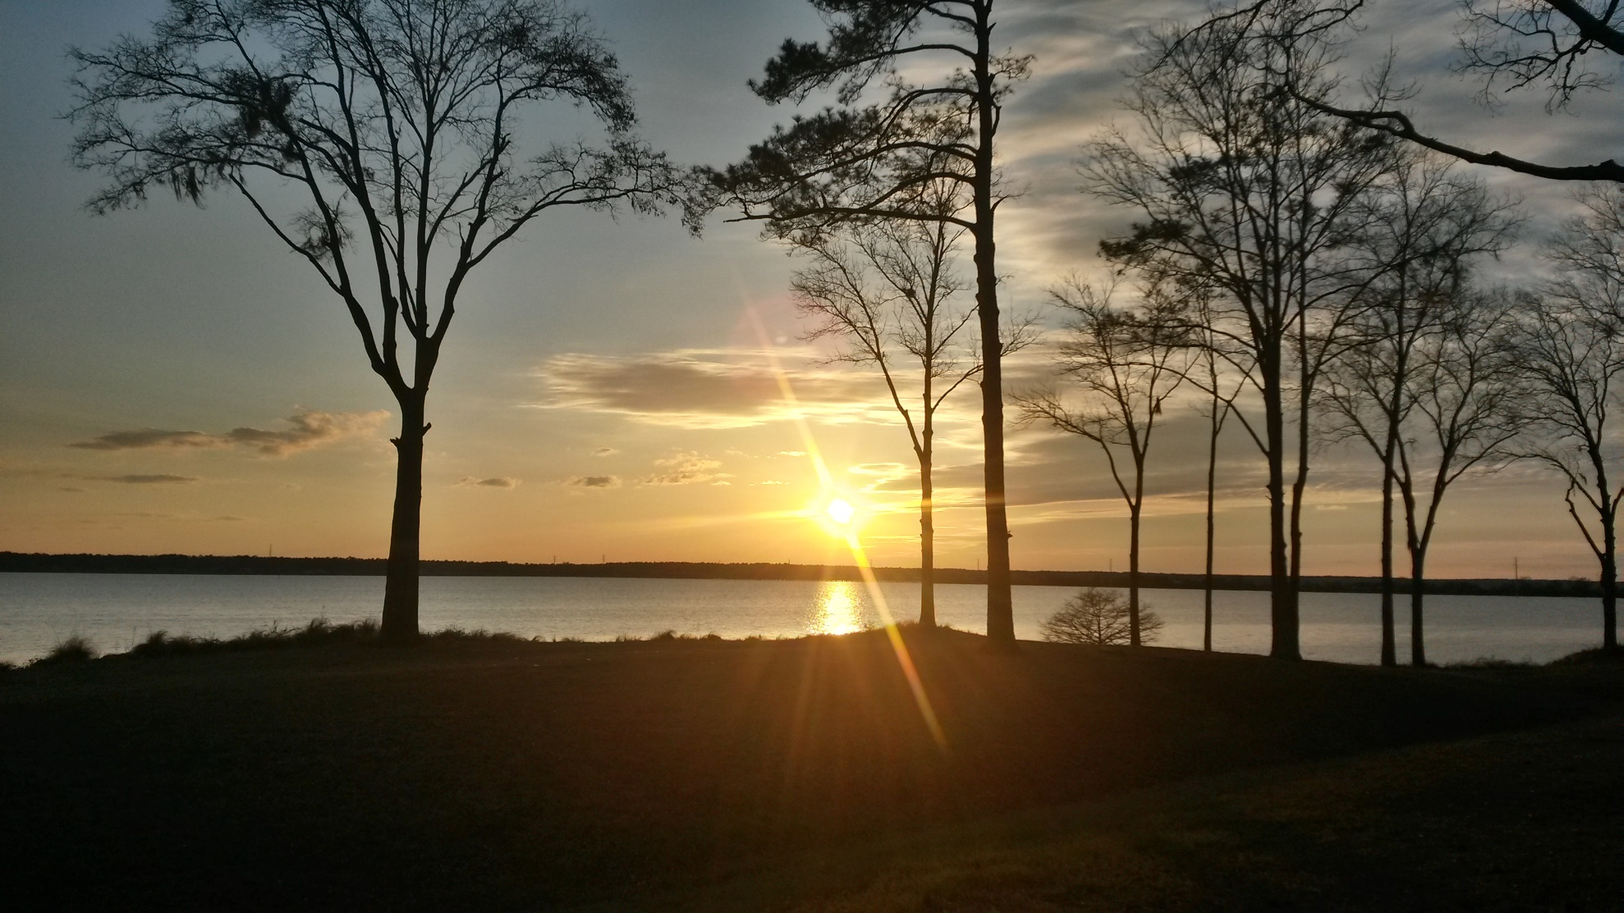
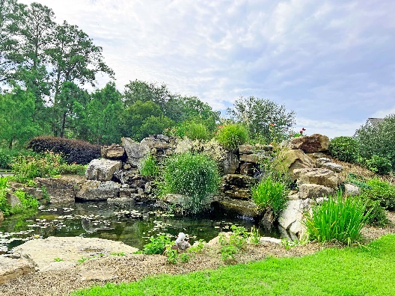
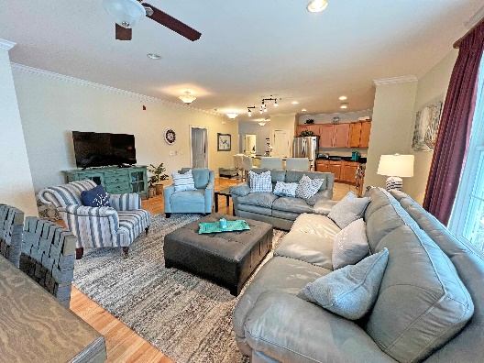
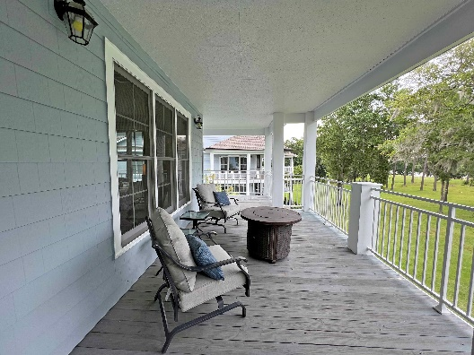

Million Dollar Views
1200 Bridgeview Ln # E304
Summerton, SC 29148 ~ $360,000
Million Dollar Views with a luxury sitting on the banks of Lake Marion This condo at North Shore Condos is ready to move in. Bring the suit case and boat. Sit on the almost 900 sqft wrap around porch with the morning coffee or entertain a dinner party with friends. The property sits just off I95 at exit 108. It is only 1 hour to Charleston, Summerville & Columbia and only 2 hours from Myrtle Beach. Grab your lake toys out of the storage shed, jump on the boat from your dock and set sail off to Charleston.....from there the limits are boundless. The Club house and grounds offer: Full kitchen with dinning room, work out gym, large pool, over 15 acers of green space, day dock, new sea wall with steps to the water, fire pit, sandy beach, & community garden plot. Boat Slip / Shed.
Lake Homes Realty, LLC
Elloree, SC 29047
www.SCLakeLife.com
Kristie Anderson
(803) 387-9459
kristie@sclakelife.com

