Slide 1
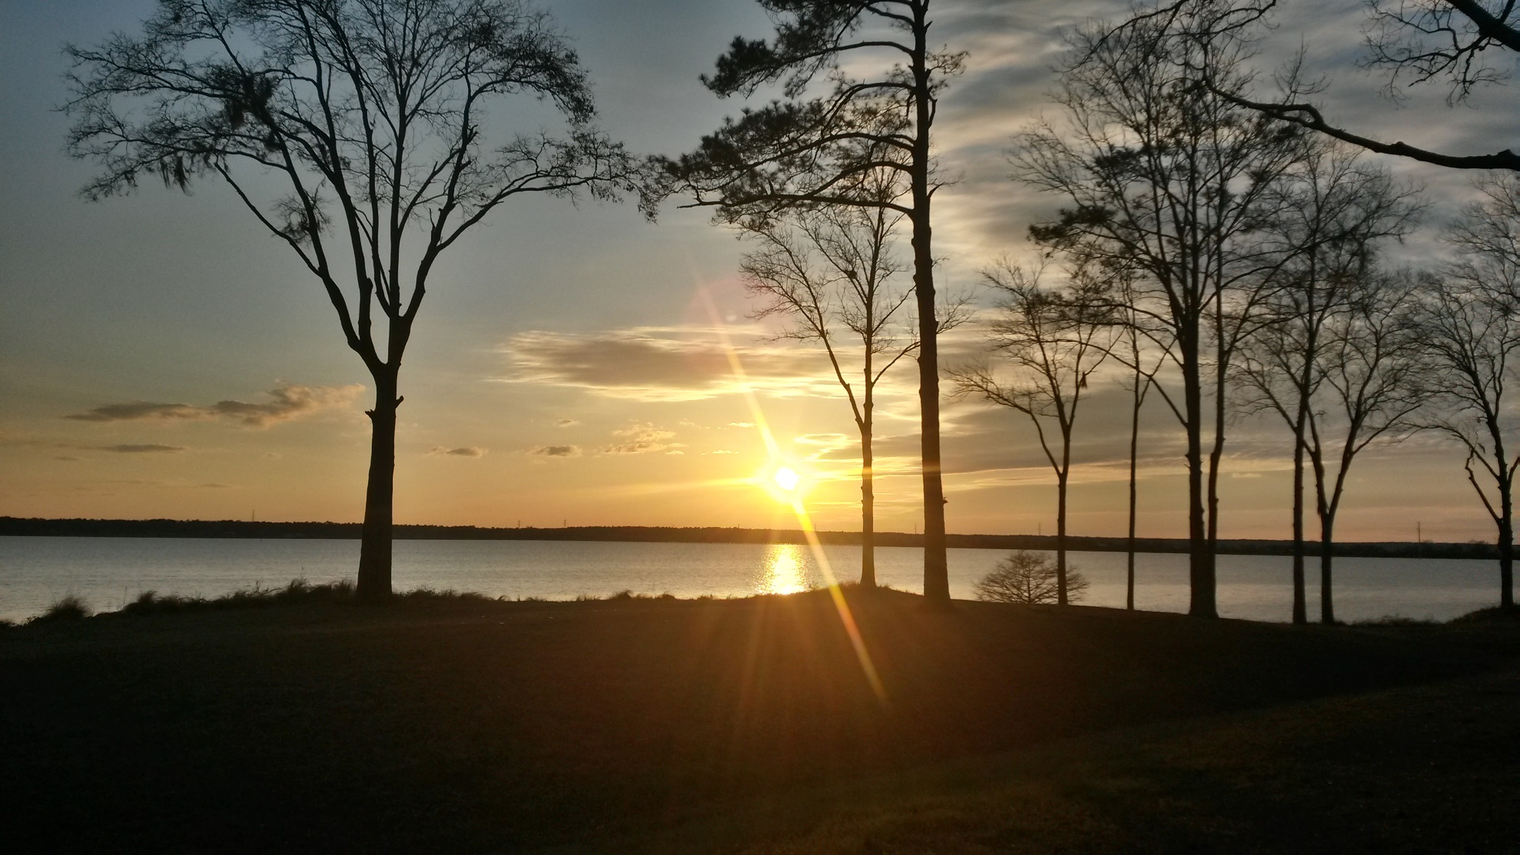
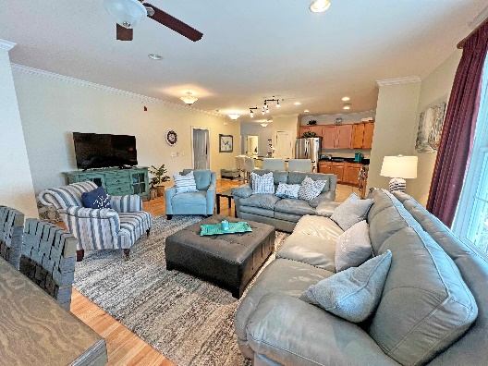
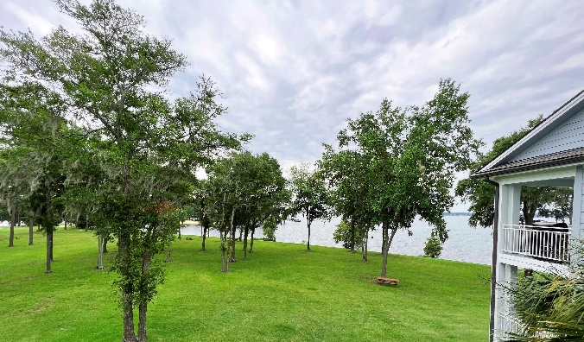
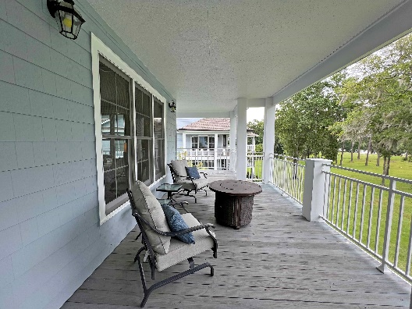

Million Dollar Views
1200 Bridgeview Ln # E304
Summerton, SC 29148 ~ $339,900
Fully furnished and turn-key, this 2 bed 2 bath condo, located at N Shore on Lake Marion, is designed with a spacious open concept floor plan, comfortably sleeps 6, and is ready for your enjoyment. Situated just off I-95, this 3rd floor, end unit offers spectacular waterfront views from the large wrap around balcony. Included is a private boat slip, and a stand-alone storage shed/barn for your ATV, golf cart, or beach toys. North Shore offers elevators in each building, a large clubhouse with waterfront pool, fitness center, large kitchen and dining room, private gated marina with electric and water access, fire pit, sandy beach & more for your family's entertainment. Just 1 hrs from Charleston, Summerville, and Columbia & 2 hrs from Myrtle Beach.
Lake Homes Realty, LLC
Elloree, SC 29047
www.SCLakeLife.com
Kristie Anderson
(803) 387-9459
kristie@sclakelife.com

