Slide 1
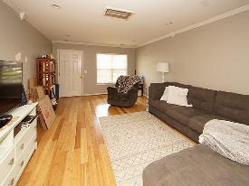
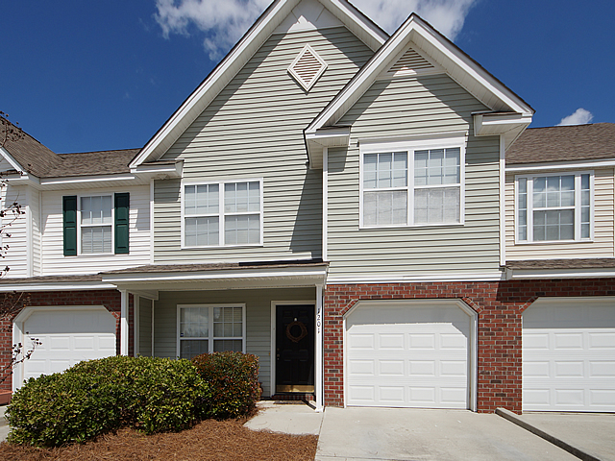
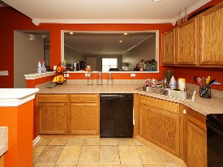
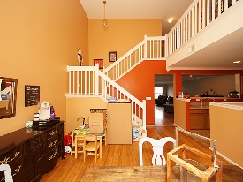
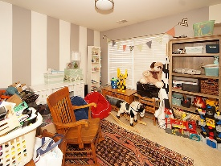
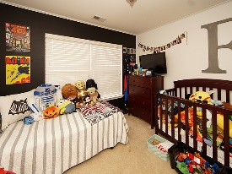
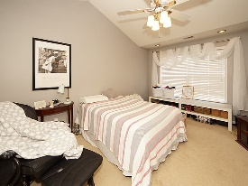
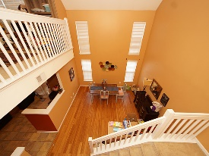

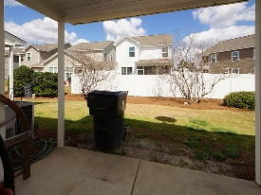

Spacious Town Home In Summer Wood
1201 Buckthorn Circle
Summer Wood
Summerville, SC 29483
Open House Canceled!
Under Contract In 3 Days!
MLS# 17008582
$155,000
2 Bed / 2½ Bath
This 2 bedroom 2.5 bath home features formal living, formal dining, family room, spacious kitchen, an open loft that could be converted into a third bedroom and this unit has a one car garage.
Summer Wood is a pool community and located in the heart of Summerville with easy access to I26 and Shopping.
Connie White, Broker
843-532-3356 · conniesyouragent@gmail.com
Charleston Homes · 597 Old Mt. Holly Road · Suite 301 · Goose Creek, SC 29445

