Slide 1
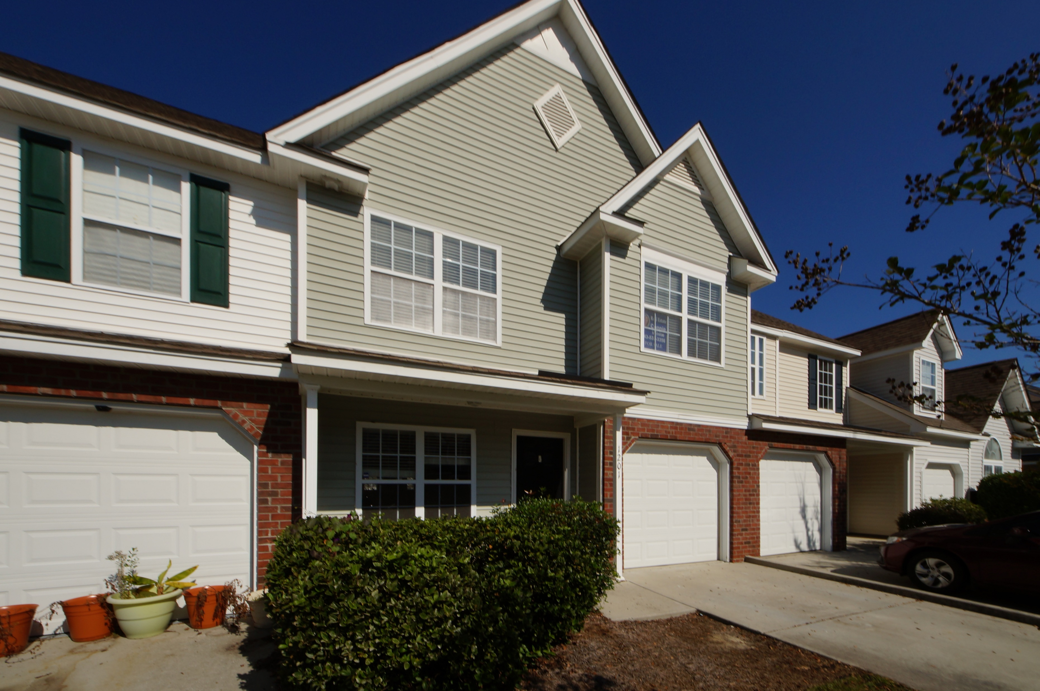
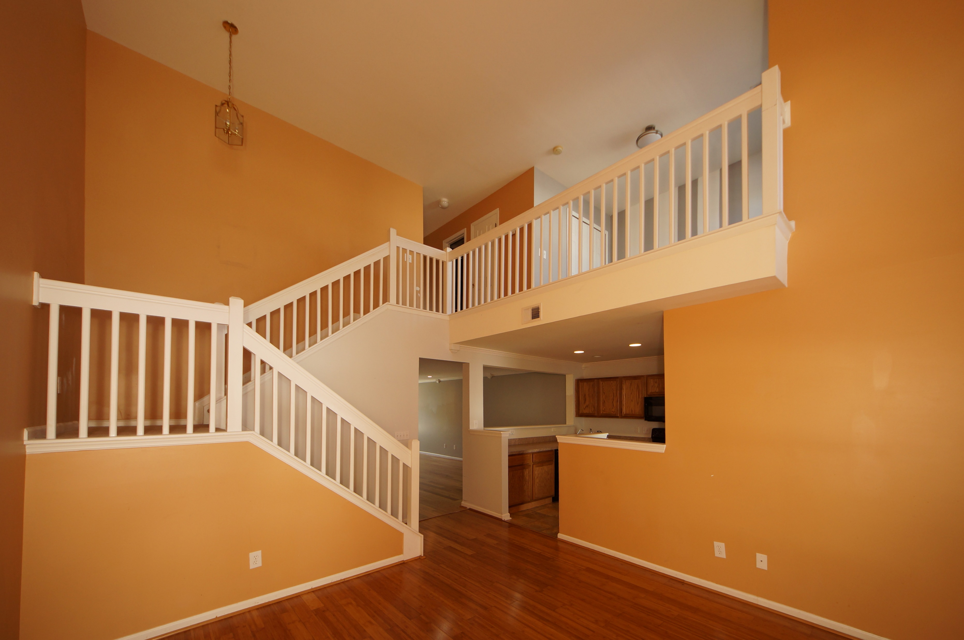
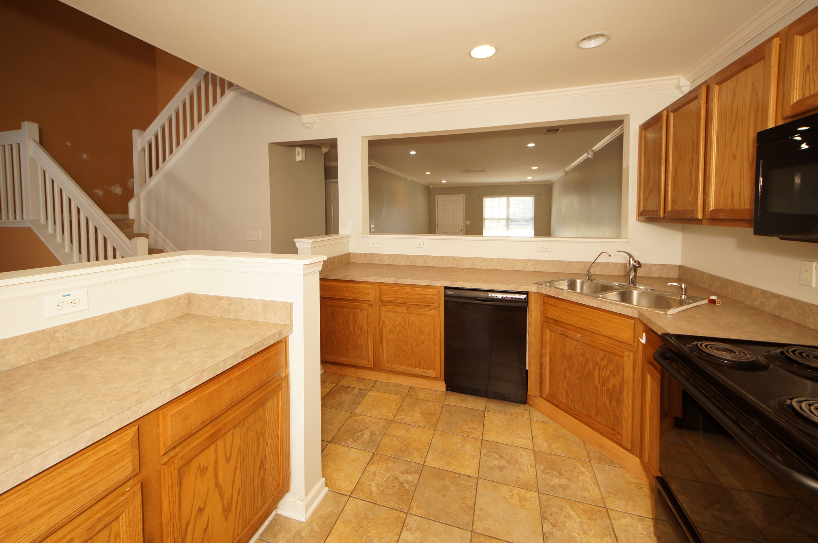
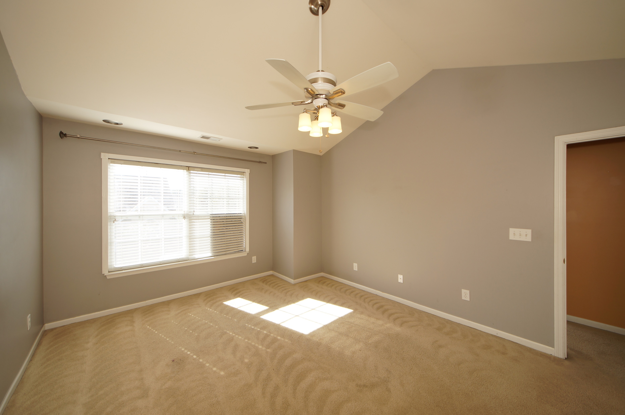


1201 Buckthorn Circle Summer Wood :: Summerville, SC 29483 MLS# 17008582 :: $155,000 2 Bed / 2½ Bath
Just Reduced $785,000!
Spacious Town Home
In Summer Wood
Realtors show this home again!! Tenant moved out and we have Painted and Cleaned this spacious town home!
This 2 bedroom 2.5 bath home is stunning featuring formal living, formal dining, family room, spacious kitchen, an open loft that could be converted into a third bedroom and this unit has a one car garage.
Summer Wood is a pool community and located in the heart of Summerville with easy access to I26 and Shopping.
Connie White, Broker
843-532-3356
conniesyouragent@gmail.com
Charleston Homes · 597 Old Mt. Holly Road · Suite 301 · Goose Creek, SC 29445

