Slide 1
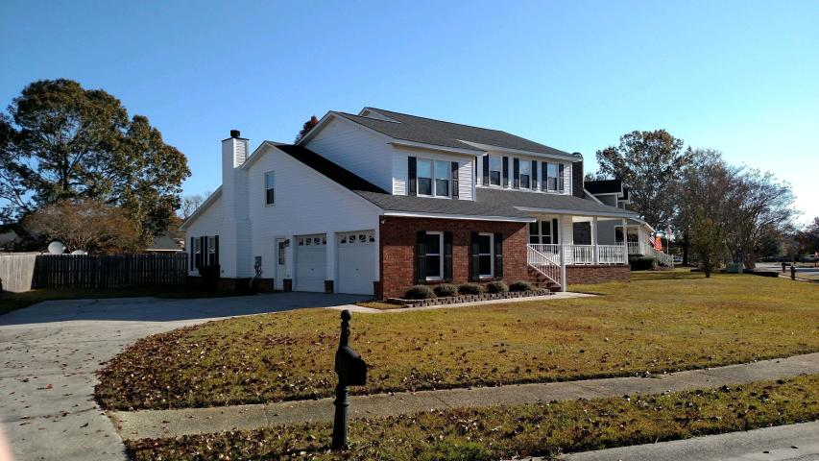
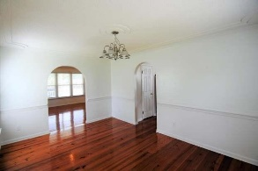
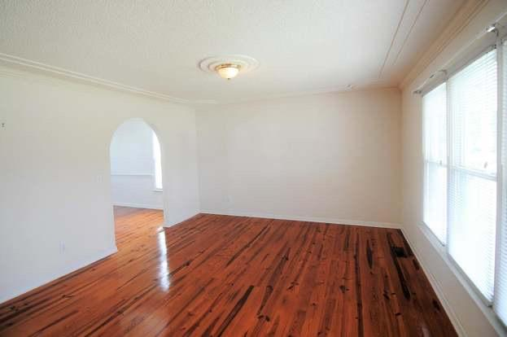
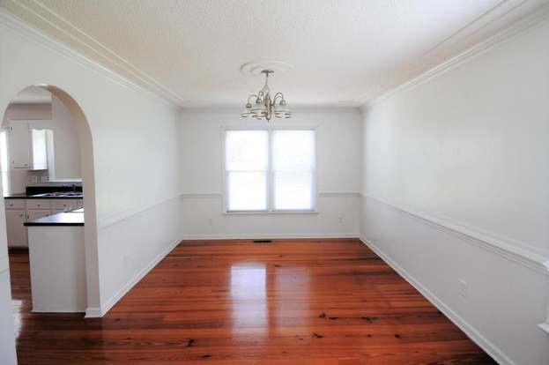
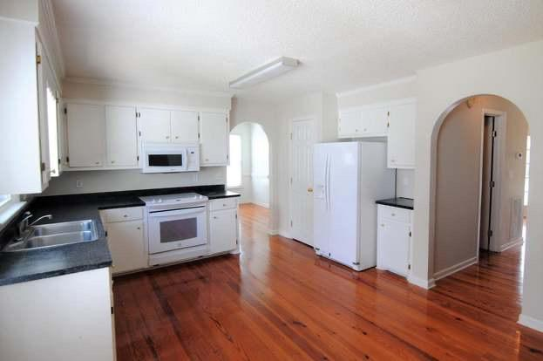
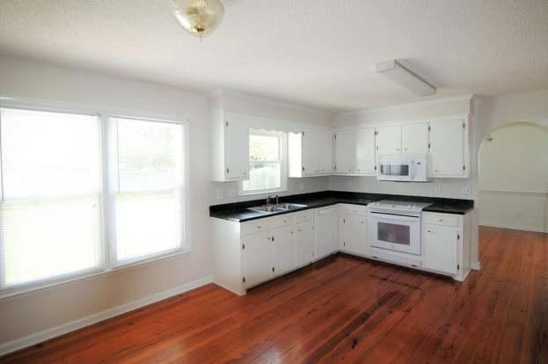
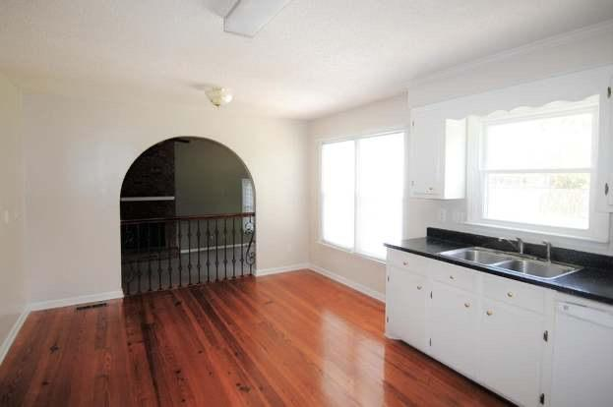
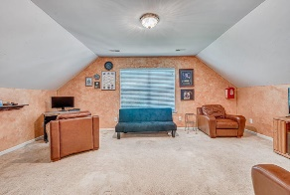

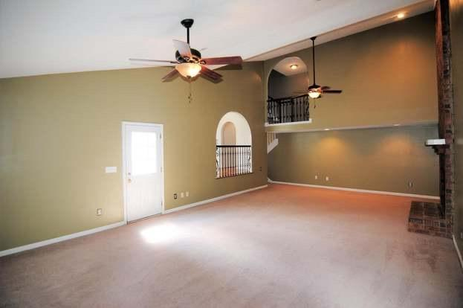
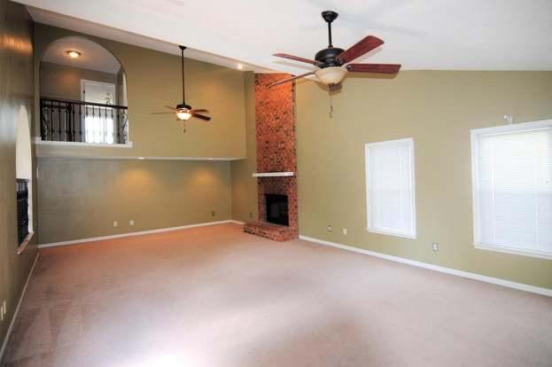
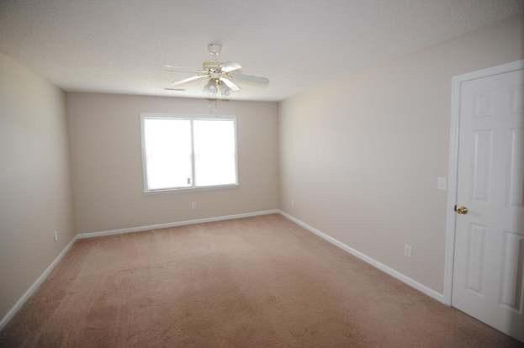
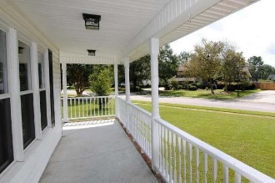
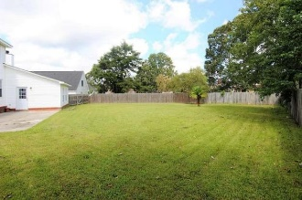


Large Lot & No HOA Fees
Starbucks card to first 10 agents
1201 Francis Marion Circle
Stony Landing ~ Moncks Corner, SC 29461 ~ MLS# 20005352 ~ $345,000
This Custom home greets you with a Southern style wrap around porch. Home sits on a large corner lot with a huge privacy fenced yard. Wood floors and arched doorways are just a couple features that are a must see. Kitchen is large with pantry & lots of cabinet, counterspace & overlooks the oversized den with a gas bricked fireplace. Den has vaulted ceilings. Plenty of closets in the home. Formal dining & living room where one could be made into an office. Under house has a sump pump, moisture barrier & foundation pillars. Master has a jacuzzi tub/separate shower/double sinks. Laundry room is large where you can walk around. See it to believe how amazing this home is with no HOA or Regime fees in this wonderful subdivision.
Sandy Infinger
M 843-670-4828 | F 843-388-3873 | O 843-670-4828
sandyinfinger@gmail.com | http://www.sandyinfinger.com
The Boulevard Company, LLC | 806 Johnnie Dodds Blvd Ste 100 | Mt Pleasant, SC 29464

