Slide 1
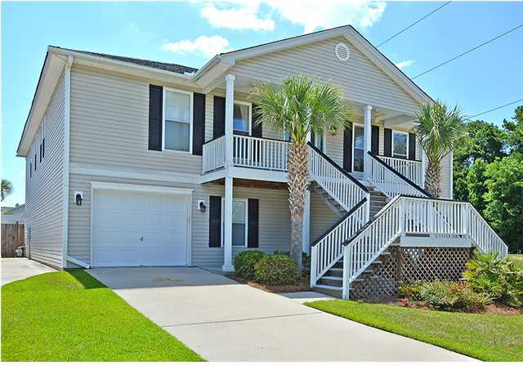
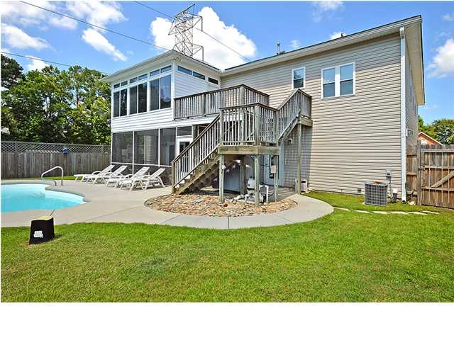
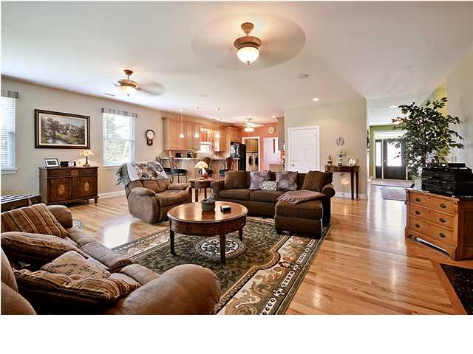
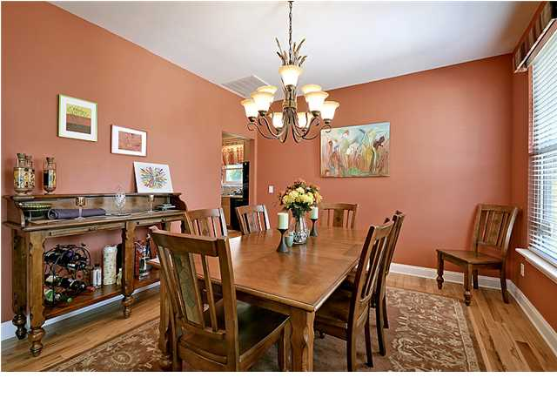
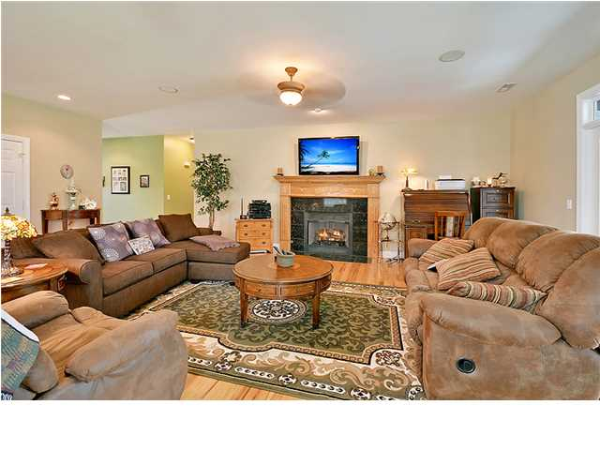
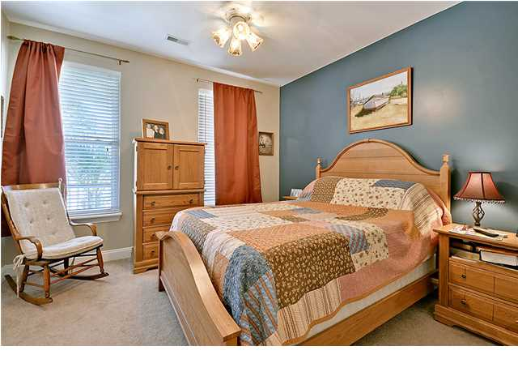
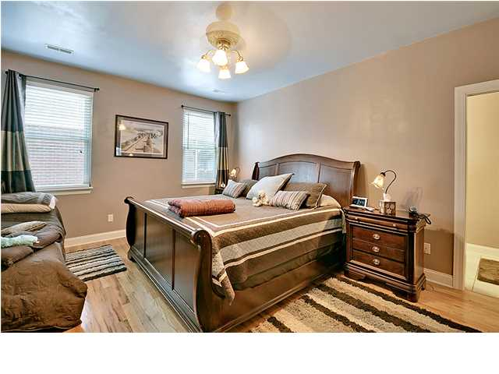
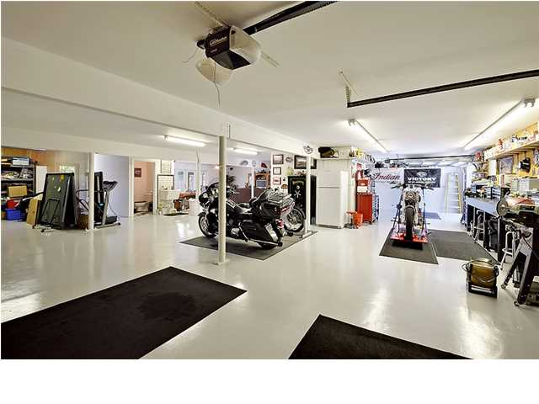
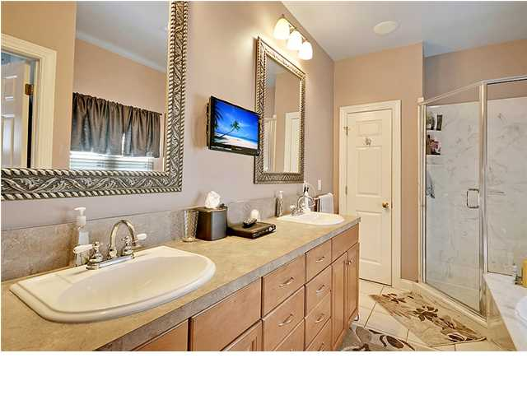
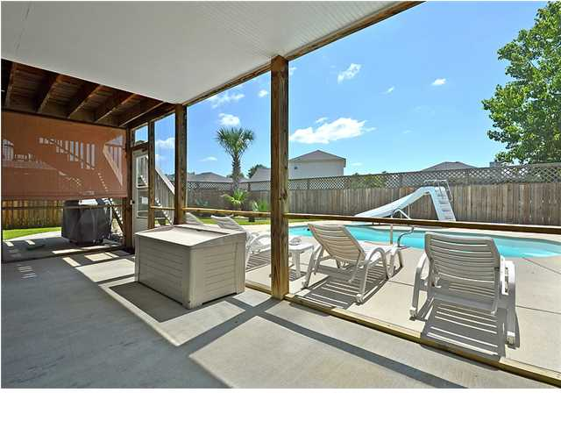

Open House
Saturday
12-5
Price Reduced!
1201 Roma Rd ~ Hanahan ~ MLS# 1416845 ~ $317,500
Eagle Landing proudly presents this gorgeous three bedroom, three bath, two car garage pool home. The symmetry of this home's exterior is a work of art with one garage on each side of the home and a palm tree on each side of the stairs that leads to the front porch. This is a peaceful spot to look out to pristine landscaping of the front yard. Off of the foyer is the formal dining room with baseboard molding and plenty of room to host holiday meals. Beautiful hardwood floors in the dining room, kitchen, living room and master help tie together the 2,254 square feet of living area. The kitchen boasts a breakfast bar and opens to the spacious living room with its cozy fireplace and marble surround. The sun room off of the living room has tile flooring and transom windows that allow natural light to pour in. The owner's retreat hosts an en-suite bath with a dual vanity, jacuzzi tub, walk-in shower and access to a walk-in closet that many would dream of. Speaking of dreams, when you go downstairs, if you've been looking for a miraculous workshop to take your passion to the next level, this space is right up your alley. But it also allows flexibility if you have other plans for this spacious lower level that has its own full bath. When it comes to outdoor living areas, there is a screened-in porch and upper deck that allow you to look out to the fenced-in, backyard oasis. The in-ground pool with its slide will provide hours of summer fun! This home is conveniently located to shopping, dining and major roadways. Don't let this beauty pass you by, come by today.
Call or email for details: Jordan Elleby (843) 819-9229 Jordan@MattONeillTeam.com

