Slide 1
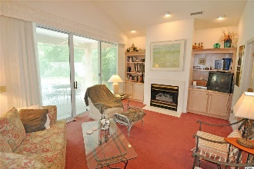
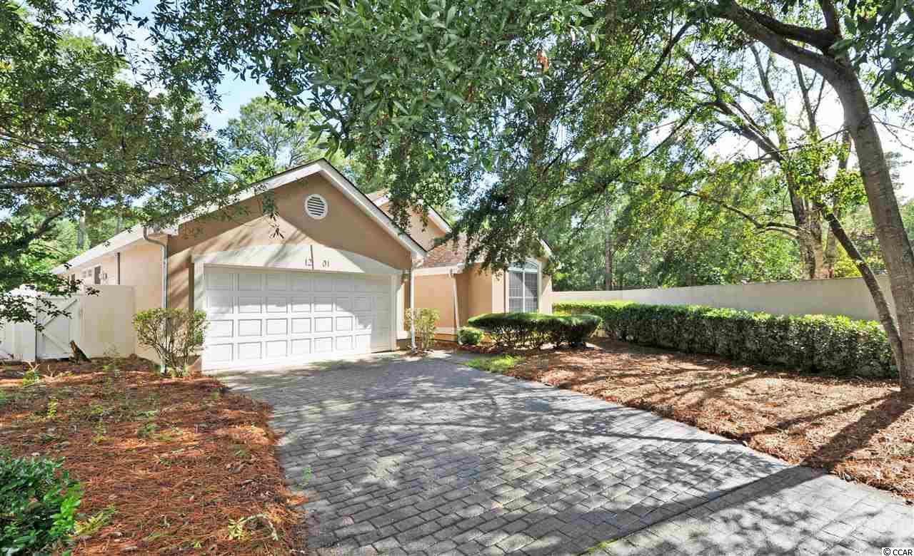
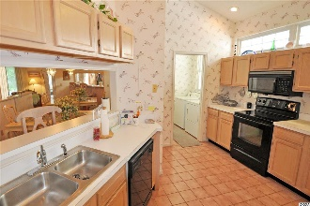
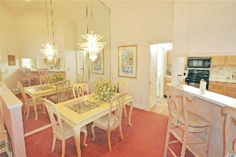
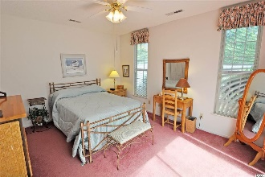
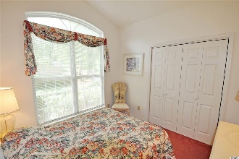
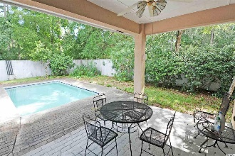
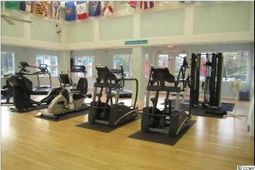
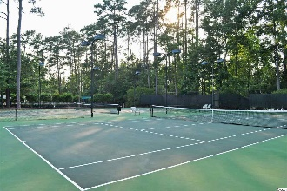
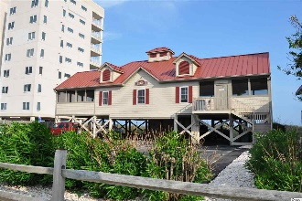


Easy Beach/Golf Living
Affordable, Rare Find!
1201 Trisail Ln
Tidewater Plantation ~ North Myrtle Beach ~ MLS# 2016171 ~ $284,900
Easy beach-golf living, this cozy Courtyard Park of Tidewater Plantation home is an affordable, rare find! Moreover, with the proven value of Tidewater, it is appealing for a permanent residence, vacation home or excellent investment property. Homes in the Plantation have low HOAs and city taxes with amazing amenities. Tidewater Plantation Resort boasts a world-class golf course, is minutes from the beach, shopping, medical services, schools, entertainment, dining & access to major highways. Amenities include owners' oceanfront beach cabana with open/screened porches, bathrooms, showers & kitchen on the wide white-sand Cherry Grove Beach, just named the 11th best in the nation, only minutes away. Residents have a private beach access entrance and plentiful beach parking. In Tidewater, residents enjoy the use of several pools/hot tubs. Other amenities are driving range, golf shop, clubhouse with bar/dining & event facilities, clay- and hard-surface tennis courts, pickle ball court, fitness center, bocce/horseshoe courts & amenity center. Tidewater is manned, gated & has a gated, monitored storage yard for boats, jet skis, etc. The resort reflects the luxury & comfort of a fine upscale beach/golf lifestyle. And, in Tidewater, BIG value often comes in likewise surprisingly compact packages, such as this comfortable cottage with tons of cabinet space, planned storage and lots and lots of closets, including entry, 2 linen, his and her masters (one walk-in), large laundry room with a wall of cabinets and sink, walk-in pantry and more. Just look around... A nice, brick-paver-inspired long front driveway leads to an over-sized two-car garage and to a covered front entry. Lot is protected and fenced! The garage ingress is through the laundry room to the kitchen, a pleasing floor plan. The front hall offers a split entry, into the great-family/living room or to a spacious guest bedroom and full bath. The second bedroom opens onto the guest wing and through formal French doors into the welcoming living area. It would also be a wonderful space for a den or office. Formal dining is to the left and the towering living/great room straight ahead, adjoining the kitchen further to the left, along with the master suite, cute kitchen nook and another full bath, convenient to the coveted outdoor pool, too. The living area is the heart of the home, has impressive vaulted, high ceilings & a wonderful gas fireplace surrounded by custom-built bookshelves. The formal dining space likewise has a high ceiling, is easily accessed from the kitchen and is nearby that guest bath for entertaining. The kitchen is open, well planned & family-sized with much counter and cabinet space, pantry, breakfast bar & breakfast nook and with a view of and access to contiguous outside living areas, the covered patio, pool & backyard. The kitchen opens as well to the hallway to the main bath and spacious master bedroom. That bath may also function as a private en suite, if desired. Terrific, flex traffic-patterns throughout make this a truly enjoyable, easy-living lay-out. HOA fee includes additional services such as front-yard lawn maintenance...Great for busy professionals or retirees who do not want extensive home upkeep or yardwork. It is a wonderful, walkable, comfortable neighborhood. This unique custom-build reflects preplanning to construct a home for the generations in popular North Myrtle Beach, a Top-10 Beach Town in the U.S., named the safest city in South Carolina, and in Tidewater Plantation Resort. Tidewater is on a tree-lined road to oceanfront Anne Tilghman Boyce Coastal Reserve, a nature conservancy, including Waties Island. Tidewater itself is on an elevated peninsula of live oaks and southern pines between the ICW and the Cherry Grove Inlet to the Atlantic Ocean. Real- & face-time virtual tours available. All original with 2-year-old HVAC; furnished, AS IS & priced to personalize; make this beach-golf home on a protected, private cul-de-sac lot your own!
Deborah Collins
843-424-9013
dctidewater@yahoo.com
Connie Ross-Karl
702-306-2643
conniesross@aol.com
NEW WAY PROPERTIES MYRTLE BEACH

