Slide 1

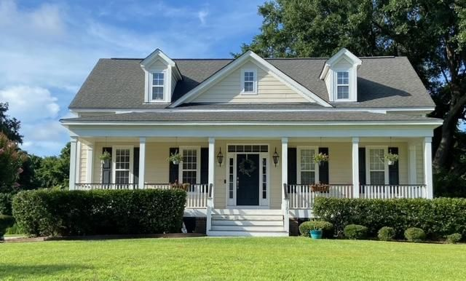


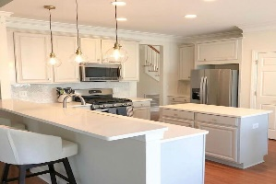

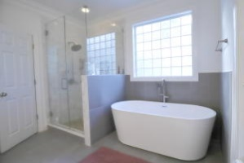
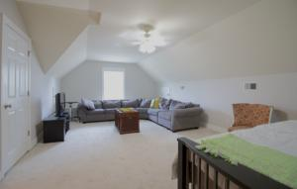
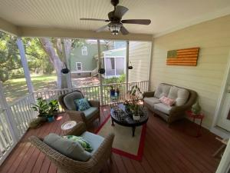
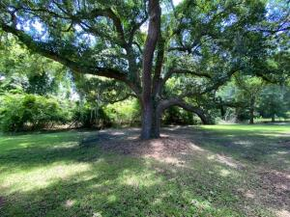

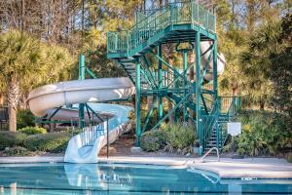

Back on the Market!
1201 Flowering Oak Way
Hamlin Plantation | Mount Pleasant, SC 29466 | MLS# 21017470 | $749,900
Southern charm at its finest with 2 beautiful Oak Trees that makes this lot so picturesque ! Highly sought after Hamlin Plantation home that has the master downstairs with open floor plan. Master suite features access to the porch wood floors, large walk in closet, & a spa like ensuite bath that was completely updated! Valuated ceilings with lots of natural light in the living room and hardwood floors through out the first floor. Newly updated kitchen that is perfect for entertaining and opens up to a spacious breakfast area with big bay window. The main staircase leads to two generous bedrooms with large closets and plenty of storage with a full bath. The screened in porch is shaded by the oak trees and is so peaceful to enjoy your morning coffee while listening to all the birds. Through the laundry room, you will find separate staircase to a spacious FROG that makes a great 4th bedroom/playroom/home theater, or office. Plenty of storage throughout with attic storage accessible from several rooms. Irrigation/sprinkler system with dedicated well. Attached garage with long driveway. and custom shelving. Large, private backyard that can be fenced also backs up to the woods.
Marthe Teixeira (917) 325-8033
marthet@carolinaone.com
Scott Fulton 843-324-8845
ScottandMarthe@gmail.com
fultonteixeirahomes.com
Carolina One Real Estate | 2713 Highway 17 North | Mt. Pleasant, SC 29466

