Slide 1
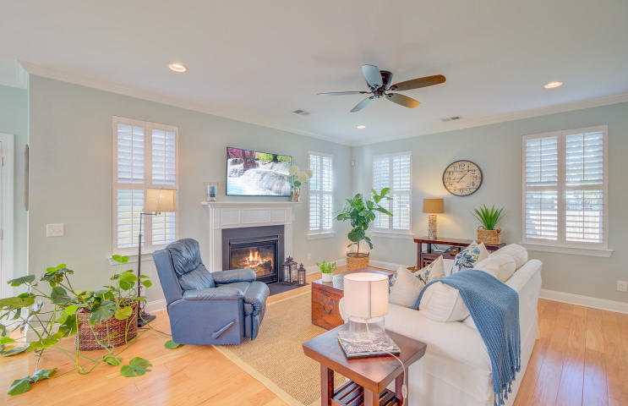
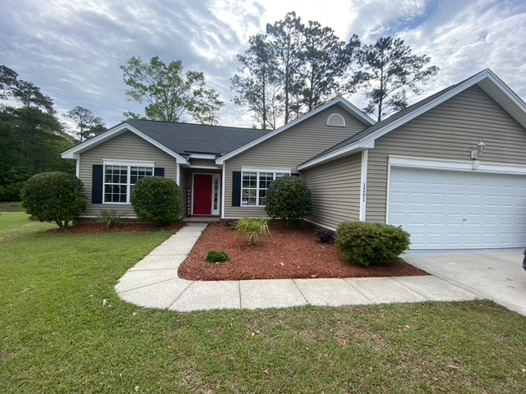
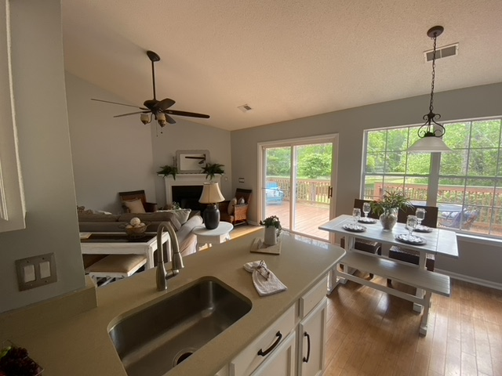
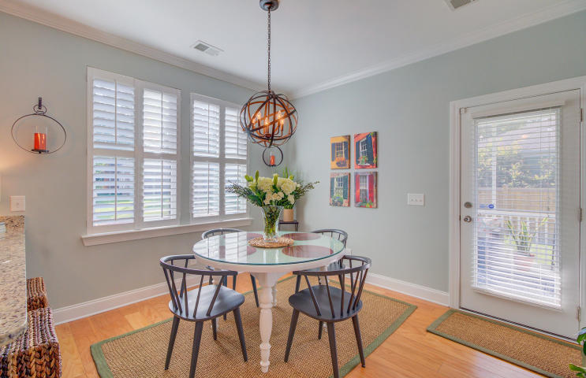
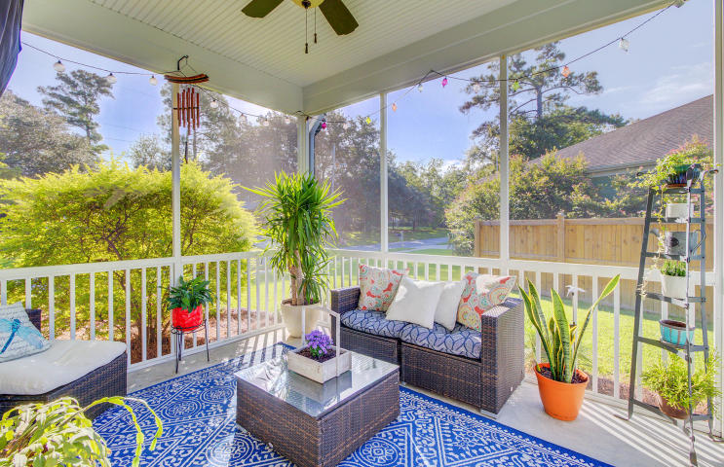
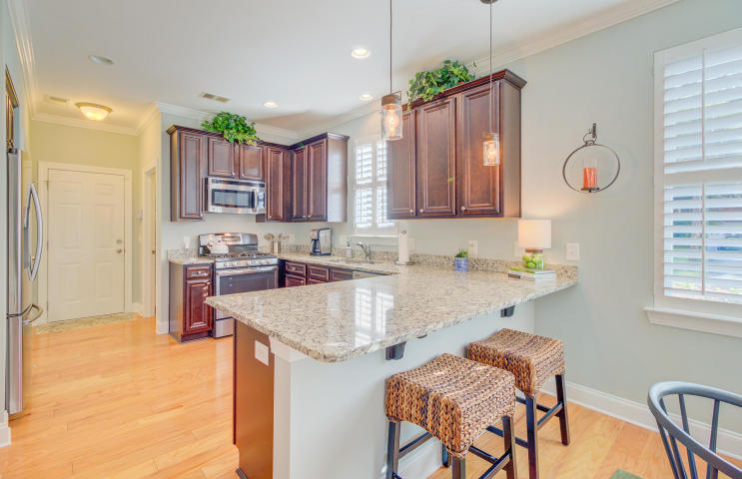
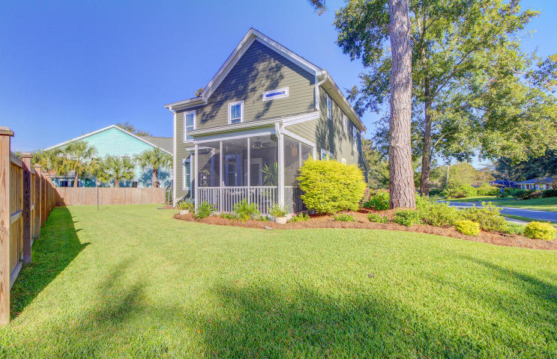


COMING SOON!
This is the one you HAVE to show your clients!
1201 Grasswind Drive
Tanner Plantation, Hanahan SC
Highly desirable split floor plan in this 3 bedroom ranch with 2 baths in Hanahan’s popular Tanner Plantation. This home has an open concept with vaulted ceilings. Best of all it sits on a premium lot located at the end of a quiet cul de sac! The new owners will enjoy a huge private back yard that is completely fenced in. Views of the pond bring peace to the soul- woods beyond the pond make it feel like a nature preserve in your own back yard. An added bonus that they will appreciate the wide gate beside the house allowing for boat (or other “toys”) to be stored on property tucked away out of sight. With a newer roof and AC, your clients will have peace of mind. Updates made throughout the house are tasteful and this home is truly move in ready. Did I mention NO CARPET? Bamboo floors and tile in the master bath are just some of the upgrades. We will go live on the mls tomorrow so call your clients to see how soon they can tour- and feel free to call me with any questions you may have!
Price $335,000
Ellen O'Neil
Broker/Owner, ABR, e-PRO, CNE
Charleston Realtor of Distinction
(843) 300-8530
www.EllenONeilProperties.com

