Slide 1

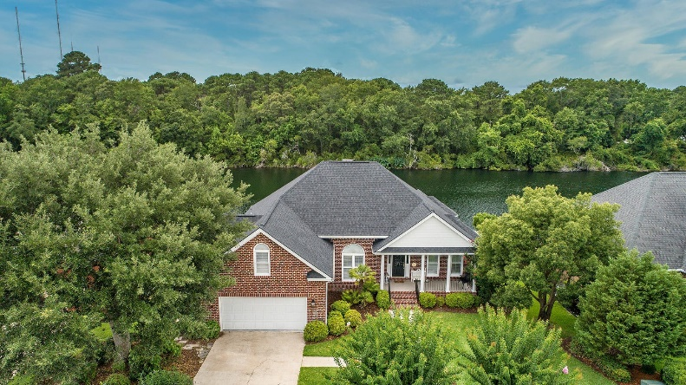
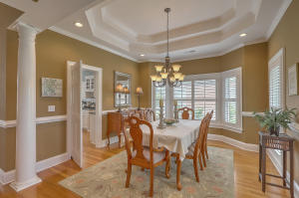
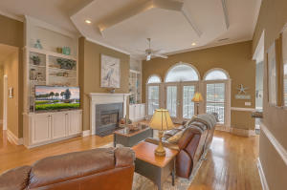
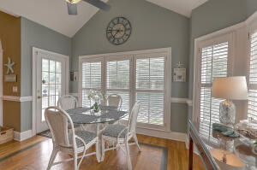
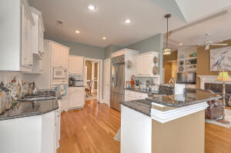

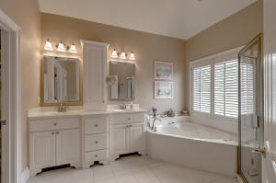
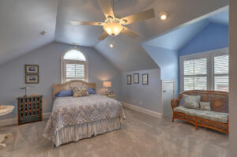
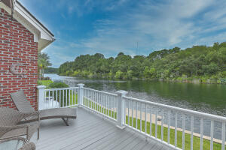
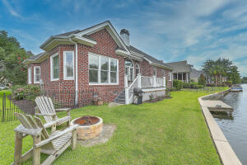
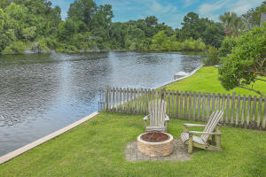

Waterfront in Central Mount Pleasant!
1201 Waterfront Drive
Hidden Lakes
Mount Pleasant, SC 29464
MLS# 21018544
$875,000
4 Bed | 2 Bath | 2,363 SF
This meticulously maintained, all brick waterfront home in Hidden Lakes is the perfect spot for those who love the peace and tranquility of the water and want to be centrally located in Mount Pleasant. The freshwater lake and canal system offers the ability to play on the water with kayaks, canoes, and electric and wind powered boats. The home has large windows to allow plenty of natural light and views of the beautiful lake as well as an open Kitchen/Living Room layout.
The Backyard includes a firepit area to enjoy viewing the water. All carpeting in the home was replaced in November 2018. Additional improvements include a new HVAC system in July 2019. The top cap of the sea wall was replaced in 2018. New shingles were installed in 2017. The quiet style garage door opener was installed a few years ago and includes a keyless entry pad. The dock and dock stairs were resurfaced in 2015. The Back Deck was replaced in 2012 and the low-maintenance white vinyl railings on the deck were added in 2018. The Deck also includes a wind-out awning to provide shade in the afternoon. Low maintenance soffit and fascia was installed in 2012 along with vinyl shaker-style siding in the front peak of the home.
Hidden Lakes is a hidden gem of a neighborhood: located close to shops, the beaches, and downtown. It features a pool, tennis courts, clubhouse, and a children's playground. It also features incredibly unique amenities such as a neighborhood lake-drawn irrigation system, a boat/trailer storage area (only $200/year) along with the above-mentioned freshwater lake and canal system.
Please note - This property is taxed as a second home. Taxes would be lower as a primary residence.
Come see this beautiful home before it is gone!

