Slide 1
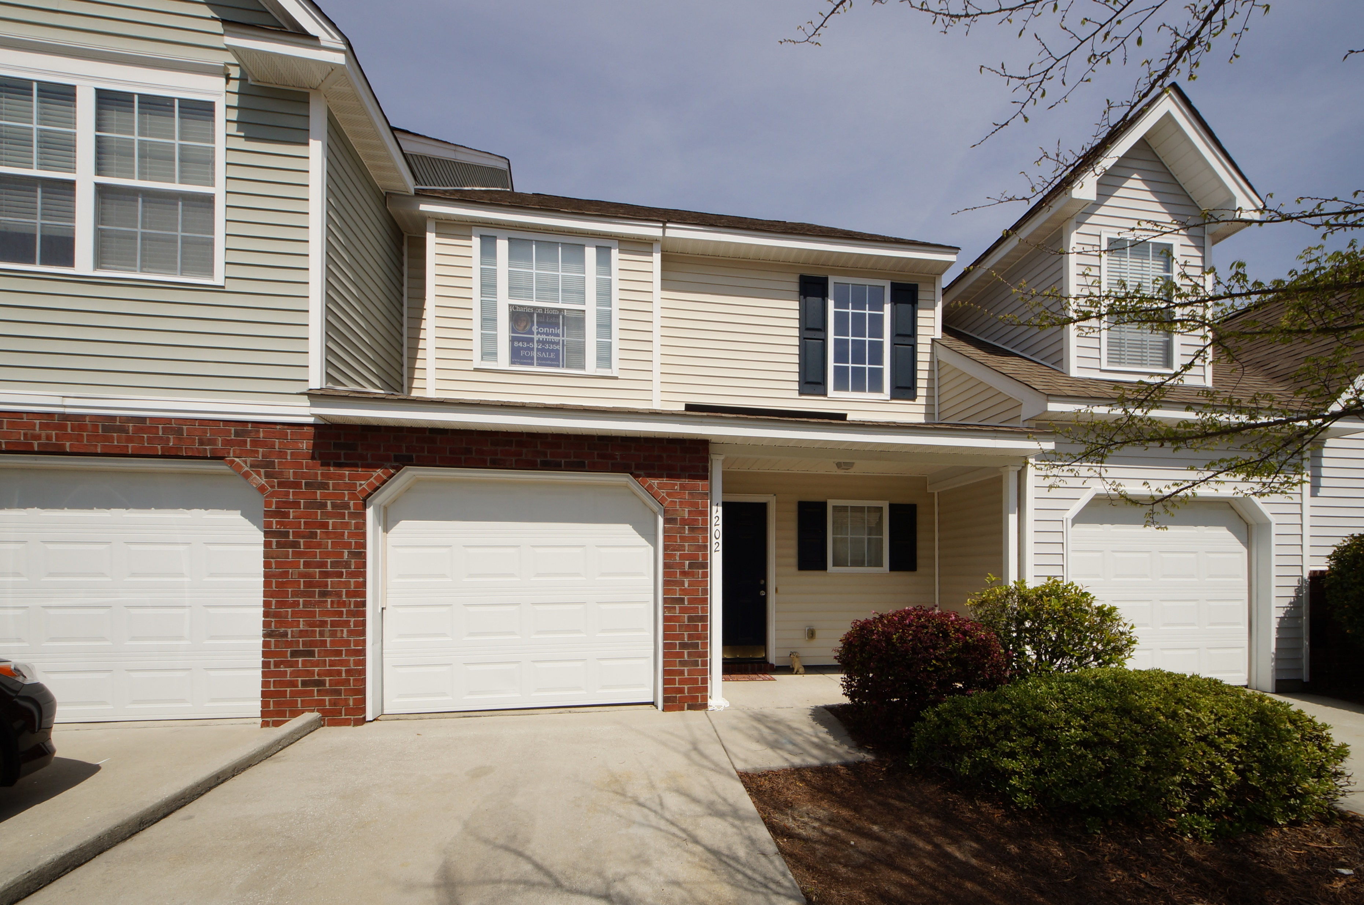
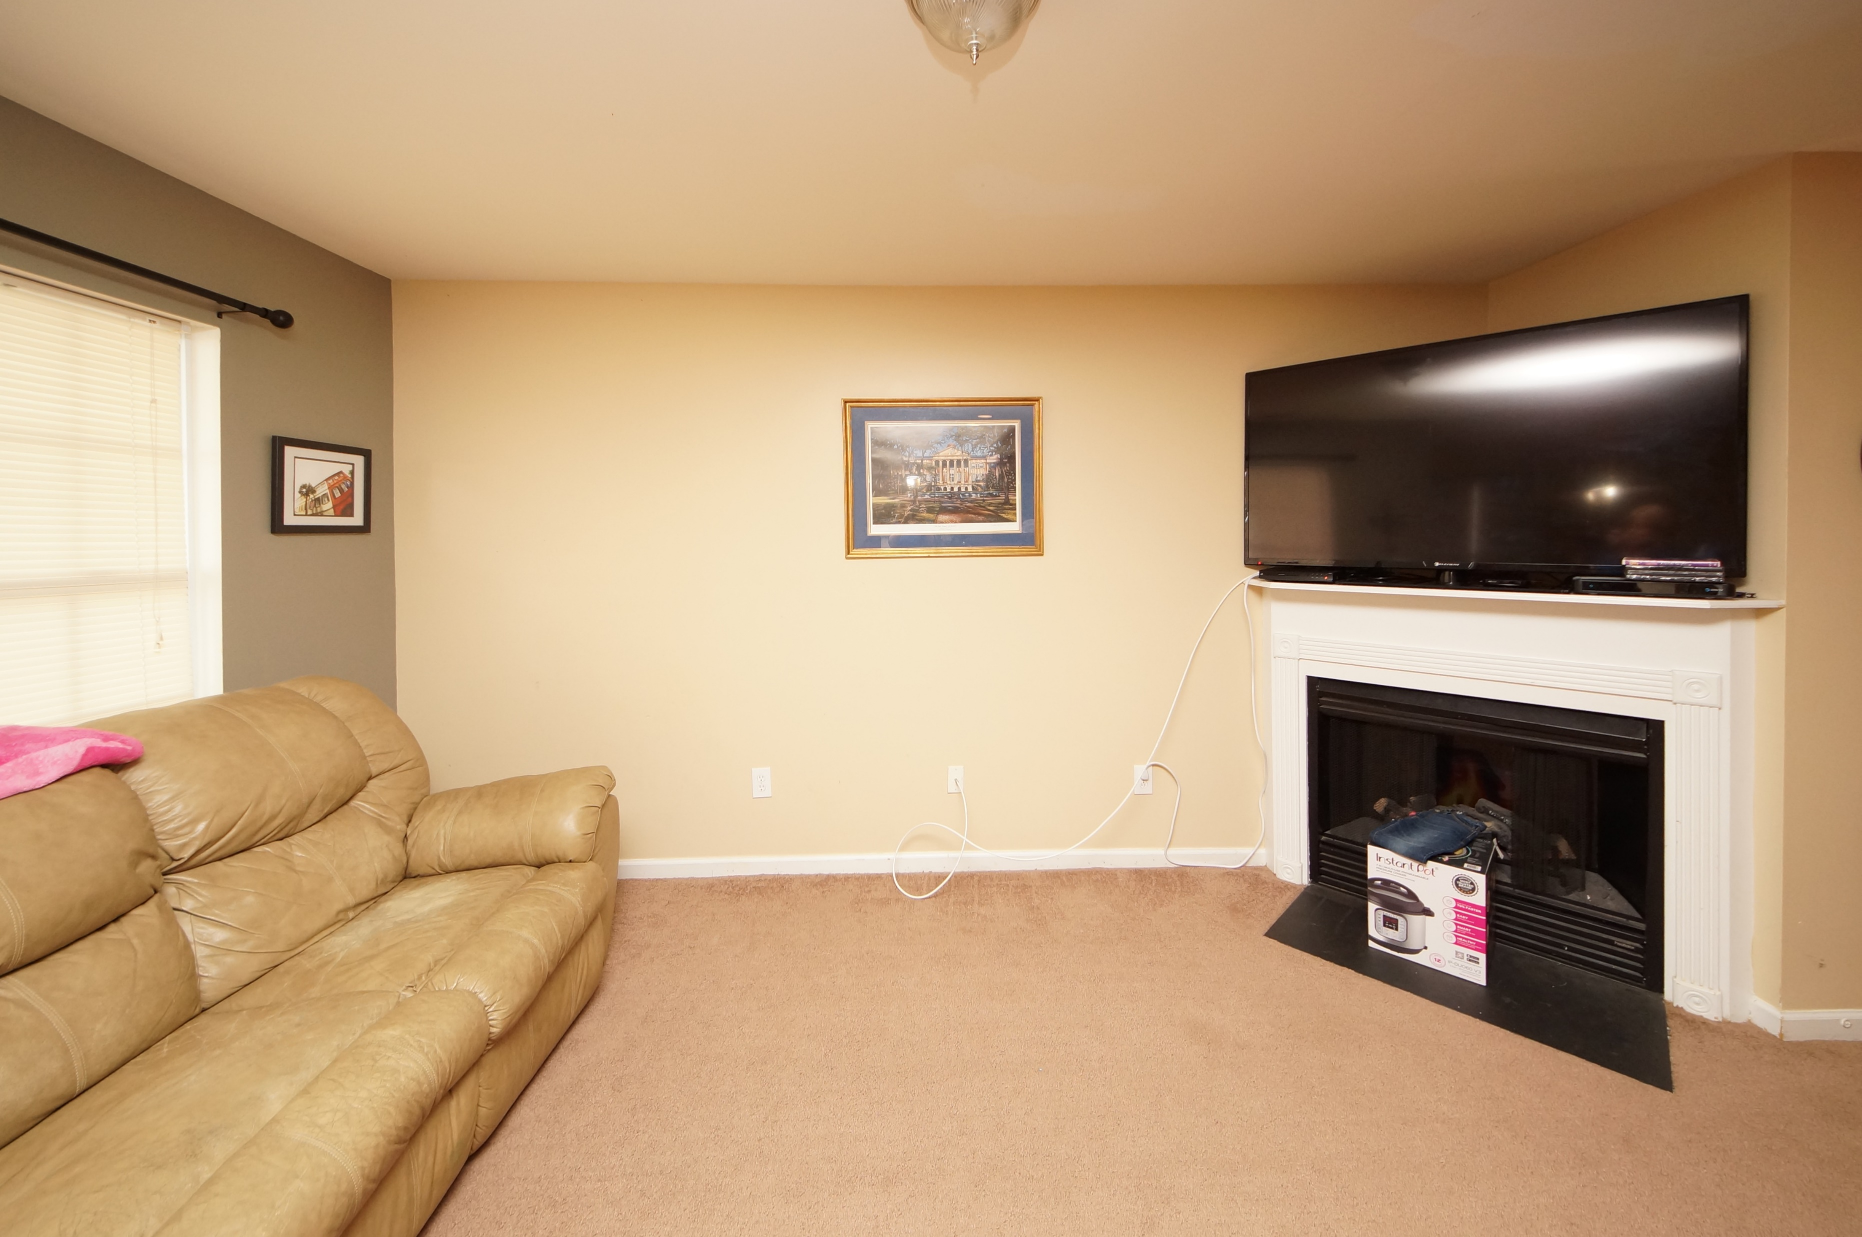
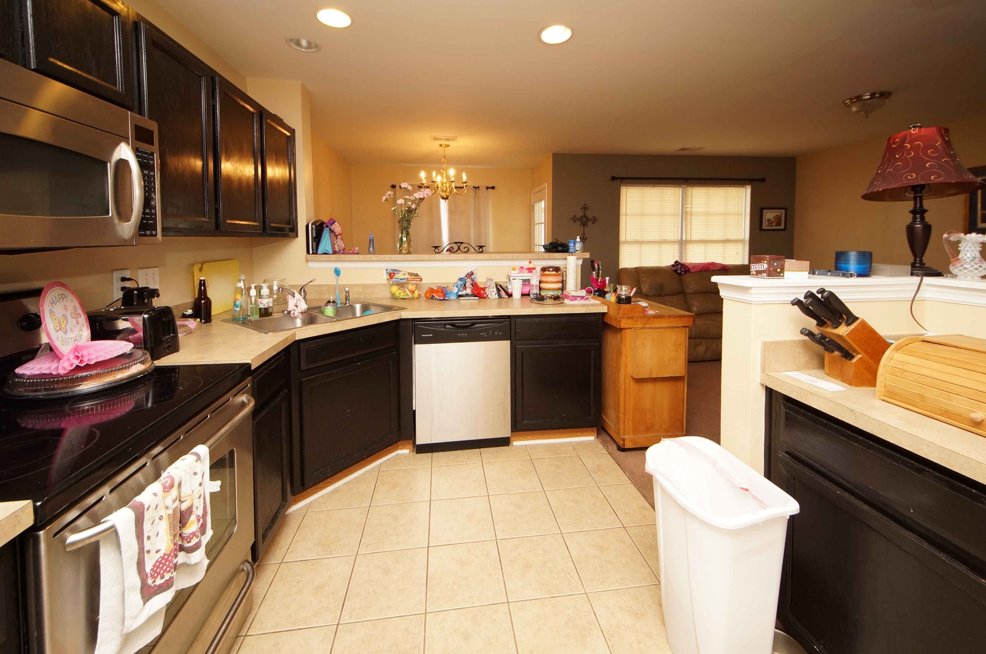
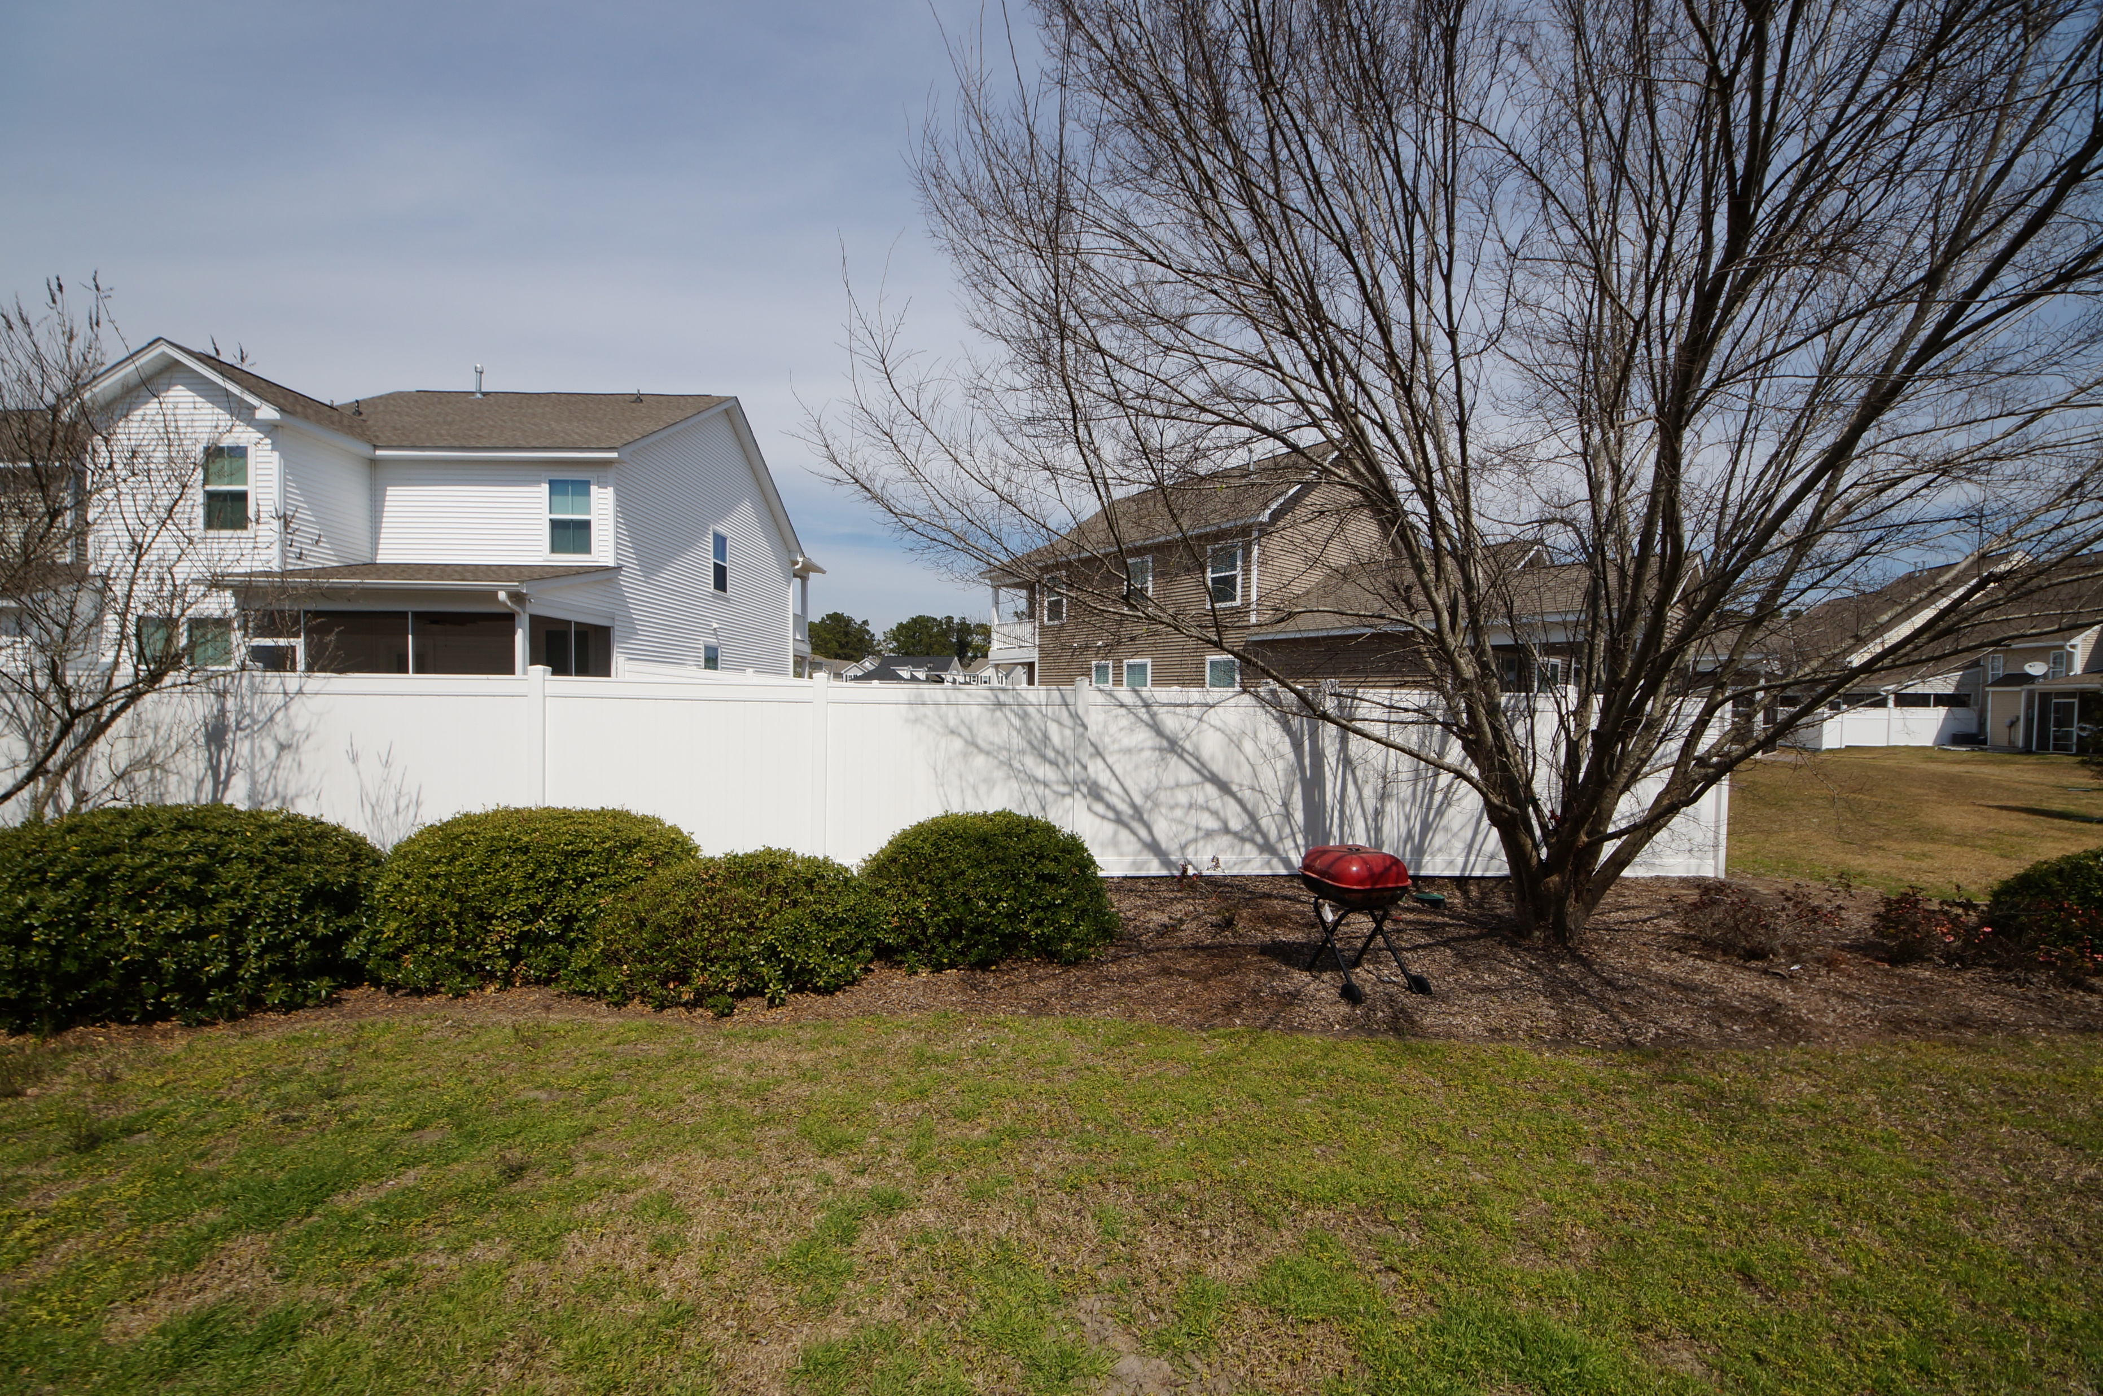


1202 Buckthorn Circle Summer Wood :: Summerville, SC 29483 MLS# 18007387 :: $145,000 2 Bed / 2½ Bath
Just Reduced $785,000!
New On the Market!!
Adorable 2 bedroom 2.5 bath town home with garage in desirable Summer Wood.
Spacious and open concept feature stainless appliances, gas fire place and screened porch.
Summer Wood is conveniently located to Summerville close to shopping and I26.
We have priced this home to sell quick!
Connie White, Broker
843-532-3356
conniesyouragent@gmail.com
Charleston Homes · 597 Old Mt. Holly Road · Suite 301 · Goose Creek, SC 29445

